Slide 1
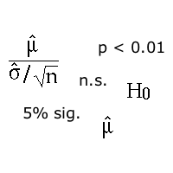
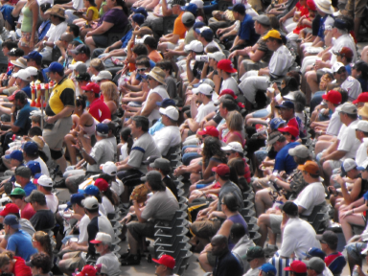
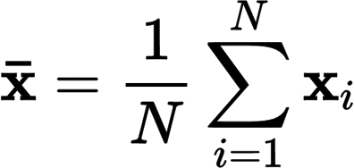
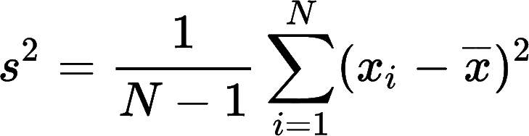
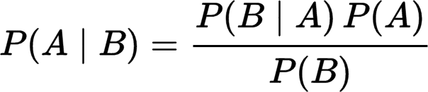
Understanding Statistics for
HCI and Related Disciplines
Part 2 – Doing It if not p then what
Alan Dix
http://alandix.com/statistics/

Slide 2
probing the unknown
quantified uncertainty

Slide 3
recall … the job of statistics

Slide 4
conditionals and likelihood
probability road will be busy
vs probability busy given 4am on Sunday
probability die is a 6
vs prob a 6 given it is 4 or bigger
conditional probability
is probability given some knowledge

Slide 5
likelihood
likelihood is
probability of measurement
given unknown things in the world
(conditional probability)
e.g. prob. of six heads given coin is fair = 1/64
… but is it fair?

Slide 6
counterfactual
statistics turns this round
from likelihood of measurement
probabilistic knowledge given the unknown world
to uncertain knowledge of the unknown world
based on measurement
… but in various different ways

Slide 7
statistical reasoning

Slide 8
statistics
is never being able to say
QED

Slide 9
types of statistics
hypothesis testing (the dreaded p!)
  robust but confusing
confidence intervals
  powerful but underused
Bayesian stats
  mathematically clean but fragile
  issues of independence
same
underlying
methods
+ simulation
methods
for either

Slide 11
hypothesis testing
the ubiquitous p

Slide 12
significance test
hypotheses:
H₁ – what want to show
H₀ – null hypothesis (to disprove)
idea (when experiment/study successful)
if H₀ were true
then observed effect is very unlikely
therefore H₁ is (likely to be) true

Slide 13
5% significance level?
it says:
if H₀ were true
then probability observed effect
happening by chance
is less than 1 in 20 (5%)
so H₀ is unlikely to be true
and H₁ is likely to be true

Slide 14
does not say
probability of H₀ is < 1 in 20
probability of H₁ is > 0.95
effect is large or important
i.e. significant in the real sense

Slide 15
all it says
if H₀ were true ...
... effect is unlikely
( prob. < 1 in 20)

Slide 16

non-significant result
can NEVER reason:
non-significant result ⇒ H₁ false
things are the same
all you can say is:
H₁ is not statistically proven

Slide 18
a quick experiment
… but are they fair

Slide 19
calculations – six coins
given coin is fair:
probability six heads = 1/2⁶ = 1/64
probability six tails = 1/2⁶ = 1/64
probability either = 2/64 ~ 3%
H₀ – coin is fair
H₁ – coin is not-fair
likelihood ( HHHHHH or TTTTTT | H₀ ) < 5%

Slide 20
your experiment
toss 6 coins
record how many heads or tails
if HHHHHH or TTTTTTT
you can reject H₀ with p< 5%
see how many times you do it before
you get 6 in a row

Slide 22
confidence intervals
bounds of uncertainty

Slide 23
proving equality
non-significant – not proved different
real difference may always be smaller
than experimental error
⇒ can never prove equality
but can put bounds on inequality

Slide 24
confidence interval
bound on true value – same theory as p values
e.g. mean of data is 0.3
95% confidence interval is [–0.7,1.3]
says if the real value not in the range [–0.7,1.3]
probability of seeing observed data
is less than 5%

Slide 25
counterfactuals
95% confidence interval is [–0.7,1.3]
does not say:
there is 95% probability that the
real mean is in the range [–0.7,1.3]
it either is or it isn’t!
all it says:
probability of seeing the observed data
if real value outside the range is less than 5%

Slide 26
proven … what?
H₀: no difference (real mean is zero)
  experimental result: mean is 0.3
  significance test: n.s. at 5% – so what?
  95% confidence interval: [–0.7,1.3]
? is 1.3 is an important difference

Slide 27
… and don’t forget …
you still need to say
what test/distribution – e.g. Student’s T
how many – degrees of freedom
it is still uncertain
the real value could be outside the interval

Slide 29
what you can say …
phenomena and statisticians

Slide 30
researcher
(ii) probabilities about ideas
and decisions during career
. . .
many hypotheses
about the world
during a career
H1
H2
H3
H2
reality
true or not
(i) unknown, but
not a probability
for each
hypotheses
do a study
p<5%, [0.3,0.7]
posterior dist.
statistics
is it correct?
decision
true/false/maybe

Slide 31
what you can say …
statement about
decision during career
not
individual phenomena
if sig <5%
and you act as if H1 as true
then you are wrong at most 1 time in 20
if you calculate 95% confidence interval
and you assume true value is within CI
then you are wrong at most 1 time in 20

Slide 33
Bayesian statistics
putting a number on it

Slide 34
traditional statistics
probability of having antennae:
if Martian = 1
if human = 0.001
hypotheses:
H₀: no Martians in the High Street
H₁: the Martians have landed
! you meet someone with antennae
reject null hypothesis p ≤ 0.1%
call the
Men in Black!

Slide 35
Bayesian thinking
what you think before evidence
prior probability of meeting:
a Martian = 0.000 001
a human = 0.999 999
probability of having antennae:
Martian = 1; human = 0.001
! you meet someone with antennae
posterior probability of being:
a Martian ≈ 0.001
a human ≈ 0.999

Slide 36
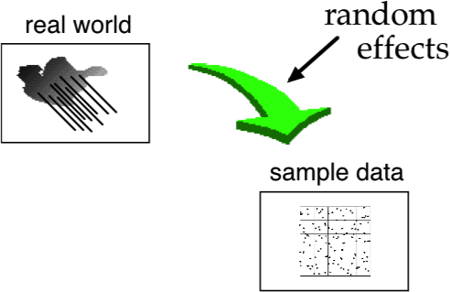
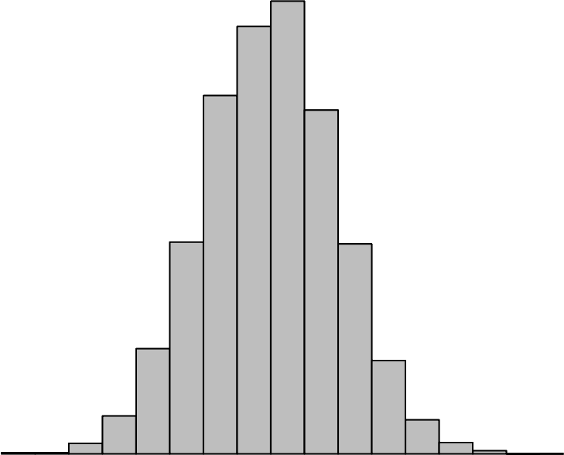
Bayesian inference
prior
distribution
posterior
combine prior
with likelihood

Slide 37


for adaptive websites
first click to
sports & leisure:
surfers: 75%
others: 12.5%

Slide 38
for adaptive websites
known visitors stats (prior):
surfers: 20%; others: 80%
imagine 100 visitors to website …
surfers others
all visitors: 20 80
click S&L: 15 10
so … if click S&L posterior probability
surfers: 60%; others: 40%
first click to
sports & leisure:
surfers: 75%
others: 12.5%

Slide 39
Bayes as a statistical method
new system B (prior):
A & B the same: 80%; B better: 20%
run a (v. small) study, all 4 users prefer B
prob. if A& B the same = 1/16
prob. If B better = 3/4 (say)
posterior probability
A & B the same: 25%; B better: 75%
odds ratio: 3:1

Slide 40
a different prior …
new system B (prior):
A & B the same: 20%; B better: 80%
same study, all 4 users prefer B
prob. if A & B the same = 1/16
prob. If B better = 3/4 (say)
posterior probability
A & B the same ~ 2%; B better ~ 98%
odds ratio: 48:1

Slide 41
what are the prior and posterior?
sometimes
actual estimate of probability
e.g. patient with symptoms
more often
encoding belief as probability
phenomena is either true or not

Slide 42
Bayesian issues
how do you get the prior?
sometimes doesn't matter too much
traditional stats rather like uniform prior
beware confirmation bias!
handling multiple evidence
can re-apply iteratively
problems with interactions
internecine warfare
traditionalists and Bayesians often fight ;)

Slide 44
what you can say … redux
phenomena and statisticians

Slide 45
researcher
(ii) probabilities about ideas
and decisions during career
. . .
many hypotheses
about the world
during a career
H1
H2
H3
H2
reality
true or not
(i) unknown, but
not a probability
for each
hypotheses
do a study
p<5%, [0.3,0.7]
posterior dist.
statistics
is it correct?
decision
true/false/maybe

Slide 46
what you can say …
statement about
decision during career
not
individual phenomena
if prior is an accurate estimate of
the probability you are right
about hypothesis
of which you have similar belief
then the posterior is
the probability you are right this time

Slide 48
philosophical differences
probing the unknown

Slide 49
philosophical stance
? what do you know about the world
traditional statistics
– assume nothing!
– reason from unknowledge
Bayesian statistics
– 'prior' probabilities
– reason from guess-timates

Slide 50
uncertain and unknown
assumptions:
  traditional – NO knowledge of real value
  Bayesian – precise `probability’ distribution
in reality … sort of half know
  traditional – choice of acceptable p
  Bayesian – ‘spread’ distributions (uniform, Cauchy)
  = measure
  of belief
  ideally should do
  sensitivity analysis
  … but no one does ☹

Slide 52
some dangers
if it can go wrong
then with 95% confidence …

Slide 53
inter-related factors
non-independent factors
  e.g. fat and sugar
correlated features
  e.g. weight, diet and exercise
the same UI but ‘not’ consistent
age and job seniority

Slide 54
avoid cherry picking
multiple tests
multiple stats
outliers
post-hoc hypotheses
survey with
40 questions
including trying both traditional and Bayesian!

Slide 56
…or worse
what to test for
and what to watch out for

Slide 57


what to test for?
10 coin tosses:
is it a fair coin?
what about … ?
Prob( THTHHHTTHH ) = 2⁻¹⁰ ~ 0.001
Prob( HHHHHHHHHH ) = 2⁻¹⁰ ~ 0.001

Slide 58
surely all heads is more extreme
the only thing ‘the same or worse’ than all heads is all tails:
but for
6 heads and 4 tails
nearly everything ‘the same or worse’

Slide 59
easy for numeric data
we got 6 heads out of 10 tosses:
prob( ‘the same or worse’ ) assuming fair
= prob( anything but 5:5)
= 1 – prob( 5 heads )
= 1 – 252/1024
~ 75%

Slide 60
another example
say 9 heads out of 10 tosses:
prob( ‘the same or worse’ ) assuming fair
= prob( 9 heads ) + prob( 10 heads )
+ prob( 9 tails ) + prob( 10 tails )
= 10/1024 + 1/1024 + 10/1024 + 1/1024
= 22/1024 ~ 2%

Slide 61
… and another
say 90 heads out of 100 tosses:
prob( ‘the same or worse’ ) assuming fair
= prob( nos heads >= 90 )
+ prob( nos tails >= 90 )
less than 1 in a million

Slide 62
but can be less obvious …

Slide 63
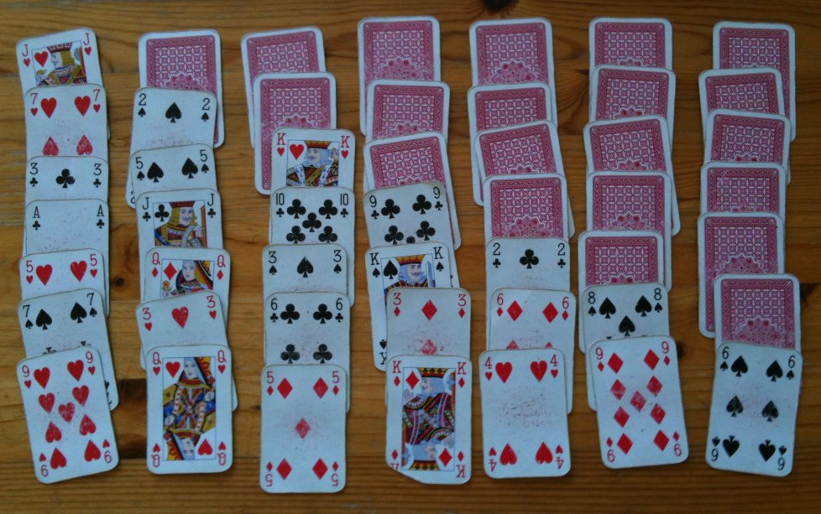
example: playing cards
run of cards
badly shuffled?

Slide 64



example: playing cards (2)
probability three cards make a decreasing run:
  first card needs to be 3 or bigger: 11/13
  second card exactly the next one down: 1/51
  third card exactly one down again: 1/50
= 11/33150 approx 1 in 3000 – p <0.001
next card
down
any card except ace or 2
next
again

Slide 65

example: playing cards (3)
but equally surprised if …
  either direction
  15 positions for the first card
= 15x2x11/33150
approx 1 in 100
and then …
how often do I play?

Slide 66
what to watch out for
I look at the data and notice
expert response time > novice resp. time
… hmm that looks interesting
I divide the data into experts and novices
… and do a t-test – Yay sig at 1% …
what else would have been equally interesting?
if 100 or even 10 then 1% doesn’t say much!

Slide 68
so which is it?
to p or not to p
Bayes forward?

Slide 69
the statistical crisis?
mostly are well known problems with known solutions
maybe more people doing stats with less training?
some of the papers about it use flawed stats!

Slide 70
comparing
traditional statistics ( p-test or confidence interval )
quite conservative …
… but only if done properly
Bayes
many of the same problems as trad. stats. …
… plus a few more!
needs expertise

Slide 71
on balance (my advice!)
for most things stick with trad. stats.
… but always confidence intervals as well as p
for special things go for Bayes
  if you know prior
  decision making with costs
  internal algorithms

Slide 72
for both
do it properly
understand what you are doing
… and know what it means

