Slide 1
Helping Hand guiding mobile app use without getting too close
NEXT
Alan Dix

Slide 2
NEXT
most apps are designed for a single person to use.
helping can be intrusive when together …
… and even harder when remote
Notes:
https://libreshot.com/sk/retirees-with-mobile-phone/

Slide 3
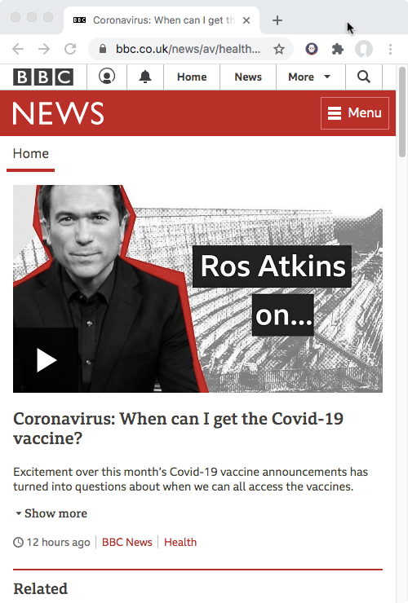
NEXT
even worse if you want to show someone what to press.
get out of my space!
Notes:
https://openclipart.org/detail/299084/generic-android-phone-edge-rounded
media controls by Magicon from the Noun Project
https://thenounproject.com/term/media-controls/382834/

Slide 4
imagine
NEXT
helper
user’s screen is shared with helper
perhaps side-by-side, across a table, or in different continents.
user
Notes:
https://openclipart.org/detail/299084/generic-android-phone-edge-rounded
media controls by Magicon from the Noun Project
https://thenounproject.com/term/media-controls/382834/

Slide 5
show me!
NEXT
helper
helper points at what to do on their screen
the same point highlights on user’s screen
for them to press
user
Notes:
https://openclipart.org/detail/299084/generic-android-phone-edge-rounded
media controls by Magicon from the Noun Project
https://thenounproject.com/term/media-controls/382834/

Slide 6
advantages
THE END
user stays in control
enables implicit learning
no invasion of personal space
helping at a distance

