Slide 1
Network-Based Interaction 3rd ed Overview and Figures Alan Dix
Full reference: Dix (2012). Network-Based Interaction. Chapter 11 in J. Jacko (Ed.), The Human-Computer Interaction Handbook (3rd Edition). CRC Press. pp.237-272
https://alandix.com/academic/papers/ network2012/

Slide 2
Main Structure
11.3 Networks as Enablers
things that are only possible with networks
11.4 Networks as Mediators
issues and problems because of networks
11.5 Networks as Subjects
understanding and managing networks
11.6 Networks as Platforms
algorithms and architectures for distributed interfaces

Slide 3
Section 11.2 About Networks
different kinds of networks

Slide 4
Section 11.3. inline.
Fixed
Flexible
PAN, NFC, IrDa Bluetooth WiFi,UWB
Local
LAN
WAN
Internet
GSM GPRS, 3G
Global
Mobile

Slide 5
Figure 11.1. reCaptcha interface (usually embedded in a web page).

Slide 6
Section 11.3 Networks as Enablers
things that are only possible with networks

Slide 7
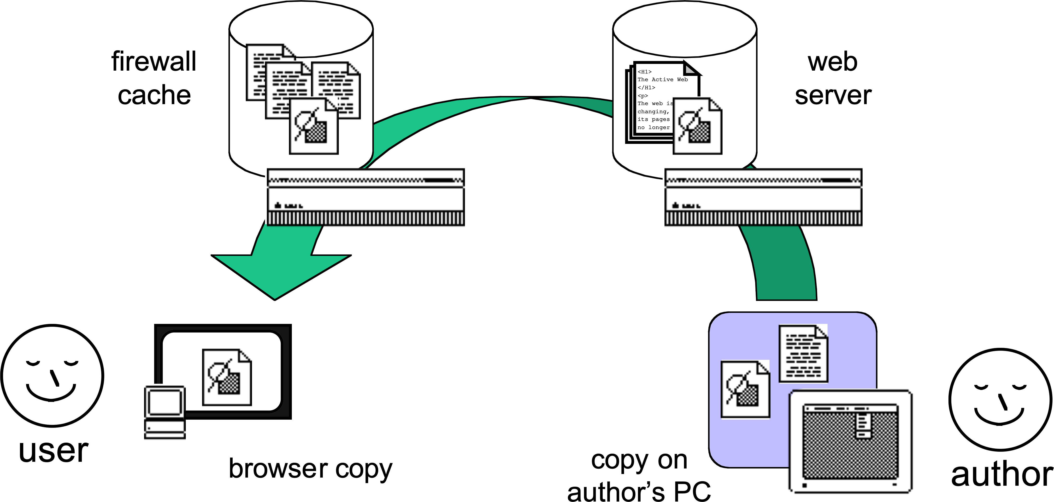
Figure 11.2. Copies of a web page in many places

Slide 8
Figure 11.3. Apple iDisk—cloud data on the desktop

Slide 9
Figure 11.4. Fragment of resource description framework at http://www.alandix.com/rdf/alandix.xml

Slide 10
Figure 11.5. Linked data as of July 2009 (http://richard.cyganiak.de/2007/10/lod/)

Slide 11
Section 11.4 Networks as Mediators
issues and problems because of networks

Slide 12
Figure 11.6. Bandwidth, latency, and jitter
Bandwidth how much
Latency how long
Send
Receive
Time
Jitter how variable

Slide 13
Figure 11.7. (a) No jitter—no problem. (b) Jitter causes irregular reception
constant latency
frames generated at fixed rate
send
1
2
3
4
5
6
7
8
9
receive
1
2
3
4
5
6
7
8
9
time
frames arrive at same rate
frames generated at fixed rate
latency varies - jitter
send
1
2
3
4
5
6
7
8
9
receive
1
2
3
4
5
6
7
8
9
time
frames arrive at irregular rate

Slide 14
Figure 11.8. Buffering will smooth the jitter, but adds delay
frames generated at fixed rate
latency varies - jitter
send
1
2
3
4
5
6
7
8
9
receive
1
2
3
4
5
6
7
8
9
frames enter buffer at irregular rate
3
4
6
9
2
2
3
3
4
5
5
6
7
8
8
buffer
1
1
1
2
2
3
4
4
5
6
6
7
7
longer initial delay while buffer fills
replay
1
2
3
4
5
6
time
frames taken from buffer at constant rate

Slide 15
Figure 11.9. Consistency breakdown. (a) Alison’s chat window. (b) Brian’s chat window

Slide 16
Section 11.5 Networks as Subjects
understanding and managing networks

Slide 17
Figure 11.10. The long path from laptop to web
phone cell
aerial
fibre-optic phone backbone
radio
microwave
telecom
service provider
Bluetooth
link
Internet backbones
web server

Slide 18
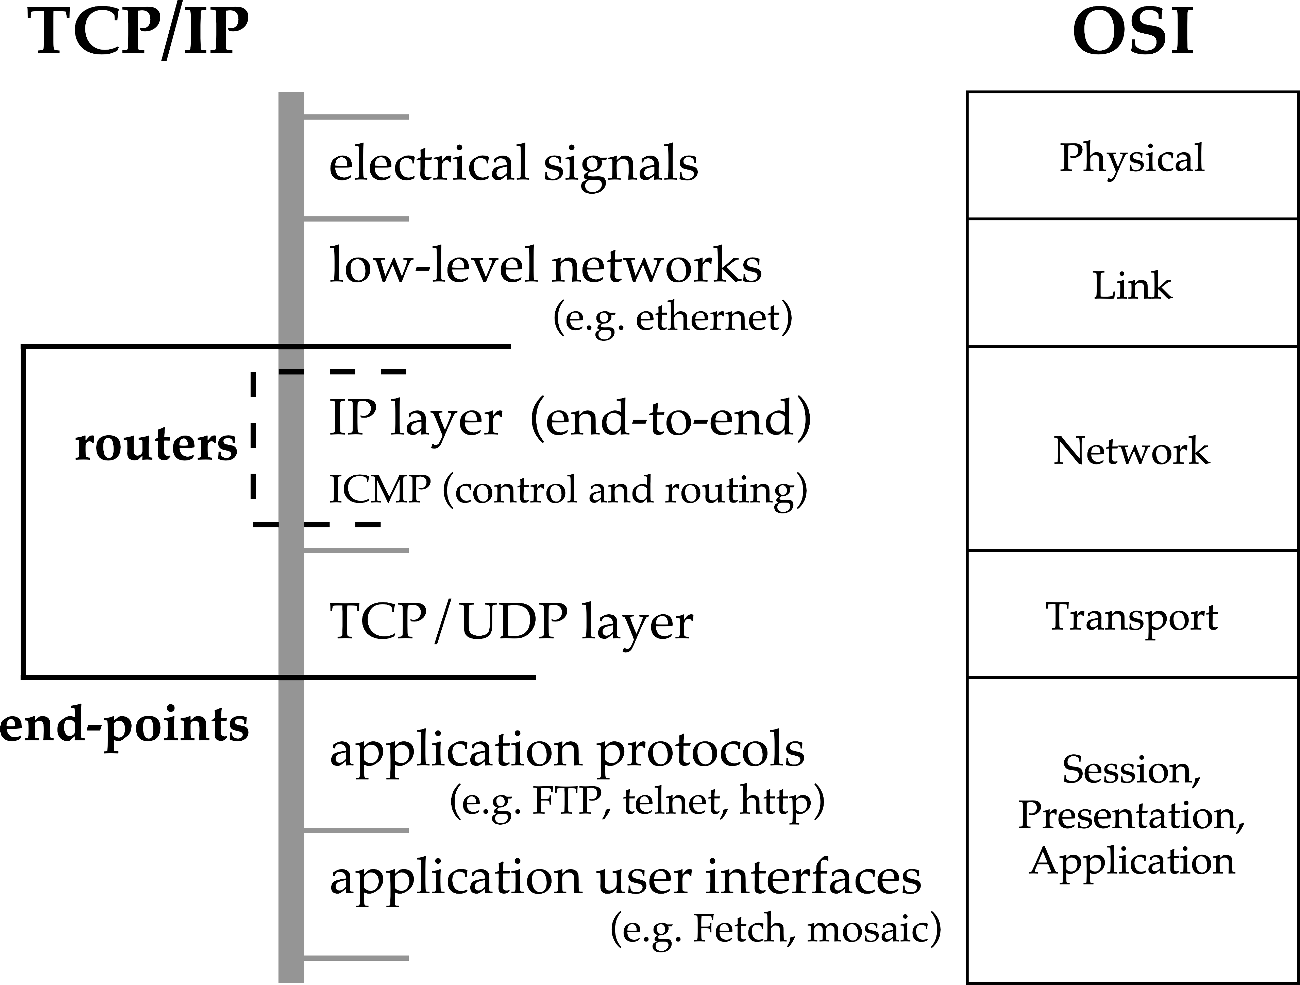
Figure 11.11. OSI seven layers and TCP/IP

Slide 19
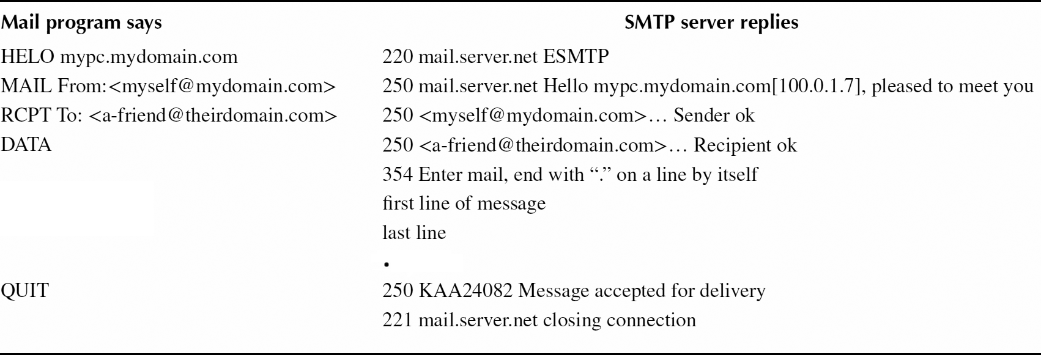
Figure 11.12. Protocols to send e-mail through Simple Mail Transfer Protocol

Slide 20
Figure 11.13. Typical network packet format (simplified)

Slide 21
Figure 11.14. Internet IP packet inside Ethernet packet

Slide 22
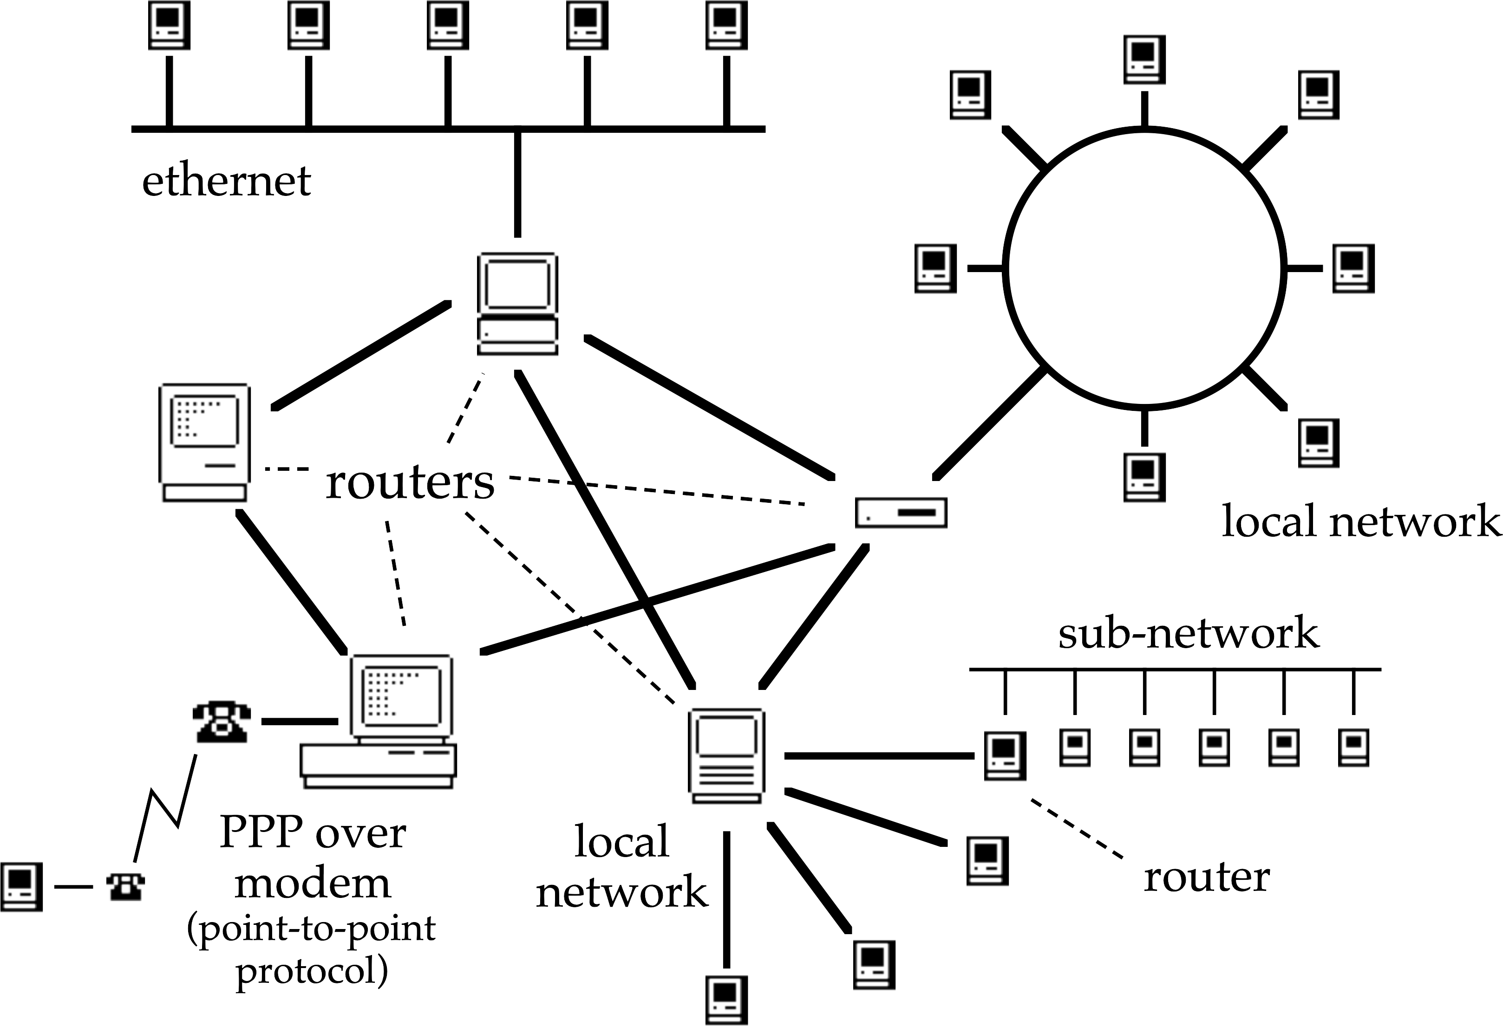
Figure 11.15. Routers send messages in the right direction through complex networks

Slide 23
Figure 11.16. (a) Open-loop control. (b) Closed-loop control
prediction
system
controller
desired effect?
feedback
system
controller
desired effect?

Slide 24
Section 11.6 Networks as Platforms
algorithms and architectures for distributed interfaces

Slide 25
Figure 11.17. Dynamic pointers from Dix (1995)

Slide 26
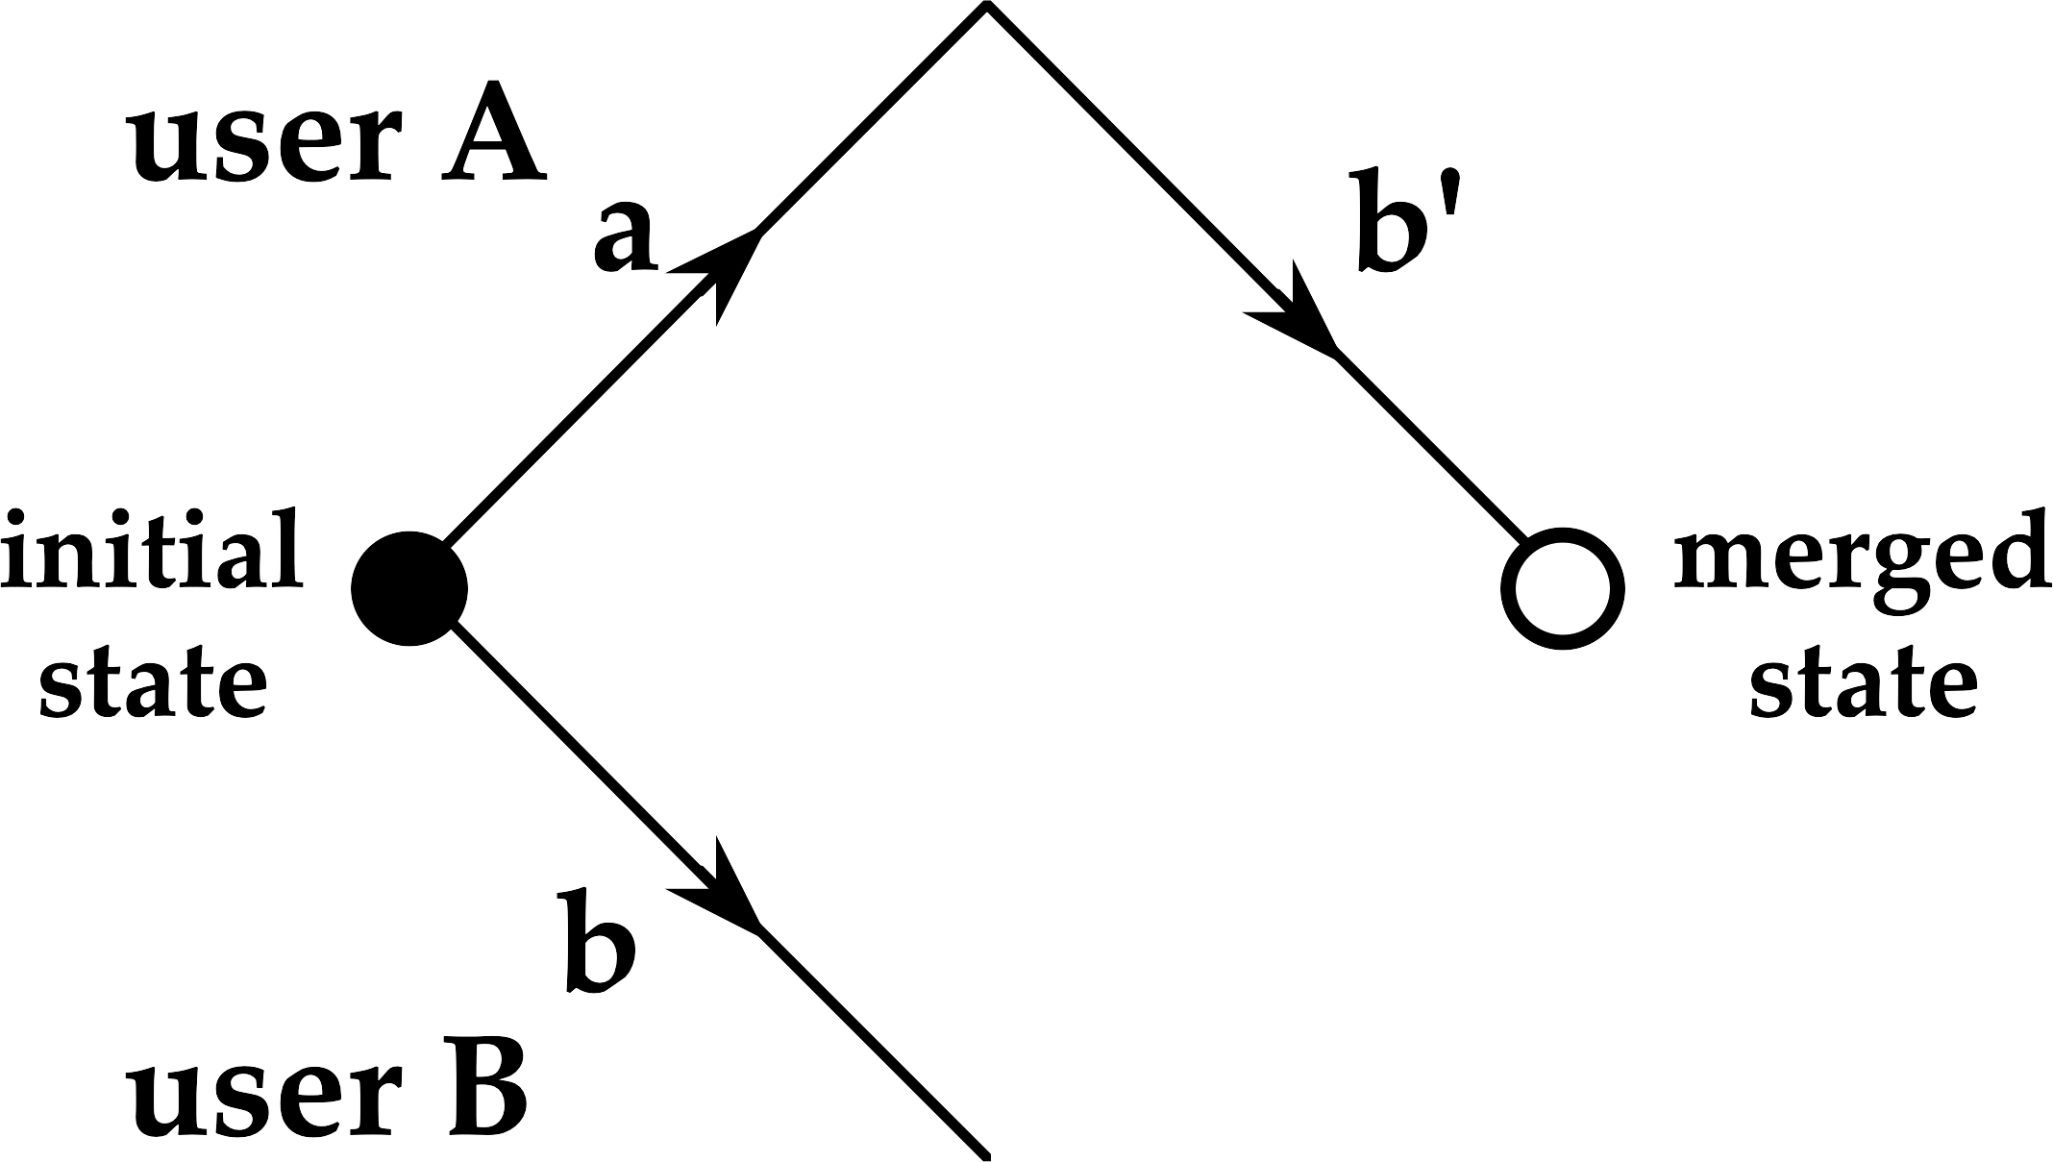
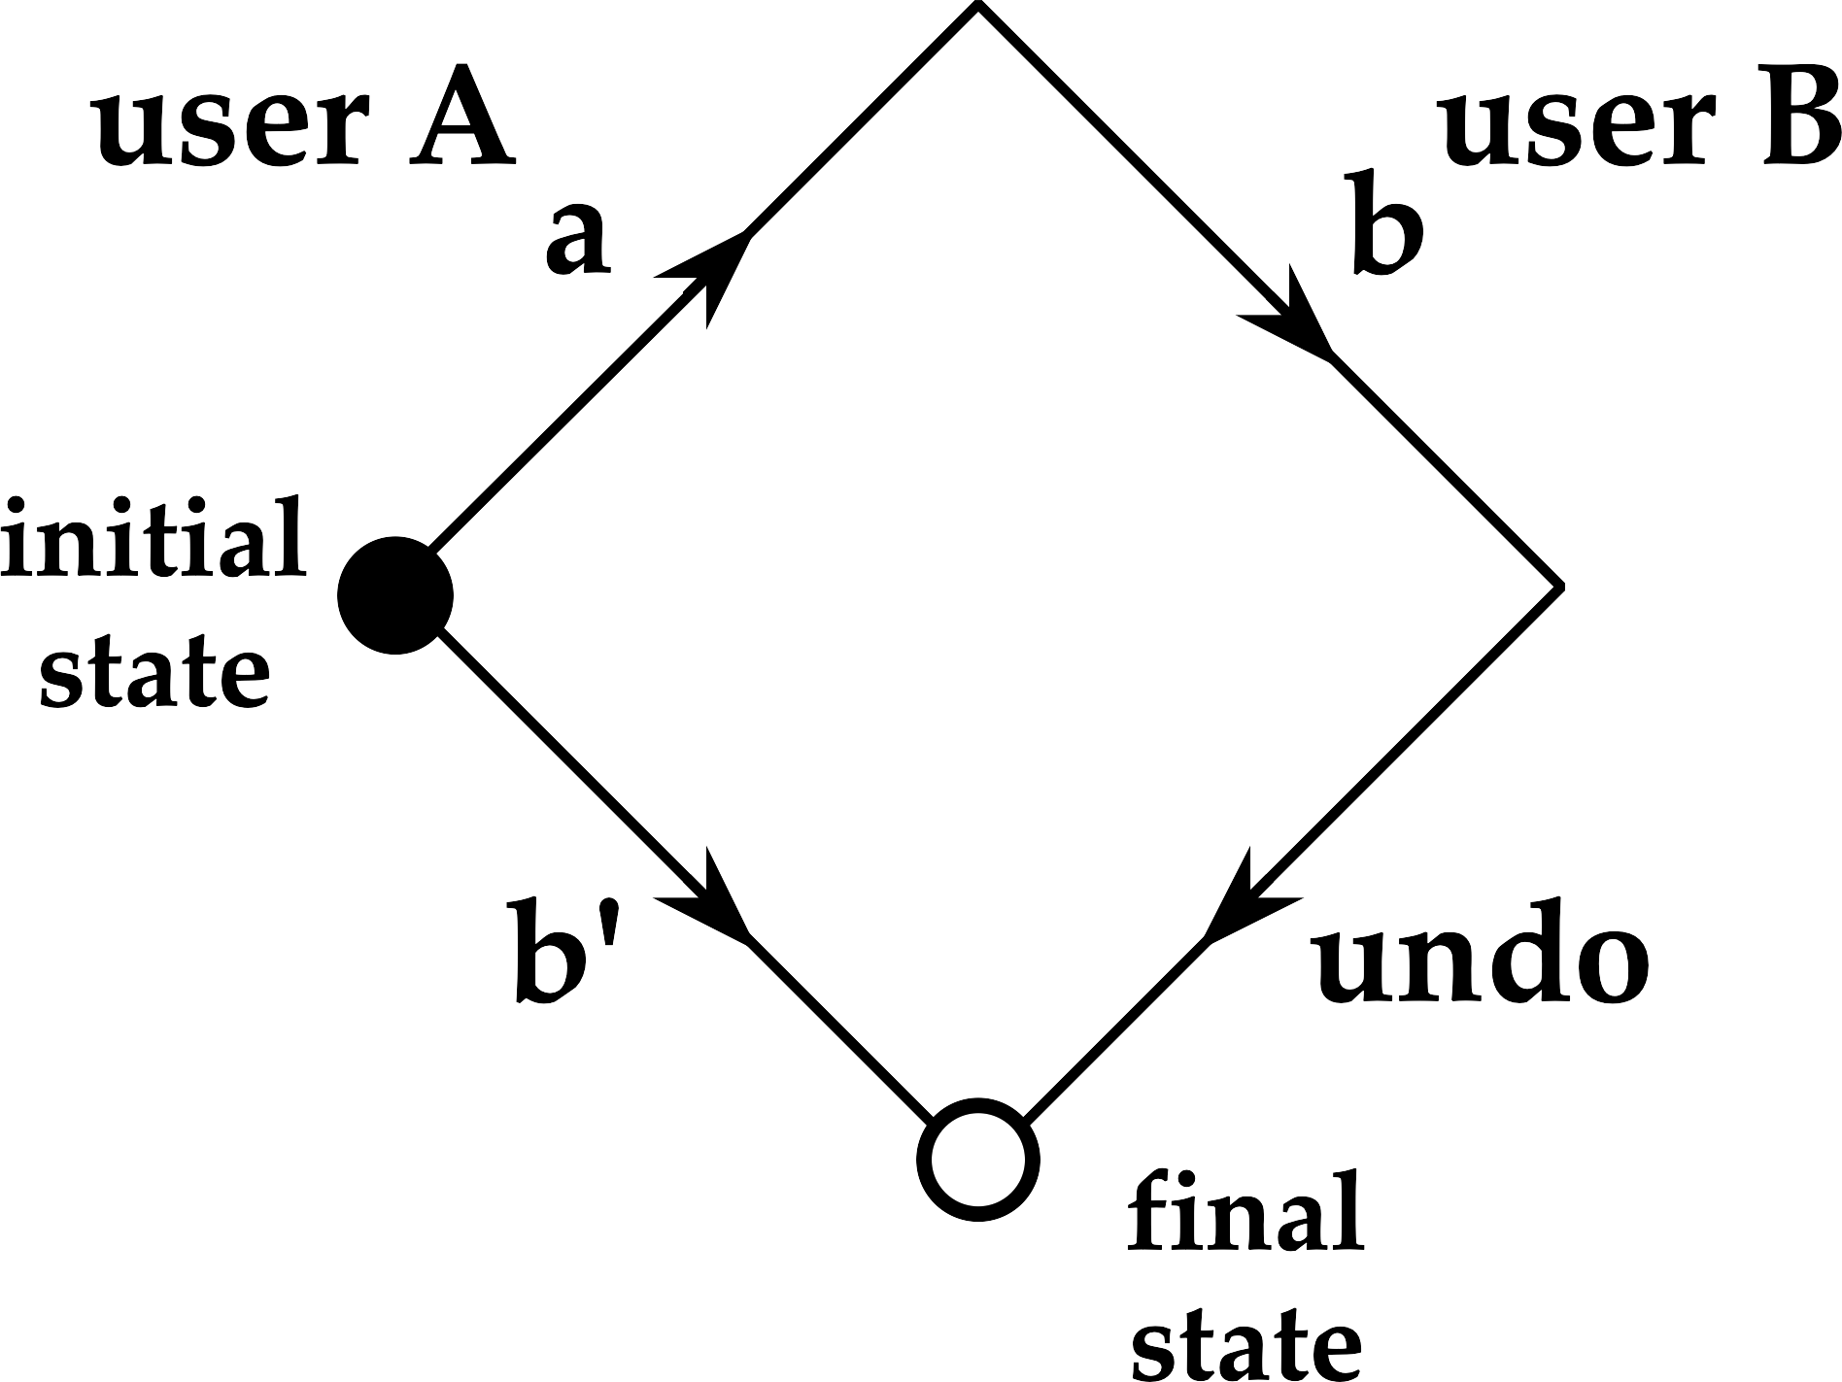
Figure 11.18. Multiuser transformations. Optimistic Concurrency. Group Undo.

Slide 27
Figure 11.19. SOAP XML encoding of Lookup (“Hello World”).

Slide 28
Section 11.7 History, Paradigm Shift and Futures
history and future of network interaction societal effects and paradigm changes due to developments in global and wireless networking

Slide 29
Timeline—key events for the Internet
1968 – First proposal for ARPANET-military and government research contracted to Bolt, Beranek & Newman
1971 – ARPANET enters regular use
1973–1974 – Redesign of lower level protocols leads to TCP/IP
1983 – Berkeley TCP/IP implementation for 4.2BSD – public domain code
1980s – Rapid growth of NSFNET-broad academic use
1990s – WWW and widespread public access to the Internet
2000 – WAP on mobile phones web transcends the Internet

Slide 30
Network-Based Interaction 3rd ed Overview and Figures Alan Dix
Full reference: Dix (2012). Network-Based Interaction. Chapter 11 in J. Jacko (Ed.), The Human-Computer Interaction Handbook (3rd Edition). CRC Press. pp.237-272
https://alandix.com/academic/papers/ network2012/

