Slide 1
Network-Based Interaction
Alan Dix
https://alandix.com/academic/papers/network2026/
Chapter 12 in
Handbook of Human Computer Interaction’ (4th Ed)
Julie Jacko (ed), CRC Press. (pub expected Aug. 2026)

Slide 2
contents
12.1 Introduction
12.2 About Networks
12.3 Networks as Enablers:
Things That Are Only Possible with Networks
12.4 Networks as Mediators:
Issues and Problems Because of Networks
12.5 Networks as Subjects:
Understanding and Managing Networks
12.6 Networks as Platforms:
Algorithms and Architectures for Distributed Interfaces
12.7 Networks and Society
12.8 Progress and Futures
Notes:
Abstract
12.1 Introduction
12.1.1 Structure
12.2 About Networks
12.2.1 Types of networks
12.2.2 History of networks – the early years
12.2.3 Paradigm Shift
12.3 Networks as Enablers: Things That Are Only Possible with Networks
12.3.1 Remote Resources
12.3.1.1 People
12.3.1.2 Physical Things
12.3.1.3 Data
12.3.1.4 Computation
12.3.2 Mobility
12.3.3 Applications
12.3.3 Virtual Networks
12.4 Networks as Mediators: Issues and Problems Because of Networks
12.4.1 Network Properties
12.4.1.1 Bandwidth and Compression
12.4.1.2 Latency and Start-Up
12.4.1.3 Jitter and Buffering
12.4.1.4 Glitches
12.4.1.5 Reliability and Loss, Datagram and Connection-Based Services
12.4.1.6 Quality-of-Service and Reservation
12.4.1.7 Encryption, Authentication, and Digital Signatures
12.4.2 UI Properties
12.4.2.1 Network Transparency
12.4.2.2 Delays and Time
12.4.2.3 Coping Strategies
12.4.2.4 Timeliness of Feedback/Feedthrough, Pace
12.4.2.5 Race Conditions and Inconsistent Interface States
12.4.2.6 Awareness
12.4.3 Media Issues
12.4.3.1 Interactive Conversation and Action
12.4.3.2 Reliability
12.4.3.3 Sound and Vision
12.4.3.4 Compression
12.4.3.5 Jitter
12.4.3.6 Broadcast and Prerecorded Media
12.4.4 Public Perception: Ownership, Privacy, and Trust
12.5 Networks as Subjects: Understanding and Managing Networks
12.5.1 Network Models
12.5.1.1 Layers
12.5.1.2 Protocols
12.5.1.3 Internetworking and Tunneling
12.5.1.4 Routing
12.5.1.5 Addresses
12.5.1.6 All Together...
12.5.1.7 Decentralizing: Peer–Peer and Ad Hoc Networks
12.5.2 Network Management
12.5.3 Network Awareness
12.5.3.1 Network Confusion
12.5.3.2 Exploiting the Limitations: Seamfulness and Virtual Locality
12.5.4 Network Within
12.5.5 Networks Tell Stories
12.6 Networks as Platforms: Algorithms and Architectures for Distributed Interfaces
12.6.1 Accessing Shared Objects
12.6.1.1 Locking
12.6.1.2 Replication
12.6.1.3 Optimistic Concurrency for Synchronous Editing
12.6.1.4 Groupware Undo
12.6.1.5 Real Solutions?
12.6.2 Architectures for Networked Systems
12.6.3 Supporting Infrastructure
12.6.3.1 Awareness Servers
12.6.3.2 Notification Servers
12.6.3.3 Event/Messaging Systems
12.6.3.4 Resource Discovery
12.6.3.5 Web Service and Remote Procedure Call
12.7 Networks and Society
12.7.1 Digital Inclusion
12.7.2 Internet Speed
12.7.3 Porous borders
12.7.4 Local and Global
12.7.5 Social structures
12.7.6 Information and Misinformation
12.7.7 Resilience and Fragility
12.7.8 Environmental impact
12.8 Progress and Futures
References

Slide 3
12.1 Introduction
Notes:
12.1.1 Structure

Slide 4
issues
are networks just an ‘implementation detail’?
on the other hand ...
networking dominates current interaction

Slide 5
structure
intro, types of networks & history
five main headings
  ... what is special for users about networks ...
round up
  future and paradigm changes

Slide 6
special things ...
networks as enablers
  things that are only possible with networks
networks as mediators
  issues and problems because of networks
networks as subjects
  understanding and managing networks
networks as platforms
  algorithms and architectures for distributed interfaces
networks and society
  how networks transform the human and natural world

Slide 7
12.2 About Networks
12.2.1 Types of networks
12.2.2 History of networks – the early years
12.2.3 Paradigm Shift
Notes:
12.2.1 Types of networks
12.2.2 History of networks – the early years
12.2.3 Paradigm Shift

Slide 8
Figure 12.1 Different kinds of network infrastructure
fixed
flexible
LAN
power-supply
networks
WiFi, PAN
Bluetooth
NFC, IrDa
local
WAN
GSM
GPRS, 5G
Internet
global
mobile & satellite
Notes:
This shows a two-by-two table of different network infrastructures.
The columns are labelled ‘fixed’ and ‘flexible’, and the rows are labelled ‘local’ and ‘global’.
In the top left quadrant (fixed–local) are LAN and power-supply networks.
In the top right quadrant (flexible–local) are WiFi, PAN, NFC and IrDa.
In the bottom left quadrant (fixed–global) is Internet.
In the bottom right quadrant (flexible–global) are GSM, GPRS and 5G.
Cutting across the bottom two quadrants are mobile and satellite phones, which are global but bridge fixed and flexible.

Slide 9
history and paradigms
history
  arpanet, internet, web etc. etc. ...
paradigm shift
  global village, cyberspace, cross-cultural issues, e/m-commerce, charging models, PopuNET

Slide 10
Timeline—key events for the Internet:
1968 — First proposal for ARPANET-military and government research contracted to Bolt, Beranek & Newman
1971 — ARPANET enters regular use
1973–1974 — Redesign of lower-level protocols leads to TCP/IP
1983 — Berkeley TCP/IP implementation for 4.2BSD—public domain code
1980s — Rapid growth of NSFNET-broad academic use
1990s — WWW and widespread public access to the Internet
2000 — WAP on mobile phones web transcends the Internet

Slide 11
12.3 Networks as Enablers:
Things That Are Only Possible with Networks
12.3.1 Remote Resources
  12.3.1.1 People
  12.3.1.2 Physical Things
  12.3.1.3 Data
  12.3.1.4 Computation
12.3.2 Mobility
12.3.3 Applications
12.3.4 Virtual Networks
Notes:
12.3.1 Remote Resources
12.3.1.1 People
12.3.1.2 Physical Things
12.3.1.3 Data
12.3.1.4 Computation
12.3.2 Mobility
12.3.3 Applications
12.3.3 Virtual Networks

Slide 12
Networks as Enablers things that are only possible with networks
access to remote resources:
  people
  physical things
  data
  computation
applications - other chapters
  groupware, mobile, e-commerce, tele-work etc.

Slide 13
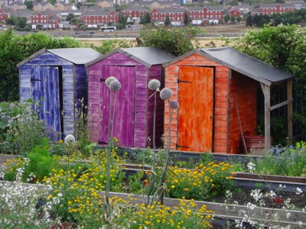

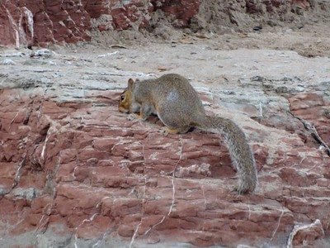
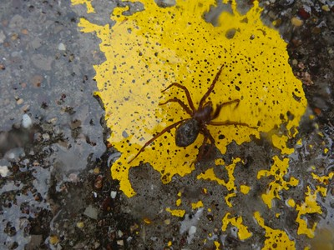
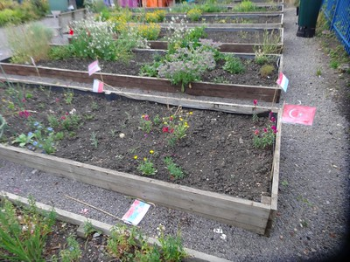
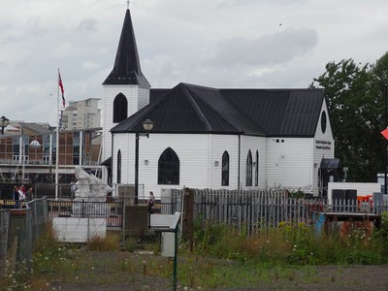

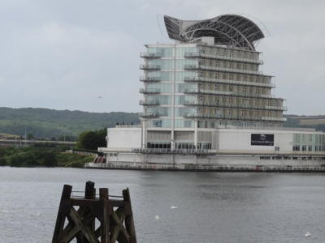
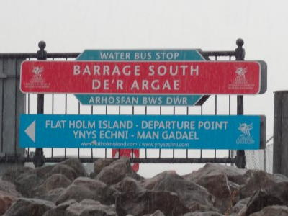
Figure 12.2. reCaptcha interface (usually embedded in a web page). Early OCR reCAPTCHA (left), and image-based reCAPTCHA (right)
Select images of buildings
Notes:
Two reCAPTCHA interfaces are shown.
On the left is a screenshot of an early reCAPTCHA that shows two words (in this case ‘Mayor’s’ and ‘Moravian’), which the user has to type.
On the right is a simulated screenshot of an image-based reCaptcha, which has nine photographs and asks the user to select the images that include buildings.

Slide 14
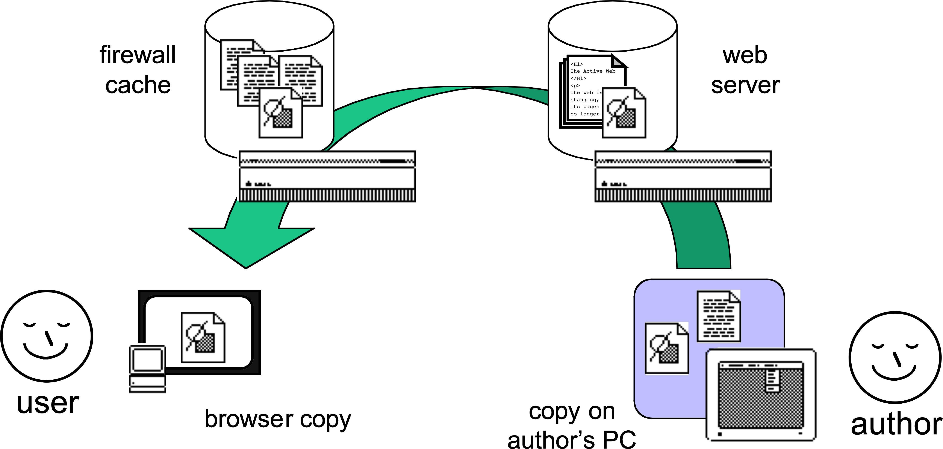

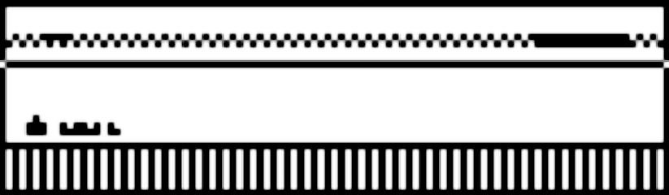
Figure 12.3. Copies of a web page in many places, including ‘nowhere’ when generated on the fly from database content.
CMS
pages created
automatically
from content
Notes:
The diagram shows the various ways that a web page may be generated and parts stored between the web page author and the user reading it.
The lower path shows the author editing the page on their own PC, uploading to a web server, then the web page passing via a firewall or cache, and eventually to the user’s browser.
There is also an upper path showing the author interacting with a CMS to create stored content. The actual web pages are then created automatically from the stored content in the CMS and delivered, via the firewall/cache, to the user’s browser.

Slide 15
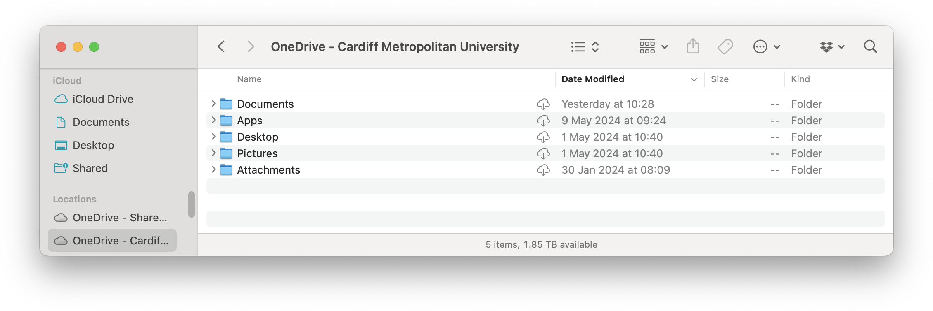
Figure 12.4. MacOS – cloud data on the desktop including a Microsoft OneDrive folder
Notes:
The image shows a MacOs folder with a number of sub-folders. However, the label at the top starts “OneDrive”, and in fact this is a folder on a cloud server but looks very much like a local folder. The fact that it is a cloud folder is made evident by small cloud icons beside the individual sub-folders.

Slide 16
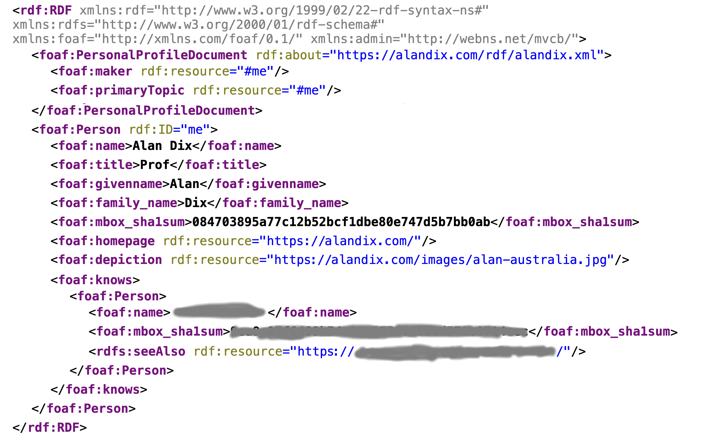
Figure 12.5. Fragment of resource description framework at https://alandix.com/rdf/alandix.xml
Notes:
This shows the contents of the data at the URL https:// alandix.com/rdf/alandix.xml
It is RDF rendered in XML and it is possible to see the name (foaf:name) Alan Dix, a link to a home page and a photo, as well as a connection to a friend.

Slide 17
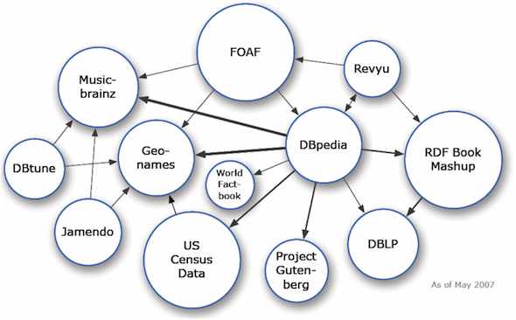
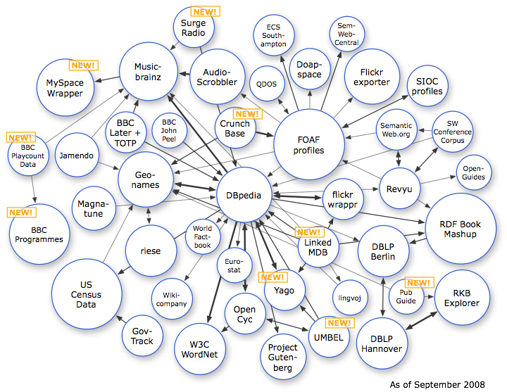
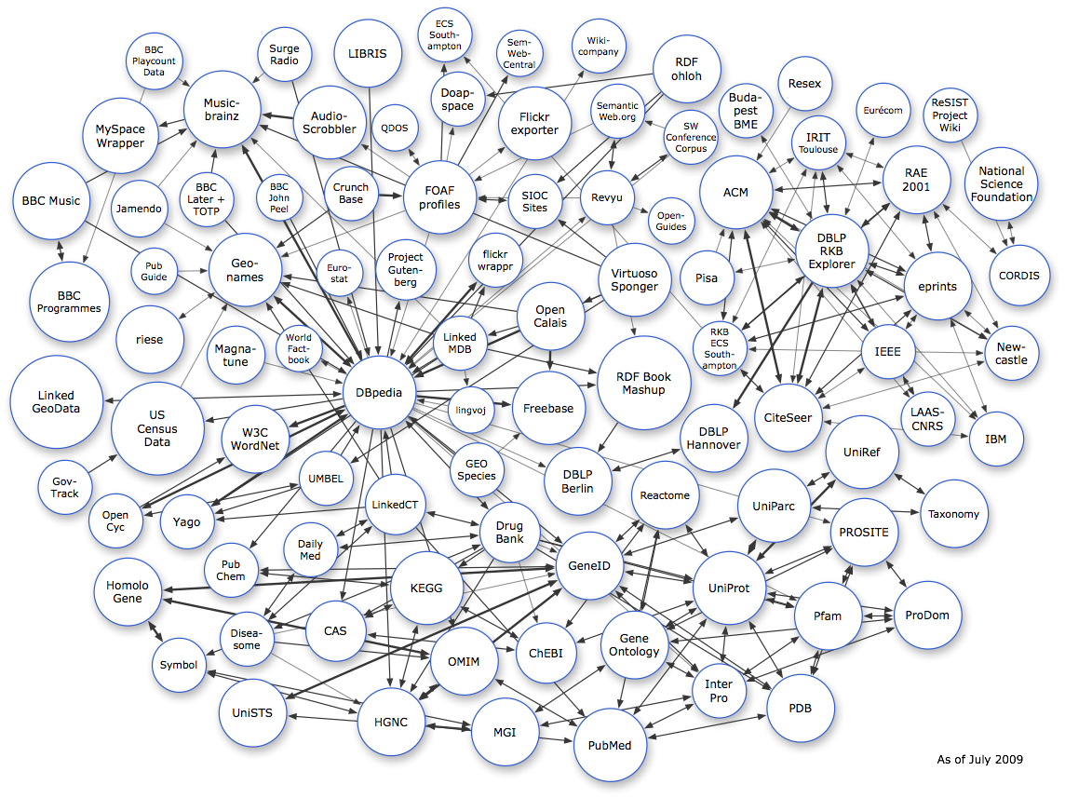
Figure 12.6 Growth of the Linked Data Cloud 2007–2020 (source https://lodcloud.net/, CC-BY)
18/9/2008
45 datasets
01/5/2007
12 datasets
14/7/2009,
95 datasets
16/11/2020
1269 datasets
Notes:
Four images show network diagrams of the Linked Data Cloud at different dates, with individual labelled datasets and connections between them.
There are 12 datasets at 01/5/2007; 45 datasets at 18/9/2008 45, 95 datasets at 14/7/2009; and 1269 datasets at 16/11/2020.
On the first three images it is possible to see individual datasets and patterns of connections, but by 2020 the image is too dense to make out any clear structure.

Slide 18
12.4 Networks as Mediators:
Issues and Problems Because of Networks
12.4.1 Network Properties
  12.4.1.1 Bandwidth and Compression
  12.4.1.2 Latency and Start-Up
  12.4.1.3 Jitter and Buffering
  12.4.1.4 Glitches
  12.4.1.5 Reliability and Loss, Datagram and Connection-Based Services
  12.4.1.6 Quality-of-Service and Reservation
  12.4.1.7 Encryption, Authentication, and Digital Signatures
12.4.2 UI Properties
  12.4.2.1 Network Transparency
  12.4.2.2 Delays and Time
  12.4.2.3 Coping Strategies
  12.4.2.4 Timeliness of Feedback/Feedthrough, Pace
  12.4.2.5 Race Conditions and Inconsistent Interface States
  12.4.2.6 Awareness
12.4.3 Media Issues
  12.4.3.1 Interactive Conversation and Action
  12.4.3.2 Reliability
  12.4.3.3 Sound and Vision
  12.4.3.4 Compression
  12.4.3.5 Jitter
  12.4.3.6 Broadcast and Prerecorded Media
12.4.4 Public Perception: Ownership, Privacy, and Trust
Notes:
12.4.1 Network Properties
12.4.1.1 Bandwidth and Compression
12.4.1.2 Latency and Start-Up
12.4.1.3 Jitter and Buffering
12.4.1.4 Glitches
12.4.1.5 Reliability and Loss, Datagram and Connection-Based Services
12.4.1.6 Quality-of-Service and Reservation
12.4.1.7 Encryption, Authentication, and Digital Signatures
12.4.2 UI Properties
12.4.2.1 Network Transparency
12.4.2.2 Delays and Time
12.4.2.3 Coping Strategies
12.4.2.4 Timeliness of Feedback/Feedthrough, Pace
12.4.2.5 Race Conditions and Inconsistent Interface States
12.4.2.6 Awareness
12.4.3 Media Issues
12.4.3.1 Interactive Conversation and Action
12.4.3.2 Reliability
12.4.3.3 Sound and Vision
12.4.3.4 Compression
12.4.3.5 Jitter
12.4.3.6 Broadcast and Prerecorded Media
12.4.4 Public Perception: Ownership, Privacy, and Trust

Slide 19
Networks as Mediators issues and problems because of networks
network properties
  bandwidth, latency, jitter, QoS, buffering, etc.
UI properties
  transparency, delays and time, consistency, races, feedback/feedthrough, awareness
media issues
  delay/droped packets, broadcast/interaction, audio/video differences

Slide 20
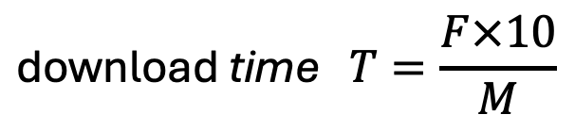
Bandwidth examples
 | size | GSM modem 9.6k bps | old modem 5.6k bps | basic b’band 100mbps | Fast b’band 100mbps
small text doc (4-5000 words) | 30kB | ~ ½ min | 5s | 30ms | 3ms
this chapter with images | 10mB | – | ~ ½ hour | 10s | 1s
raw audio per second | 200kb | ✘ | ✘ | ✔︎ | ✔︎
raw video per second | >100mb | ✘ | ✘ | ✘ | just
compressed video | 10-50mb | ✘ | ✘ | ✔︎ | ✔︎
$$\text{download} \text{time} T=\frac{F×10}{M}$$
F is the size of file in bytes
10 is the number of raw bits per byte
M is the network speed in bits per second
bps = bits per second Bps = bytes per second
1 byte = 8 bits ~ 10bits for transmission including start/stop bits

Slide 21
Figure 12.7 Bandwidth, latency, and jitter
Bandwidth
how much
Latency
how long
Send
Receive
Time
Jitter
how variable
Notes:
This timeline diagram compares bandwidth, latency and jitter. Arrows go from a send timeline to a receive timeline.
Some arrows are wider, and some narrower; this difference is labelled ‘Bandwidth – how much’.
The spacing between when the arrow leaves the send timeline and arrives at the receive timeline is labelled ‘latency – how long’.
The receive timeline has tick marks at fixed intervals and the variation of actual arrival times around these is labelled “Jitter – how variable”.

Slide 22
Figure 12.8. (upper) No jitter—no problem. (lower) Jitter causes irregular reception
constant latency
frames generated at fixed rate
send
1
2
3
4
5
6
7
8
9
receive
1
2
3
4
5
6
7
8
9
time
frames arrive at same rate
frames generated at fixed rate
latency varies - jitter
send
1
2
3
4
5
6
7
8
9
receive
1
2
3
4
5
6
7
8
9
time
frames arrive at irregular rate
Notes:
This diagram shows the effect of jitter.
There are two pairs of timelines labelled send and receive.
On the upper pair of timelines, frames are generated at a fixed rate at the send timeline, and have a constant latency. This means they are also spaced evenly at the receive timeline, each with a delay of the same length.
On the lower pair of timelines, the frames are generated at a fixed rate on the send timeline as before, but latency varies due to jitter and so they arrive at an irregular rate on the receive timeline.

Slide 23
Figure 12.9. Buffering will smooth the jitter, but adds delay
frames generated at fixed rate
latency varies - jitter
send
1
2
3
4
5
6
7
8
9
receive
1
2
3
4
5
6
7
8
9
frames enter
buffer at
irregular rate
3
4
6
9
2
2
3
3
4
5
5
6
7
8
8
buffer
1
1
1
2
2
3
4
4
5
6
6
7
7
longer initial delay
while buffer fills
replay
1
2
3
4
5
6
time
frames taken from buffer at constant rate
Notes:
The diagram shows four timelines labelled “send”, “receive”, “buffer” and “replay” with time flowing from left to right.
On each timeline, frames are shown numbered 1 to 9.
On the send timeline the frames are generated at a fixed rate, so are equally spaced.
Due to latency and jitter they take differing times to arrive and hence are spaced unevenly on the receive timeline.
The buffer timeline shows the frames being added as they arrive and stored in small heaps.
Finally, the replay timeline shows a “longer initial delay while the buffer fills” and then takes the items from the buffer at a constant rate.

Slide 24
Figure 12.10. Different timescales of frequency of occurrence and length of delay/drop. Glitches sit between jitter and occasional disconnection
frequency
days
intermittent
connectivity
hours
glitches
mins
jitter
total
failure
secs
ms
ms
secs
mins
hours
days
length of drop
Notes:
The diagram shows a quadrant graph with the vertical axis labelled ‘frequency’ and the horizonal axis labelled ‘length of drop’.
Both have markers labelled (starting at the origin): milliseconds, seconds, minutes, hours and days.
The bottom right half of the quadrant, where length of drop is greater than frequency, is labelled ‘total failure’.
The other half, the top left, has three labels: jitter, glitches and intermittent connectivity.
Jitter is towards the bottom left – high frequency and short length of drop (milliseconds to seconds).
Intermittent connectivity is towards the top – slower frequency and longer drops (hours to days).
Glitches lie between, with middle to low frequencies and smaller to medium length of drop.

Slide 25
three main timescales for networked user interfaces
100 milliseconds
  Feedback for hand-eye coordination tasks needs to be less than 100–200 milliseconds to feel fluid. This is probably related to the fact that there are delays of this length in our motor-sensory system anyway. For aural feedback, the timescales are slightly tighter again.
1 second
  Timescale for apparent cause-effect links such as popping a window after pressing a button. If the response is faster than this, the effect seems “immediate.” This is related to a period of about 1 second that the brain regards as “now.”
5–10 seconds
  Waits longer than this make it hard to maintain task focus and can be annoying. This may be related to short-term memory decay.

Slide 26
longer feedback cycles e.g. pressing a button
Syntactic feedback
  the system has recognized your action
Intermediate feedback
  the system is dealing with the request implied by your action (and if possible progress toward that request)
Semantic feedback
  the system has responded and the results obtained

Slide 27
Figure 12.11. Consistency breakdown. (a) Alison’s chat window, (b) Brian’s chat window
Notes:
This shows the chat windows of two friends, Alison and Brian, and how the order of messages can change the interpretation.
(a) Alison’s window:
Alison: It’s a beautiful day. Let’s go out after work.
Alison: Perhaps not. I look awful after the late party.
Brian: I agree totally.
(b) Brian’s window:
Alison: It’s a beautiful day. Let’s go out after work.
Brian: I agree totally.
Alison: Perhaps not. I look awful after the late party.

Slide 28


Inline box in section 12.4.2.5
×
×
unmute
unmute
YOU
CHAIR
×
×
chair
clicks first
unmute
unmute
unmute
mute
mute
you click
mute
×
unmute
×
unmute
Notes:
This is a timeline diagram with the conference participant’s timeline on the left (labelled ‘YOU’, but in fact a photo of Alan) and the chair’s timeline on the right (labelled ‘CHAIR’).
Images at the top show the initial view of both the participant and the chair. Each sees the same image of the participant, with the ‘unmute’ button visible and their respective cursors hovering over it.
Below the images, the timelines start with both seeing the button say ‘unmute’ and beside the chair’s timeline is an annotation: “chair clicks first”.
The chair’s button is then shown changed to say ‘mute’ and an ‘unmute’ message is shown passing from the chair to the participant’s system.
The participant’s timeline is then annotated “you click” and their button is also changed to say ‘mute’.
Note that this is assumed to be only a moment after the chair’s click, and before the participant notices the button has changed.
The participant’s button is then shown changed back to ‘unmute’ and a message ‘mute’ is shown passing from the participant’s timeline to the chair’s timeline.
When this final message arrives the chair’s button says ‘unmute’ also.

Slide 29
12.5 Networks as Subjects:
Understanding and Managing Networks
12.5.1 Network Models
  12.5.1.1 Layers
  12.5.1.2 Protocols
  12.5.1.3 Internetworking and Tunneling
  12.5.1.4 Routing
  12.5.1.5 Addresses
  12.5.1.6 All Together...
  12.5.1.7 Decentralizing: Peer–Peer and Ad Hoc Networks
12.5.2 Network Management
12.5.3 Network Awareness
  12.5.3.1 Network Confusion
  12.5.3.2 Exploiting the Limitations: Seamfulness and Virtual Locality
12.5.4 Network Within
12.5.5 Networks Tell Stories
Notes:
12.5.1 Network Models
12.5.1.1 Layers
12.5.1.2 Protocols
12.5.1.3 Internetworking and Tunneling
12.5.1.4 Routing
12.5.1.5 Addresses
12.5.1.6 All Together...
12.5.1.7 Decentralizing: Peer–Peer and Ad Hoc Networks
12.5.2 Network Management
12.5.3 Network Awareness
12.5.3.1 Network Confusion
12.5.3.2 Exploiting the Limitations: Seamfulness and Virtual Locality
12.5.4 Network Within
12.5.5 Networks Tell Stories

Slide 30
Networks as Subjects understanding and managing networks
network models
  standard OSI-ish stuff, but high-level
network management
  large scale (BT) and small scale (PC)
network awareness
  exposing costs, network/resource availability
  feature interaction (not quite right place?)

Slide 31

Figure 12.12. The long path from laptop to web
phone cell
aerial
fiber-optic
phone
backbone
radio
microwave
telecom
service
provider
Bluetooth
link
Internet backbones
web server
Notes:
The diagram shows the various devices and hops between a laptop and a webserver. The laptop is drawn communicating with a Bluetooth phone via a Bluetooth link. This in turn connects to a phone cell aerial. The phone cell aerial is shown communicating using a microwave link to a fiber-optic phone backbone, which in turn connects with a telecom service provider. The telecom server provider is connected to the Internet backbone which (finally!) links to the web server.

Slide 32
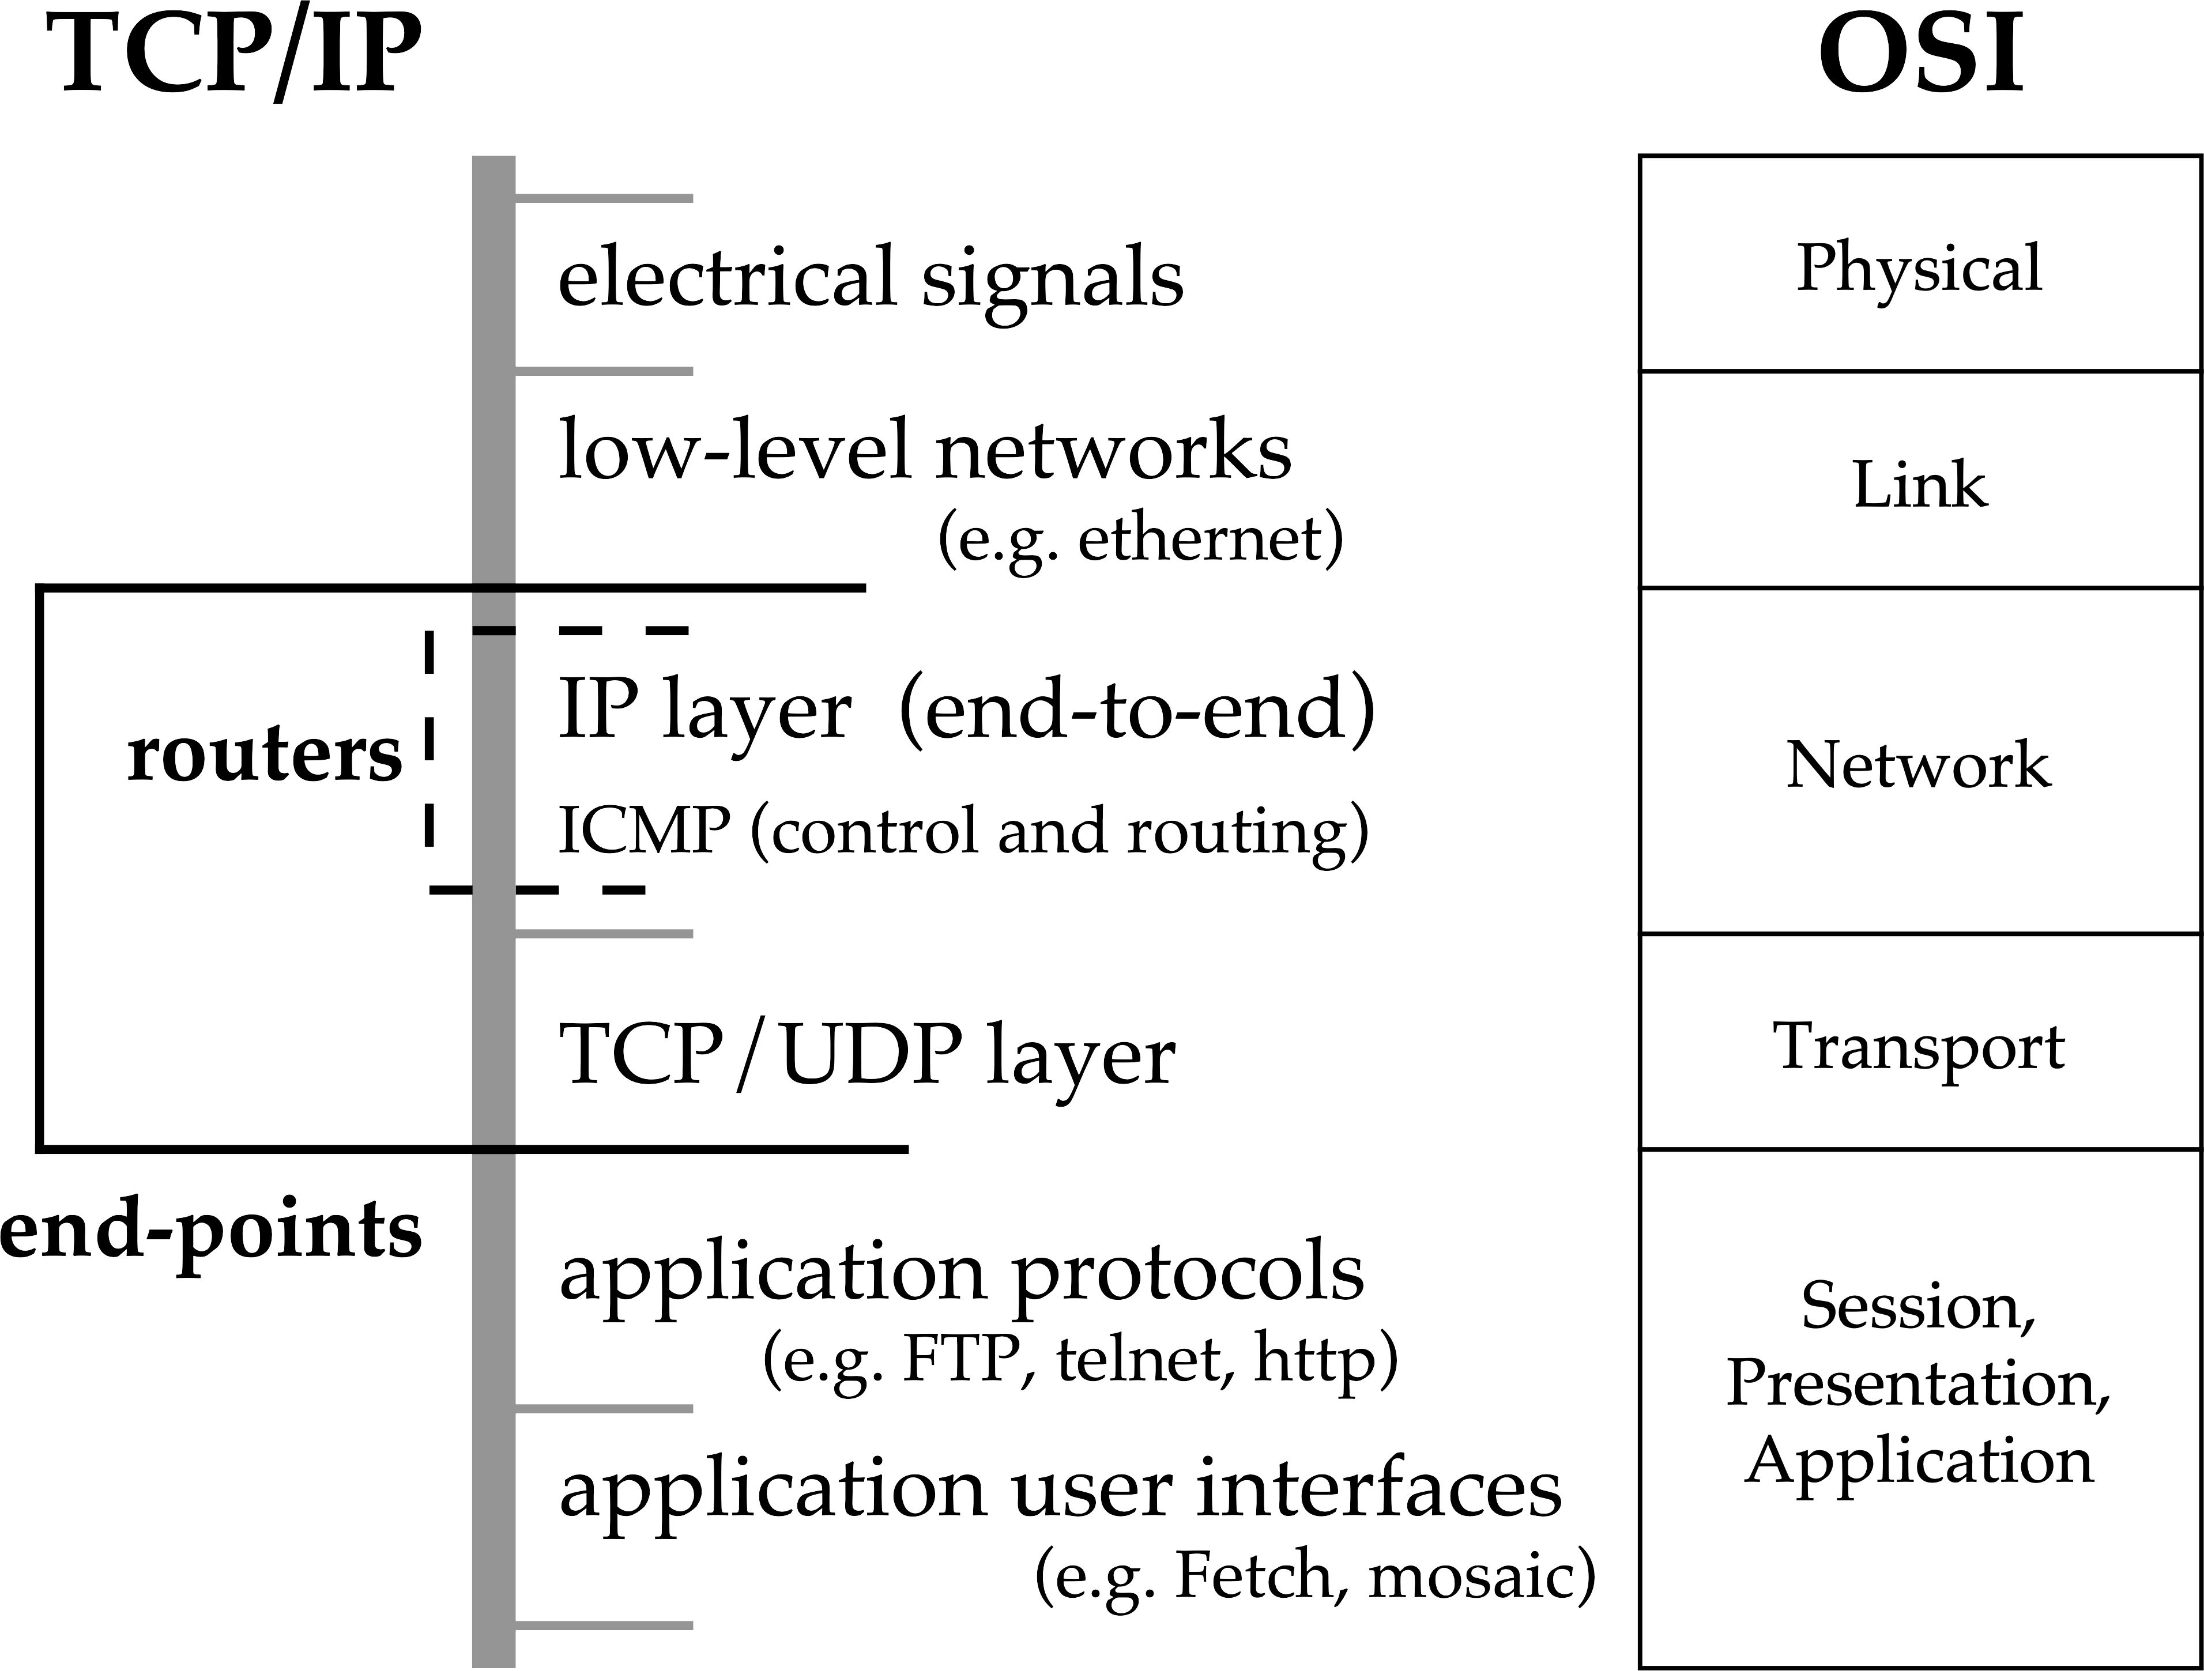
Figure 12.13. OSI seven layers and TCP/IP
Notes:
The diagram shows the rough correspondence between OSI layers (shown on the right) and TCP/IP layers (shown on the left).
The seven OSI layers (from lowest to highest) are: Physical, Link, Network, Transport, Session, Presentation and Application. The last three (upper layers) are grouped together in this diagram.
The TCP layers (from lowest to highest) are:
electrical signals (corresponding to OSI Physical);
low-level networks (e.g. ethernet) (corresponding to OSI Physical);
routers, including IP layer (end-to-end) and ICMP (control and routing) (corresponding to OSI Network);
TCP/UDP layer (corresponding to OSI Transport);
and end-points (corresponding to OSI Session/Presentation/Application).
The TCP/IP end-points layer is subdivided into application protocols (e.g. FTP, telnet, http) and application user interfaces (e.g. Fetch, mosaic).

Slide 33
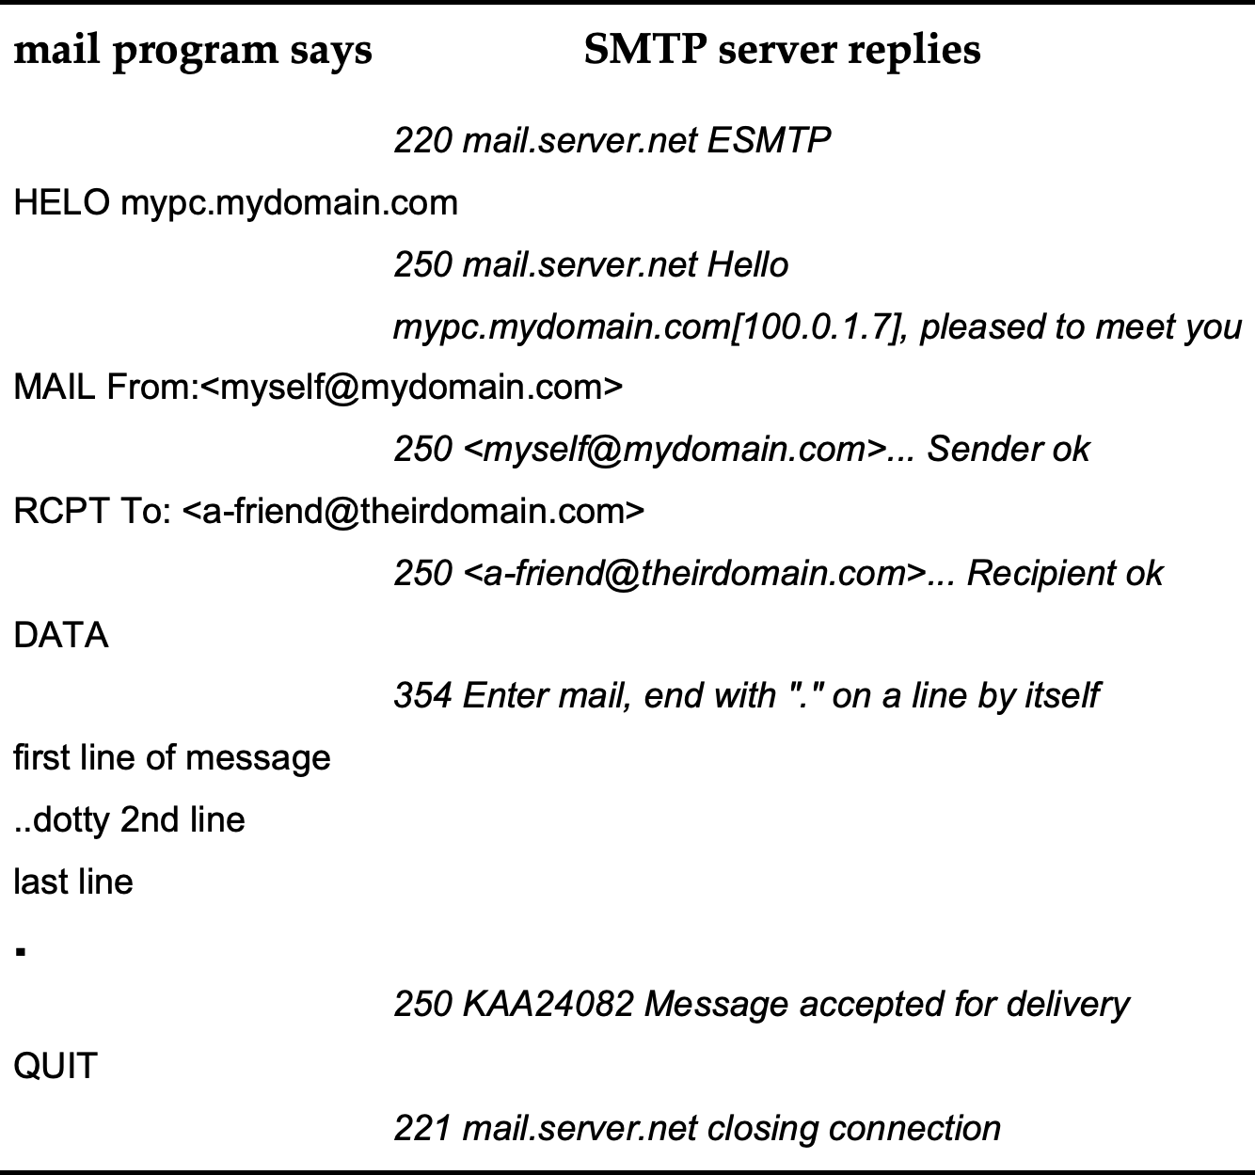
Figure 12.14 Protocols to send email through Simple Mail Transfer Protocol
Notes:
Sequence of messages between a mail client program and an SMTP server. In the diagram these are written on the left and right hand columns, but here prefixed by CLIENT: and SERVER:
SERVER: 220 mail.server.net ESMTP
CLIENT: HELO mypc.mydomain.com
SERVER: 250 mail.server.net Hello mypc.mydomain.com [100.0.1.7], pleased to meet you
CLIENT: MAIL From:<myself@mydomain.com>
SERVER: 250 <myself@mydomain.com>... Sender ok
CLIENT: RCPT To: <a-friend@theirdomain.com>
SERVER: 250 <a-friend@theirdomain.com>... Recipient ok
CLIENT: DATA
SERVER: 354 Enter mail, end with "." on a line by itself
SERVER: first line of message
SERVER: ..dotty 2nd line
SERVER: last line
SERVER: .
SERVER: 250 KAA24082 Message accepted for delivery
CLIENT: QUIT
SERVER: 221 mail.server.net closing connection

Slide 34
Figure 12.15 Typical network packet format (simplified)
Notes:
This shows the structure of a typical network packet.
It consists of two main parts, a header and a body.
The header includes a ‘to’ address, a ‘from’ address, miscellaneous other information, and the length of the data body.
The body is the actual data to be sent.

Slide 35
Figure 12.16 Internet IP packet inside Ethernet packet
Notes:
This shows the structure of an Internet IP packet embedded within an Ethernet packet.
It consists of two main parts: an Ethernet header and an Ethernet body.
The Ethernet header includes, inter alia, an Ethernet ‘to’ address, an Ethernet ‘from’ address, a flag to say it contains an IP payload and the length of this.
The Ethernet body contains the IP payload which in turn consists of two parts: an IP header and an IP body.
The IP header contains an IP ‘to’ address, an IP ‘from’ address and other IP specific headers information.
The IP body is the actual internet data to be sent.

Slide 36
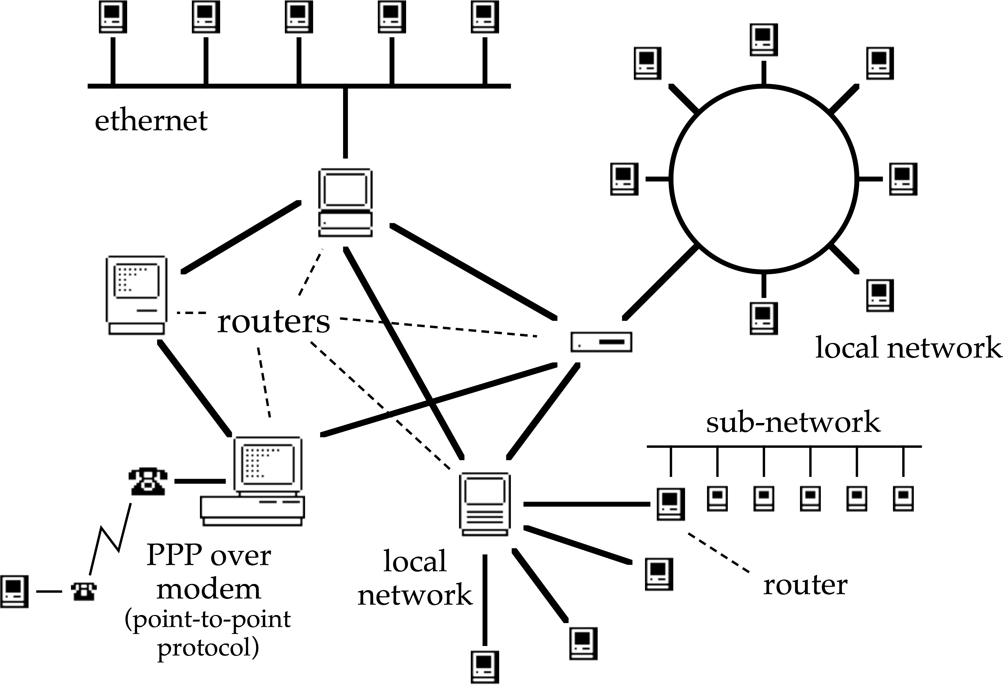
Figure 12.17. Routers send messages in the right direction through complex networks
ethernet or WiFi
Notes:
This shows a complex network diagram with lots of different configurations of computers, routers, etc. It includes: some sub-networks arranged as a linear bus (or WiFi broadcast), another arranged as a ring, another in star configuration with one main computer and several connected just to it, and also two computers connected via PPP (point to point protocol) over a modem. In the middle are a group of computers and dedicated devices labelled ‘routers’, that connect together all of the different sub-networks. The diagram is intended to show the way that many kinds of network can be interconnected and messages routed between them.

Slide 37
stages in accessing a web page
(simplified)
access the URL – https://datatodata.com/qbb/
Send IP-level request to DNS asking for datatodata.com.
Wait for reply.
DNS sends reply 94.237.60.197.
Establish TCP level connection with 94.237.60.197.
Send HTTP request (“GET /qbb/ HTTP/1.1”).
Web server sends the page back in reply.
Close TCP connection.

Slide 38


Figure 12.18 (upper) Open-loop control. (lower) Closed-loop control
prediction
system
controller
desired
effect?
feedback
system
controller
desired
effect?
Notes:
Two diagrams one above the other. Both show a computer controller on the left, an automated system in the middle, and on the right a starburst labelled ‘desired effect?’. Both have arrows, one from the controller to the automated system (denoting some form of control commands) and one from the automated system to the ‘desired effect’, denoting the impact of the system’s behaviour.
The diagram at the top (Open Loop Control) has a small thought cloud at the controller that says ‘prediction’, with an icon to show that it refers to a prediction about the automated system behaviour. This shows that the prediction is used to choose the appropriate control commands for the system.
The diagram at the bottom (Closed Loop Control) has no prediction, but instead an additional arrow from the effect back to the controller, labelled ‘feedback’.

Slide 39
12.6 Networks as Platforms:
Algorithms and Architectures for Distributed Interfaces
12.6.1 Accessing Shared Objects
  12.6.1.1 Locking
  12.6.1.2 Replication
  12.6.1.3 Optimistic Concurrency for Synchronous Editing
  12.6.1.4 Groupware Undo
  12.6.1.5 Real Solutions?
12.6.2 Architectures for Networked Systems
12.6.3 Supporting Infrastructure
  12.6.3.1 Awareness Servers
  12.6.3.2 Notification Servers
  12.6.3.3 Event/Messaging Systems
  12.6.3.4 Resource Discovery
  12.6.3.5 Web Service and Remote Procedure Call
Notes:
12.6.1 Accessing Shared Objects
12.6.1.1 Locking
12.6.1.2 Replication
12.6.1.3 Optimistic Concurrency for Synchronous Editing
12.6.1.4 Groupware Undo
12.6.1.5 Real Solutions?
12.6.2 Architectures for Networked Systems
12.6.3 Supporting Infrastructure
12.6.3.1 Awareness Servers
12.6.3.2 Notification Servers
12.6.3.3 Event/Messaging Systems
12.6.3.4 Resource Discovery
12.6.3.5 Web Service and Remote Procedure Call

Slide 40
Networks as Platforms algorithms and architectures for distributed interfaces
  locking
    traditional and lightweight groupware forms
  optimistic concurrency
    algorithms for distributed (text) editing dOPT etc.,
    asynchronous replication mechanisms (Notes etc.)
  architectures for networked systems
    web arch, mobile arch, PoP
  supporting infrastructure
    awareness servers, notification servers, event/messaging systems
    discovery (JINI, UPaP), mobile code, intelligent networks etc.

Slide 41
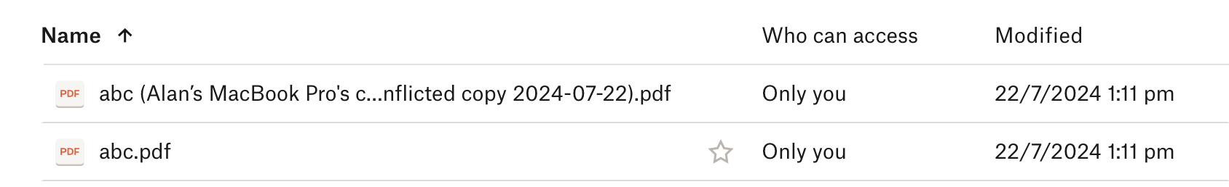
Figure 12.19. Dropbox manages conflicts by duplicating the file
Notes:
Screenshot of Dropbox folder contents. In the folder are two files updated at the same moment (on different machines).
One file is labelled “abc.pdf”.
The other file is labelled “abc (Alan’s MacBook Pro’s conflicted copy 2024-07-22).pdf”.

Slide 42
Figure 12.20 Dynamic pointers from Dix (1995)
Notes:
Scenario with shared document fragments. Cursors are denoted [A] and [B] and the document fragments are surrounded in the following description by ==.
Imagine two users, Adonis and Beatrice.
They are working using a shared editor and their current document reads:
== Adonis is [A] and Beatrice is [B] ==.
The sentence is partial and both users are about to type in their prime personal characteristic in order to complete it.
Adonis' insertion point is denoted by the boxed [A] and Beatrice's insertion point is the boxed [B].
Beatrice types first yielding:
== Adonis is [A] and Beatrice is beautiful [B] ==.
Adonis then types 'adorable', but unfortunately the implementor of the group editor was not very expert and the resulting display was:
== Adonis is adorable [A] and Beatrice is [B] beautiful ==.
Beatrice's insertion point followed the 36th character before Adonis' insertion, and still followed the 36th character afterwards.
Reasonable but wrong! The actual text should clearly read:
== Adonis is adorable [A] and Beatrice is beautiful [B] ==.
This correct behaviour is called a dynamic pointer as opposed to the static pointer 'character position 36'.

Slide 43
operation transform
given preference
e.g. earlier timestamp
a Insert texta at location n
b Insert textb at location m
b’. | if (m < n) insert textb at location m | (i)
 | if (m = n) insert textb at location m | (ii)
 | if (m > n) insert textb at location m + length(texta) | (iii)

Slide 44
a Insert texta at location n
b Insert textb at location m
but decide to give insert a preference, then we have to transform b to b’ as follows:
b’. | if (m < n) insert textb at location m | (i)
 | if (m = n) insert textb at location m | (ii)
 | if (m > n) insert textb at location m + length(texta) | (iii)

Slide 45
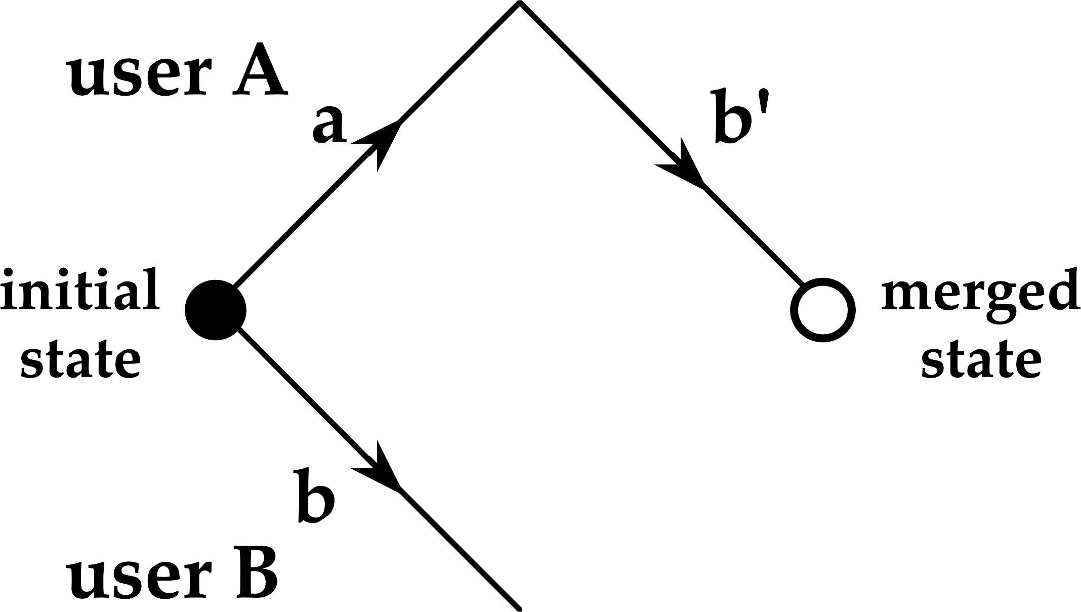
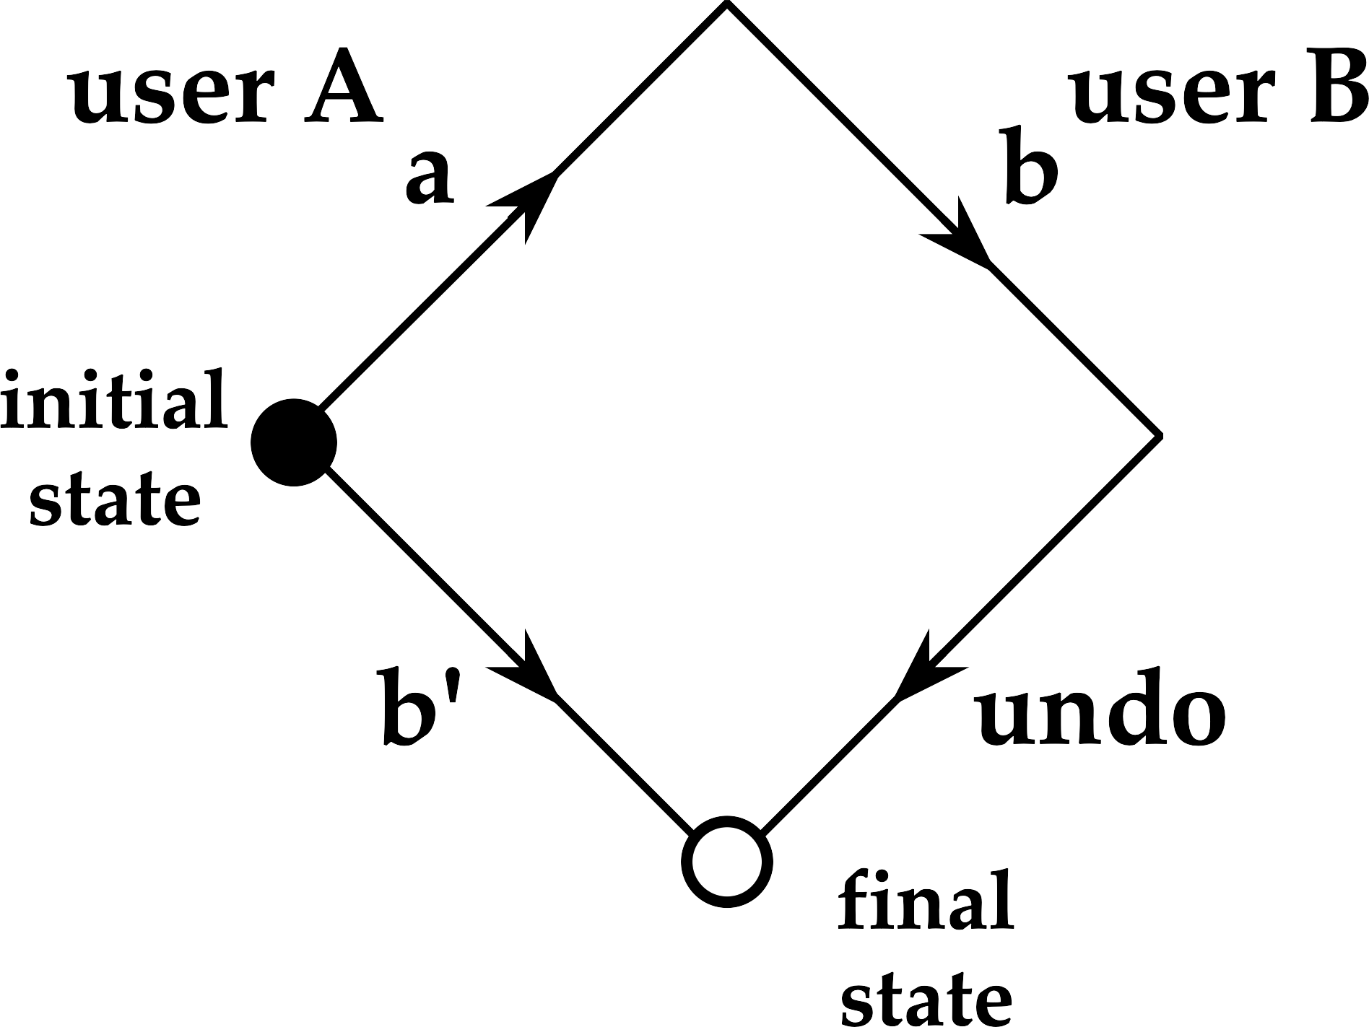
Figure 12.21. Multiuser transformations: (left) optimistic concurrency, (right) group undo.
Notes:
Two diagrams related to multiuser transformations.
On the left, optimistic concurrency: There is an initial state with two arrows from it, one labelled with an action “a” performed by user A; the other an action “b” performed by user B. At the end of the arrow labelled “a” is a second arrow, labelled “b’” (b prime), which leads to a merged state. The action b prime denotes the transformation of “b” to operate after “a”.
On the right, group undo: Going clockwise from the initial state are three arrows, the first labelled with an action “a” performed by user A, followed by an action “b” performed by user B, and this is then followed by the third arrow labelled “undo” leading to a final state. There is also a single arrow from the initial state to the final state labelled “b’” (b prime), which in this diagram denotes the transformation of “b” to operate as if “a” had never happened.

Slide 46

Figure 12.22. Eventual consistency in cloud infrastructure may lead to temporary inconsistency in the user interface
update sent to
server A in
cloud
2
1
A
user creates new
data item in
left-hand pane
B
3
4
cloud
servers may
take some time
to synchronise
with one
another
update to
right-hand pane
may take some time
leading to temporary
inconsistency in UI
Notes:
This shows four steps in a cloud update. On the right a laptop is shown, with two window panes side by side and on the left cloud storage with two disks labelled A and B.
Step (1) labelling the laptop: user creates new data item in left-hand pane.
Step (2) labelling an arrow from the laptop to cloud disk A: update sent to server A in cloud.
Step (3) labelling an arrow from cloud disk A to cloud disk B: cloud servers may take some time to synchronise with one another.
Step (4) labelling an arrow from cloud disk B to the laptop: update to right-hand pane may take some time leading to temporary inconsistency in UI.

Slide 47
Figure 12.23. SOAP XML encoding of Lookup (“Hello World”).
Notes:
Fragment of SOAP encoding of a RPC call Lookup(“Hello World”). It consists of fourteen lines starting “<SOAP-ENV:Envelope”, including several referencing standard schemas for the XML encoding. There are eight lines before the line that says xmlns:ns1 = “Lookup”.

Slide 48
Figure 12.24. JSON encoding of Lookup ("Hello World").
{
"op": "Lookup",
"args": {
"search_term": "Hello World"
}
}
Notes:
Fragment of JSON encoded data that says: { "op": "Lookup", "args": { "search_term": "Hello World” } }

Slide 49
12.7 Networks and Society
12.7.1 Digital Inclusion
12.7.2 Internet Speed
12.7.3 Porous borders
12.7.4 Local and Global
12.7.5 Social structures
12.7.6 Information and Misinformation
12.7.7 Resilience and Fragility
12.7.8 Environmental impact

Slide 50
12.8 Progress and Futures
Notes:
12.8 Progress and Futures

