Slide 1
AI for HCI – Chapter 1
Introduction
1.1 What is Artificial Intelligence?
1.2 What is Human–Computer Interaction?
1.3 Coming Together
1.4 Is AI special?
1.5 An AI and HCI Framework
1.6 Structure of the book
Notes:
1 Introduction
1.1 What is Artificial Intelligence?
1.2 What is Human–Computer Interaction?
1.3 Coming Together
1.4 Is AI special?
1.5 An AI and HCI Framework
1.6 Structure of the book

Slide 2
1.1 What is Artificial Intelligence?

Slide 3
what is AI?
any algorithmic technique that gives rise to
behaviour one might regard as ‘clever’
traditional AI
  largely hand-written sets of rules or patterns, executed by some form of reasoning engine
machine learning
  examples are analysed by an algorithm
  includes neural networks and LLMs
statistical techniques
  often involving matrix algebra or Bayesian analysis
  may be ‘unreasonably effective’

Slide 4
EU Definition
European Union AI Act – Article 3: Definitions
  https://artificialintelligenceact.eu/article/3/
  (1) ‘AI system’ means a machine-based system that is designed to operate with varying levels of autonomy and that may exhibit adaptiveness after deployment, and that, for explicit or implicit objectives, infers, from the input it receives, how to generate outputs such as predictions, content, recommendations, or decisions that can influence physical or virtual environments;

Slide 5
human like?
… or Alien Intelligence?
intelligent but ‘not as we know it
e.g. computer chess
complementing human intelligence

Slide 6
1.2 What is Human–Computer Interaction?

Slide 7
what is HCI?
academic study
  how humans (individually or collectively)
  experience computer technology
design discipline
  how to make systems
  that work better for people

Slide 8
three facets
core early terms, codified in ISO standards
effectiveness
  can users achieve their goals
efficiency
  can they do so with minimal effort
satisfaction
  do they feel happy doing this
  (or at least without discomfort)

Slide 9
1.3 Coming Together

Slide 10
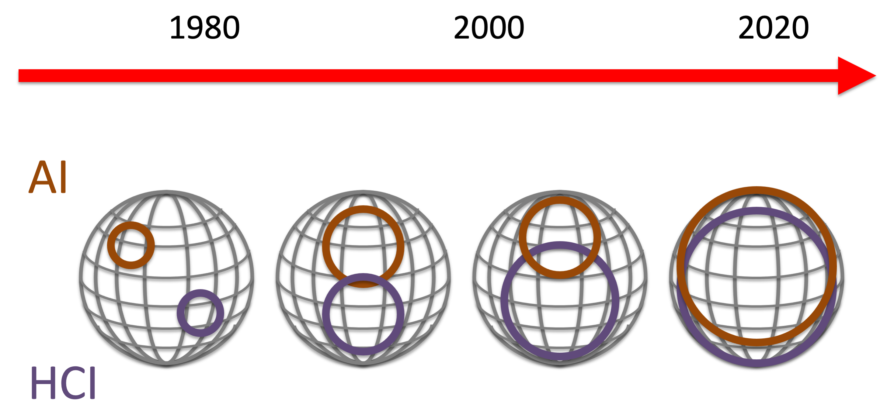
coming together
long pedigrees: first HCI paper 1959, AI early 1950s
early links through cognitive science
HCI-AI workshops in early 1990s
now both ubiquitous and intertwined

Slide 11
1.4 Is AI special?

Slide 12
just another technology?
radical changes historically
    fire, wheel, internal combustion engine, television
  new technologies build on:
    understanding of old technologies:
    basic human capabilities
digital technology sufficiently different
=> HCI as separate discipline
old rules and methods still apply to AI:
    understand users & context, ethnography,
    co-design, effective & enjoyable use, …
  but also …

Slide 13
is AI different?
the three Cs:
complexity
(un)certainty
co-adaptation

Slide 14
good AI+HCI
not about developing the most accurate AI
but creating the most effective and enjoyable
overall human-AI
socio-technical system

Slide 15
1.5 An AI and HCI Framework

Slide 16
AI and User Interaction
Ethics
Intelligent
Interfaces
HCI for AI
Rich Systems
Human
like
Computing
Big Data
and Evaluation
Interfaces
for AI developers
Social Justice
Governance

Slide 17
intelligent interfaces
appropriate intelligence
AI & error
Ethics
Intelligent
Interfaces
HCI for AI
Rich Systems
Intelligent
Interfaces
Human
like
Computing
Big Data
and Evaluation
Interfaces
for AI developers
Social Justice
Governance

Slide 18
Ethics
Intelligent
Interfaces
HCI for AI
Rich Systems
Human
like
Computing
Big Data
and Evaluation
Interfaces
for AI developers
Big Data
and Evaluation
A-B testing
layout design
surrogate users
heuristics & guidelines
Governance
Social Justice

Slide 19
autonomous vehicles
smart houses
using ChatGPT
Ethics
HCI for AI
Rich Systems
Intelligent
Interfaces
HCI for AI
Rich Systems
Human
like
Computing
Big Data
and Evaluation
Interfaces
for AI developers
Social Justice
Governance

Slide 20
Ethics
Intelligent
Interfaces
HCI for AI
Rich Systems
Human
like
Computing
Interfaces
for AI developers
Big Data
and Evaluation
Interfaces
for AI developers
Social Justice
Governance
XAI
visualization
hidden values

Slide 21
front-end
user-facing
Ethics
Intelligent
Interfaces
HCI for AI
Rich Systems
UI
helping
AI
AI
helping
UI
Human
like
Computing
Big Data
and Evaluation
Interfaces
for AI developers
Social Justice
Governance
back-end
developer-facing

Slide 22
AI behaving more like humans
to improve AI and H-AI
explainable AI
Ethics
Intelligent
Interfaces
HCI for AI
Rich Systems
Human
like
Computing
Human
like
Computing
Big Data
and Evaluation
Interfaces
for AI developers
Social Justice
Governance

Slide 23
all tech in a social, political and organizational context
ethics, smart weapons
legal accountability
social justice
bias
Ethics
Intelligent
Interfaces
HCI for AI
Rich Systems
Human
like
Computing
Big Data
and Evaluation
Interfaces
for AI developers
Social Justice
Governance

Slide 24
1.6 Structure of the book

Slide 25
rest of the book …
2 AI in the User Interface
3 User Interfaces for AI-Rich Systems
4 Synergy
5 What happens when it all goes wrong
6 AI Behind the Scenes in UX/IxD
7 HCI for backend AI developers
8 Human-life Computing
9 Wider Context

Slide 26
Key Points

Slide 27
key points
AI includes:
  traditional AI (symbolic); machine learning esp. neural networks (sub-symbolic); and statistical techniques
AI is Alien Intelligence.
HCI both academic study and practical design
practical HCI design three facets:
  effectiveness (can you do what you want?)
  efficiency (can you do it easily?)
  satisfaction (is it enjoyable or without discomfort?).
AI and HCI converging
  both needed in almost every computer systems
AI systems typically involve the three Cs:
  complexity, (un)certainty and coadaptation

