Slide 1
AI for HCI – Chapter 2
AI in the User Interface
2.1 Introduction
  2.1.1 Why use AI?
  2.1.2 Dimensions of use
2.2 Invisible AI – natural user interfaces and augmentation
2.3 Explicit interaction with AI
  2.3.1 Task inference
  2.3.2 Deterministic ground
  2.3.3 Appropriate Intelligence
  2.3.4 Case study: onCue – designing for Appropriate Intelligence
2.4 Evaluating intelligent interfaces
Notes:
2 AI in the User Interface
2.1 Introduction
2.1.1 Why use AI?
2.1.2 Dimensions of use
2.2 Invisible AI – natural user interfaces and augmentation
2.3 Explicit interaction with AI
2.3.1 Task inference
2.3.2 Deterministic ground
2.3.3 Appropriate Intelligence
2.3.4 Case study: onCue – designing for Appropriate Intelligence
2.4 Evaluating intelligent interfaces

Slide 2
2.1 Introduction
2.1.1 Why use AI?
2.1.2 Dimensions of use
Notes:
2.1.1 Why use AI?
2.1.2 Dimensions of use

Slide 3
why use AI
To improve the user – augmenting human abilities
To increase comfort – e.g. active suspension in a car
To support the user – e.g. adaptive keyboards
To protect the user – inc. safety and security
To support usability of interactive systems – e.g. notification timing
To replace some activity of the user – e.g. SPAM detection
To entertain the user – e.g. AI opponents
To increase context of use – e.g. instrument landing in planes
To go beyond user capabilities – e.g. large calculations
To detect and prevent user errors – e.g. ABS
AVI’2020 Philippe Palanque

Slide 4
dimensions of use
level of exposure
  low-level – under the bonnet, e.g. speech recognition
  high level – clear part of the interface, e.g. recommender system
level of intention:
  explicit – deliberate user action, e.g. press a button
  implicit (direct) – ordinary-like action wit meaning, e.g. gestural UI
  expected – knows what will happen, but not purpose, e.g. automatic doors
  incidental (pure) – unknown, or not considered side effect, e.g. profiles

Slide 5
continuum of purpose
intentional
explicit
press light switch
implicit
tip e-reader to turn page
expected
walk into room expecting lights to switch on
incidental
walk into room … unbeknown to you
… air conditioning increases

Slide 6
2.2 Invisible AI – natural user interfaces and augmentation

Slide 7
natural user interface
gestures, bodily movements
AI at multiple levels
  low-level touch detection of touch, position of fingers
  often device drivers or OS
  gesture recognition
  partly in toolkits, may need rule based or NN
… but not always ‘natural’
  becomes invisible after use
  few truly natural gestures, so need to be learnt
  scaffold learning or let users define their own?

Slide 8
2.3 Explicit interaction with AI
2.3.1 Task inference
2.3.2 Deterministic ground
2.3.3 Appropriate Intelligence
2.3.4 Case study: onCue – designing for Appropriate Intelligence
Notes:
2.3.1 Task inference
2.3.2 Deterministic ground
2.3.3 Appropriate Intelligence
2.3.4 Case study: onCue – designing for Appropriate Intelligence

Slide 9
the interaction cycle
deciding what to do and doing it
  (planning and executing an action)
  Norman’s gulf of execution
feedback and visibility – did it do what was expected?
  (understanding the system response)
  Norman’s gulf of evaluation
checking and fixing things
  (dealing with errors – Ch:5)
AI complexity makes (1) and (2) harder

Slide 10
task inference

Slide 11
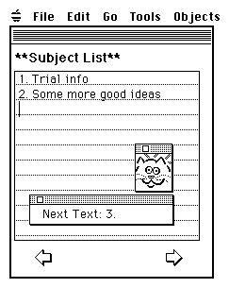
EAGER – early system
intelligence was embodied
  only affected other entities
  in the user interface
  when requested;
only made suggestions
  when it made a mistake
  it could simply be ignored.

Slide 12
general heuristics …
deterministic ground
  knowing what may change
appropriate intelligence
  what happens when it all goes wrong

Slide 13
deterministic ground

Slide 14
deterministic ground ... for menus
Message
adaptive area
most popular/likely at top
quick when it gets it right
David
Mary
Florence
Adrian
Andy
Brian
Charlotte
Colin
David
Devina
. . .
deterministic ground
alphabetic below
still easy to scan when it isn’t

Slide 15
deterministic ground ... for menus
… another option
Message
Adrian
Andy
Brian
Charlotte
Colin
David
Devina
Elizabeth
Florence
George
. . .
deterministic ground
overall order
always alphabetic
adaptive aspect
highlight most popular/likely items

Slide 16
appropriate intelligence

Slide 17
rules of standard AI interfaces
it should be right as often as possible
when it is right it should be good
good for demos
look how clever it is!

Slide 18
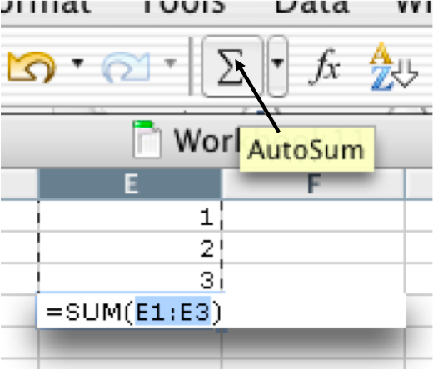

rules of appropriate intelligence
it should be right as often as possible
when it is right it should be good
when it isn’t right ...
it shouldn’t mess you up
what makes a system really work!
✗
✔

Slide 19
Case study: onCue designing for appropriate intelligence

Slide 20


onCue
intelligent ‘context sensitive’ toolbar
sits at side of the screen
watches clipboard for cut/copy
suggests useful things to do
with copied date

Slide 21
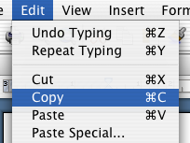

onCue (dot com days!)
intelligent ‘context sensitive’ toolbar
user selects text
20 21 22 23
25 24 20 17
7 7 3 7
the dancing histograms very useful a
ing out some of the textile sites yo
x's page at http://www.hiraeth.com/
and copies it to clipboard
icons slowly fade in
histograms

Slide 22
2.4 Evaluating intelligent interfaces

Slide 23
special challenges of AI in UI
complexity
  unfamiliarity and rapid change
  use Wizard of Oz or expensive (now) ‘lash ups’
(un)certainty
  stochastic nature of AI
  => repeatability hard, variability high
  use expert evaluation, blend justification and targeted empirical
co-adaptation
  ML & user adjusting, benefits need scale
  => short-term evaluations problematic
  possible to measure shirt-term gains
  … but maybe novelty effects or idea of AI

Slide 24
a cautionary tale …
many years ago experiment
  accordion style interface for hypertext-like code
  predictable vs intelligent versions
  intelligent won … but why?
  maybe just idea of ‘intelligent’
right to be cautions
  computers are social actors paradigm
    people polite to computers – maybe more so if AI?
  placebo effect when people think they are using AI!

Slide 25
Key Points

Slide 26
key points
AI in UI: improve usability, prevent human error and augment human capabilities.
AI low-level & invisible vs. apparent to user
intentional continuum – explicit to incidental
natural user interfaces – may need training
task inference – early UI+AI still important
adaptive systems need a deterministic ground
appropriate intelligence – overall AI+UI design

