Slide 1
AI for HCI – Chapter 3 User Interfaces for AI-Rich Systems
3.1 Introduction
3.2 Explicit digital interactions
3.3 Managing automation
3.4 Activity and context recognition
3.4.1 Types of sensors
3.4.2 Processing sensor data
3.5 Low-intention interaction
3.5.1 Designing for low-intention interaction
3.5.2 Dealing with uncertainty
3.5.3 Case study: The internet-enabled cafe-open sign
3.6 Evaluating low-intention systems
Notes:
3 User Interfaces for AI-Rich Systems
3.1 Introduction
3.2 Explicit digital interactions
3.3 Managing automation
3.4 Activity and context recognition
3.4.1 Types of sensors
3.4.2 Processing sensor data
3.5 Low-intention interaction
3.5.1 Designing for low-intention interaction
3.5.2 Dealing with uncertainty
3.5.3 Case study: The internet-enabled cafe-open sign
3.6 Evaluating low-intention systems

Slide 2
3.1 Introduction

Slide 3
AI at the forefront
automating human-controlled systems, e.g. autonomous car
new types of interactive experience, e.g. recommender systems
predominantly digital
decision support systems and visual analytics e.g. domains such as medicine, science, and energy management
recommender systems and social media helping those with minority interests … but filter bubbles and misinformation
physical world
autonomous systems affects humans – direct (e.g. drivers) and indirect (e.g. pedestrian)
smart homes, smart cities, IoT and sensing

Slide 4
3.2 Explicit digital interactions

Slide 5
AI explicit in the user interface
direct user action
explicit response to system-initiated suggestion

Slide 6
system suggestions
knowledge rich:
e.g. task inference, data detectors and named entity recognition
data rich:
e.g. recommender systems 3,000,000 x 3,000,000 matrices – need data reduction!
more of the same
=> filter bubbles – ‘left of field’ suggestions hard
not always right!
ChatGPT stupid mistakes – e.g. stick cheese to pizza with glue
HCI challenges – visualising uncertainty

Slide 7
directly invoking AI
user knows they have done it … but not what the exact result will be!
may be flexible
generative AI “tortoise riding a bicycle,” unknown image, but do expect a tortoise and bicycle
recommender system – can miss some results so long as most good
but may need to be precise
e.g. AI-powered personal finance system to fill out tax return

Slide 8
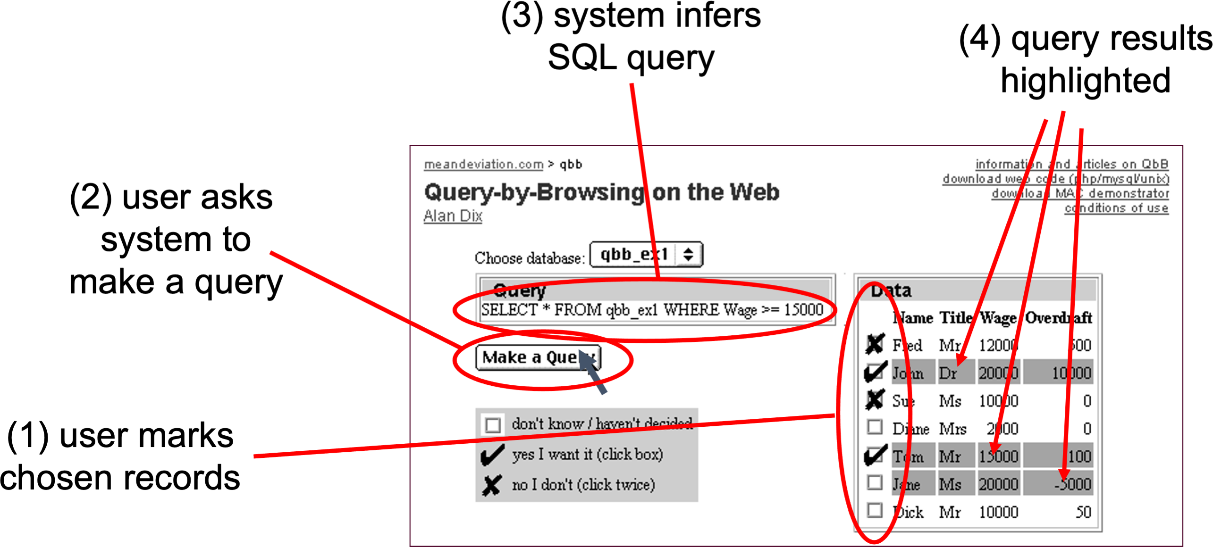
Query-by-Browsing
extensional
intensional

Slide 9
lessons
multiple representations
inc. intensional and extensional
users can recognise the right answer
if presented appropriately
AI answers may need to be tweaked
some things easier for user to set explicitly
a human–AI dialogue
e.g. when user selects additional examples from the listing

Slide 10
3.3 Managing automation

Slide 11
Managing automation
Expectability and predictability
Communicate options for interventions
Exploration of interventions
Easy reversal of automated and intervention actions
Minimize required attention
Communicate how control is shared
Schmidt and Herrmann (2017)
may need ‘forward’ error-correction

Slide 12
3.4 Activity and context recognition
3.4.1 Types of sensors
3.4.2 Processing sensor data
Notes:
3.4.1 Types of sensors
3.4.2 Processing sensor data

Slide 13
types of sensors
vision
off the shelf, low-cost cameras, unobtrusive … privacy?
dedicated sensors
fitness, smart watches – temp, gait, etc.
sound
privacy? needs early stage processing
eye-gaze
emotion detection
implicit attention (e.g. radiographers)
possible platform activity recognition API

Slide 14
processing sensor data
bottom-up pipeline:
sensor fusion from heterogeneous devices and sensors
differing volume, data rate, etc.
need data-type specific processing before fusion
e.g. Fourier transform, ML
maybe use activity recognition API
followed by explicit rules or ML
may also need top-down context, etc.
expected data volume critical to choices

Slide 15
3.5 Low-intention interaction

Slide 16
shopping cart
goods in shopping cart analysed
e.g. Amazon books
used to build knowledge about books
people who like X also like Y
used to give you suggestions
“you might like to look at …”, “special offer …”
my purpose to buy a book
incidentally shown related titles

Slide 17
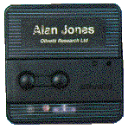
Pepys
Xerox Cambridge (RIP)
active badges
automatic diaries
Allan's purpose to visit Paul’s office
incidentally diary entry created

Slide 18
two tasks
sensed task (primary task)
current focus of attention
may directly include AI
supported task (secondary task)
supported by sensing
may be same or different user same or different time

Slide 19
intelligent system – data + AI
user interaction episodes
implicit interaction and context-sensitive interaction immediate use of sensing in the same episode
sensed task
‘primary’
supported task
‘secondary’
secondary task
may also be sensed for subsequent interactions
sensed data used to support subsequent episodes

Slide 20
designing for low-intention interaction
sensed task (primary task)
more complicated – users doesn’t know!
if aware may change behaviour e.g. Classroom2000
design to enhance peripheral awareness
benefits for others or diffuse – gamify
supported task (secondary task)
AI-augmented interface
existing IUI advice

Slide 21
design for uncertainty
sensed task (primary task)
minimise impact on user
user’s actions uncertain
=> analyse real user task ascertain likelihoods of states and reliability of sensors
maybe modify (see epistemic action) in extremis ask users
supported task (secondary task)
analyse for criticality/sensitivity of data
use appropriate intelligence

Slide 22
Case study: the internet-enabled cafe-open sign
sensed task – in the cafe
door reliable but impractical in situation
to café
café open sign
turned on and off by owners
add IoT sensing – need to analyse reliability
supported task – potential customers
web-based indicator – understand criticality
looks like real sign to signal potential uncertainty

Slide 23


sensed task – café sign
(vi) go home
café empty
(i) arrive at café
prepare to open
(a) forget sign
café open
(v) close café doors
tidying up
open sign off
(ii) switch on sign
(b) remember sign
(iv) switch off sign
(d) remember sign
open sign on
café empty
prepare to open
café open
tidying up
(iii) open café doors
(c) forget sign
key
consistent state:
likely path:
likely state:
inconsistent:
unlikely:
unlikely:

Slide 24
3.10 Evaluating low-intention systems

Slide 25
evaluation
sensed task (primary task)
does the sensing impact the interaction?
passive sensing => check privacy risk, etc.
modified UI => evaluate UI and assess cost
data gathered
assess quality
sensed activity valid for purpose, accuracy of sensors, reliability of infereences
supported task (secondary task)
analyse for criticality/sensitivity of data
use appropriate intelligence

Slide 26
Key Points

Slide 27
key points
some systems where AI is key element
purely digital systems and/or interaction with the physical world
digital interaction initiated by:
system suggestions – communicate effectively & include level of certainty
direct user actions – AI fills in details.
automated systems
need to be managed or monitored by a human
like digital systems, but reversal of actions requires forward error recovery
activity and context recognition:
from raw sensor data, => sensor fusion => rule based or ML-based inference
low-intention interactions two tasks: sensed and supported
may be same or different: tasks, times, or users.
sensed/supported distinction drives effective design and evaluation.
analyse sensed & supported tasks to design for uncertainty

