Slide 1
AI for HCI – Chapter 4
Synergy
4.1 Styles of collaboration
4.2 Who does what?
  4.2.1 Case study: Cut your cloth
  4.2.2 Task allocation and task migration
  4.2.3 Handover initiative
  4.2.4 Handover timing and passing control
4.3 Cooperation and mutual adaptation
  4.3.1 Adapting AI for interaction
  4.3.2 Case study: matching records for musicology
  4.3.3 Adapting interaction for AI
  4.3.4 Case study: epistemic action for search results
4.4 Trust and over-reliance
Notes:
4 Synergy
4.1 Styles of collaboration
4.2 Who does what?
4.2.1 Case study: Cut your cloth
4.2.2 Task allocation and task migration
4.2.3 Handover initiative
4.2.4 Handover timing and passing control
4.3 Cooperation and mutual adaptation
4.3.1 Adapting AI for interaction
4.3.2 Case study: matching records for musicology
4.3.3 Adapting interaction for AI
4.3.4 Case study: epistemic action for search results
4.4 Trust and over-reliance

Slide 2
4.1 Styles of collaboration

Slide 3
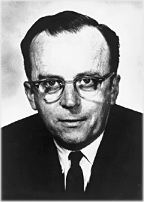
styles of collaboration
Servant – we tell AI what to do (explicitly)
Master – AI tells us what to do, e.g. Uber
Synergistic – using complementary abilities
“Man-Computer Symbiosis”
J. C. R. Licklider, March 1960
N.B. boundaries may be blurred
– e.g. maps interfaces, recommendations
Notes:
https://commons.wikimedia.org/wiki/File:J._C._R._Licklider.jpg

Slide 4
4.2 Who does what?
4.2.1 Case study: Cut your cloth
4.2.2 Task allocation and task migration
4.2.3 Handover initiative
4.2.4 Handover timing and passing control

Slide 5
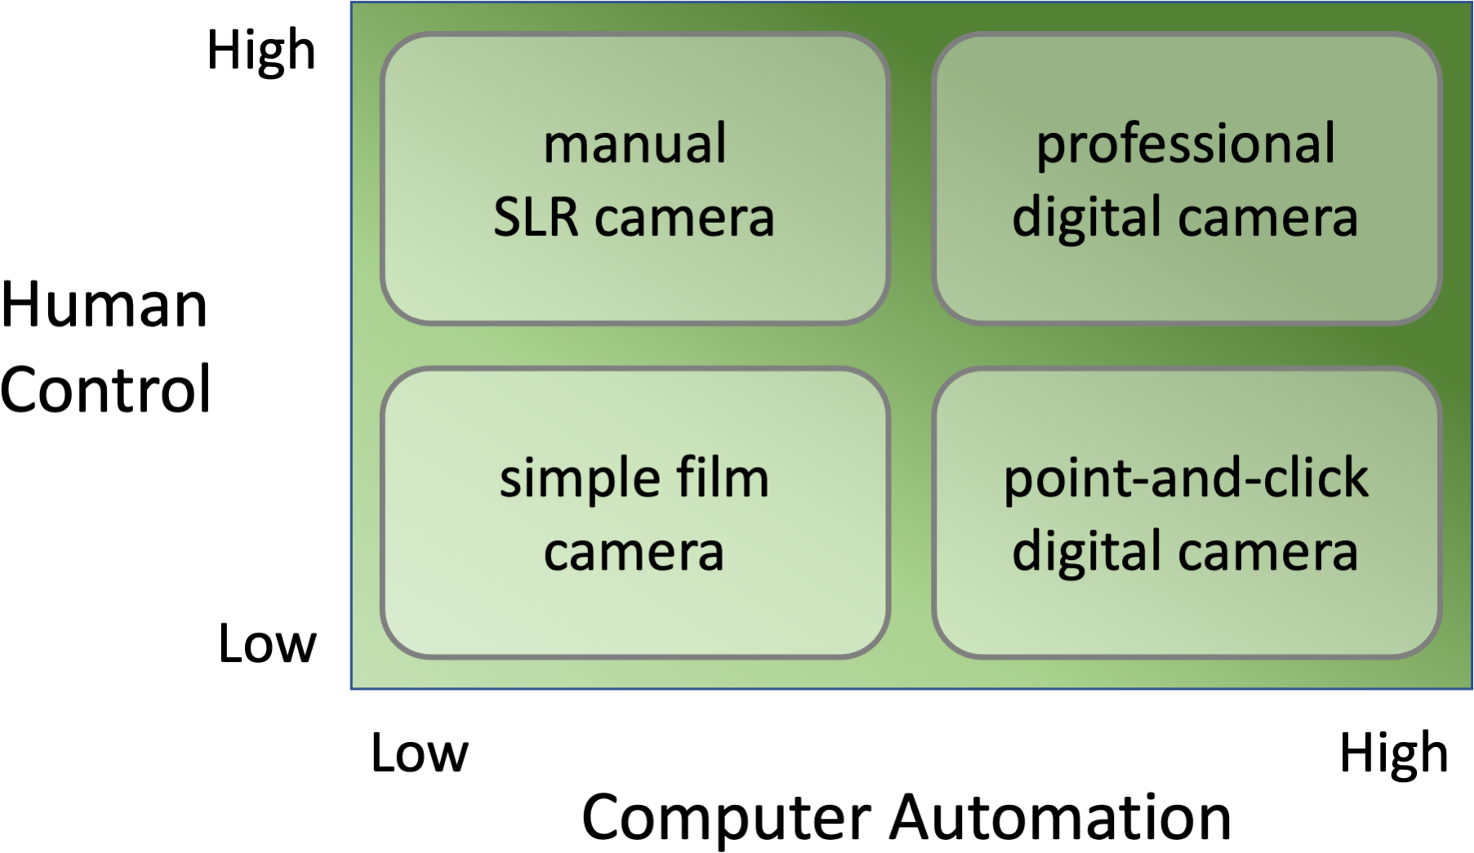
Shneiderman's human–centred
AI framework
Notes:
19.1 Shneiderman's two-dimensional human--centred AI framework. 297
human/shneiderman-levels.png

Slide 6
case study: cut your cloth
Benetton early 1970s
existing process
  pile of cloth stamped out like giant cake cutter
  pattern arrangers lay out pieces to optimise cloth use
new NC cutters
  possible to plan multiple garments in same cutting
  too complex for pattern arrangers
solution
  computer ‘jiggles to fit
  human spots opportunities for large scale changes

Slide 7
task allocation and task migration
from adaptive websites to semi-autonomous cars ...
think about abilities (function allocation)
  rote vs creative
  pattern finding vs interpretation
  some clear human/AI, some could be either
balance may change (dynamic function allocation)
  environment, attention, stress,
  task migration
  think about handover

Slide 8
handover initiative
who decides to handover?
explicit human action e.g. cruse control, auto-pilot
  handing back?
    N.B. cruise control still not consistent ☹
  may be partial
    e.g. tell car to take the coast road
system initiative
  system to user – is user ready?
  learning to defer (condescend!)
    system decides who knows best!

Slide 9
timing and passing control
if AI makes the decision when control exchanged
  user => system – when user sleepy, etc.
  system => user – when too difficult for AI!
managing system to user
  physical handover e.g. slow force on steering wheel
  regaining situational awareness
    aids to refocus, but beware automation bias
  not at the last moment!
    allow user time to reorientate
    predict possible handover ahead of time
    also approprpriate pace of notifications in digital system

Slide 10
4.3 Cooperation and mutual adaptation
4.3.1 Adapting AI for interaction
4.3.2 Case study: matching records for musicology
4.3.3 Adapting interaction for AI
4.3.4 Case study: epistemic action for search results
Notes:
4.3.1 Adapting AI for interaction
4.3.2 Case study: matching records for musicology
4.3.3 Adapting interaction for AI
4.3.4 Case study: epistemic action for search results

Slide 11
synergy cooperation and adaptation
AI
adapting AI for human interaction
adapting user interfaces for AI

Slide 12
adapting AI for interaction
full automation – best/safe
human in the loop – suggest and inform
not just
‘best’
confidence &
explainability

Slide 13
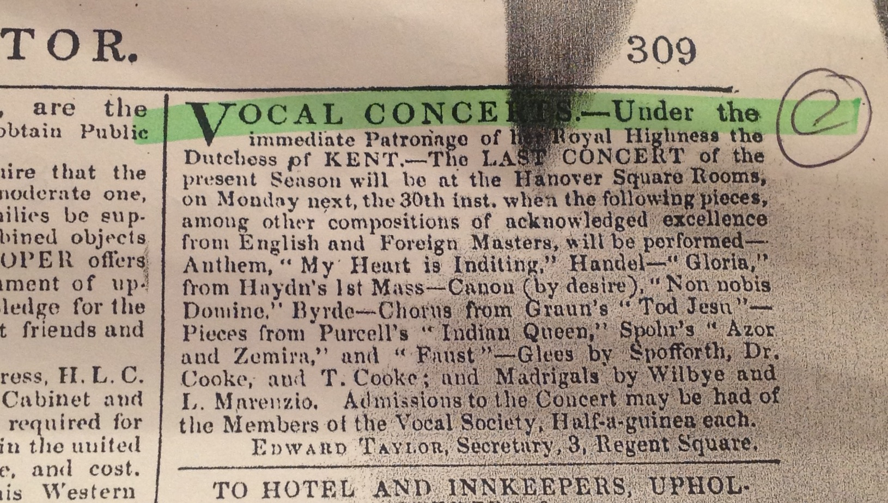
case study: matching records for musicology

Slide 14
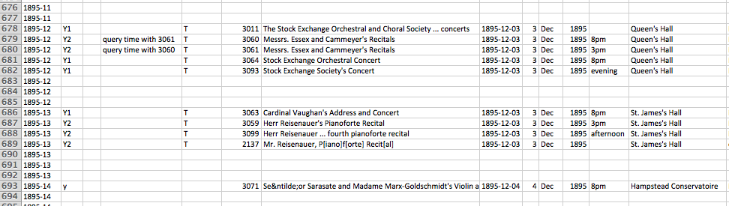
collating notices
  several newspaper notices for each concert
  semi-automated grouping:
– liberal suggestions
– conservative warnings

Slide 15
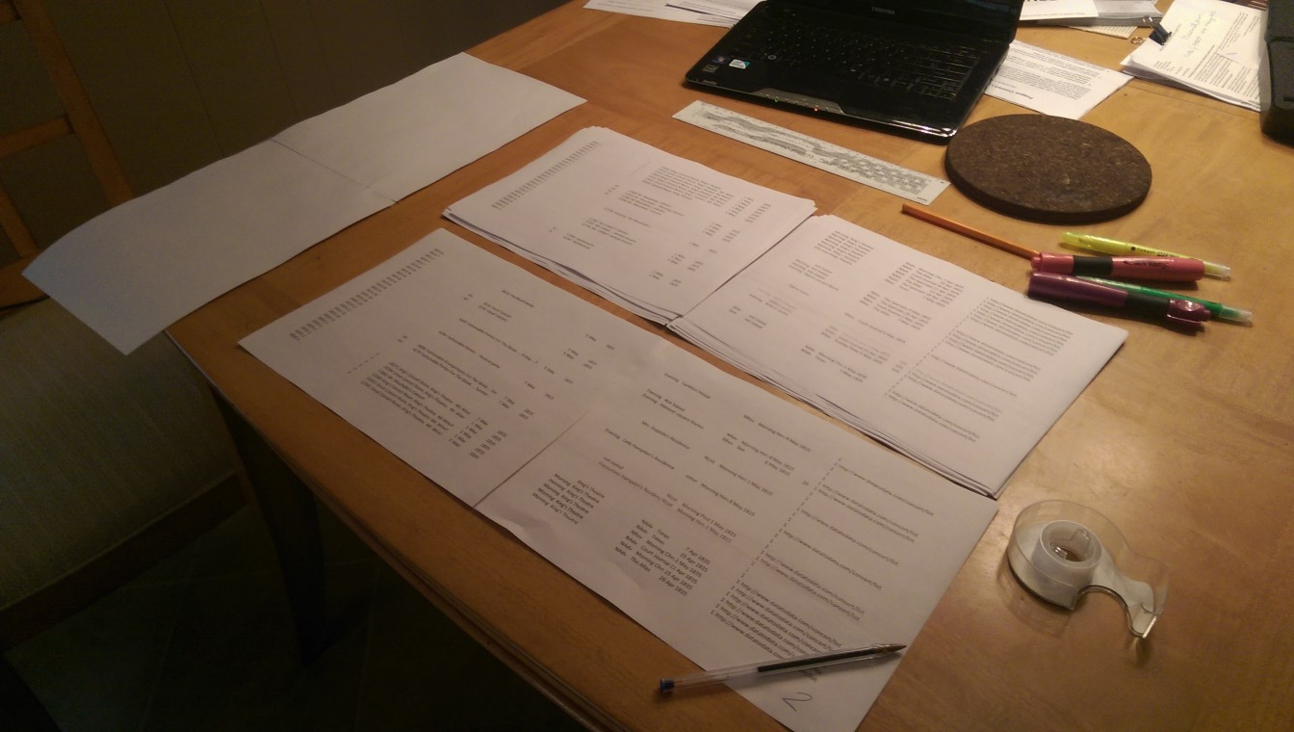
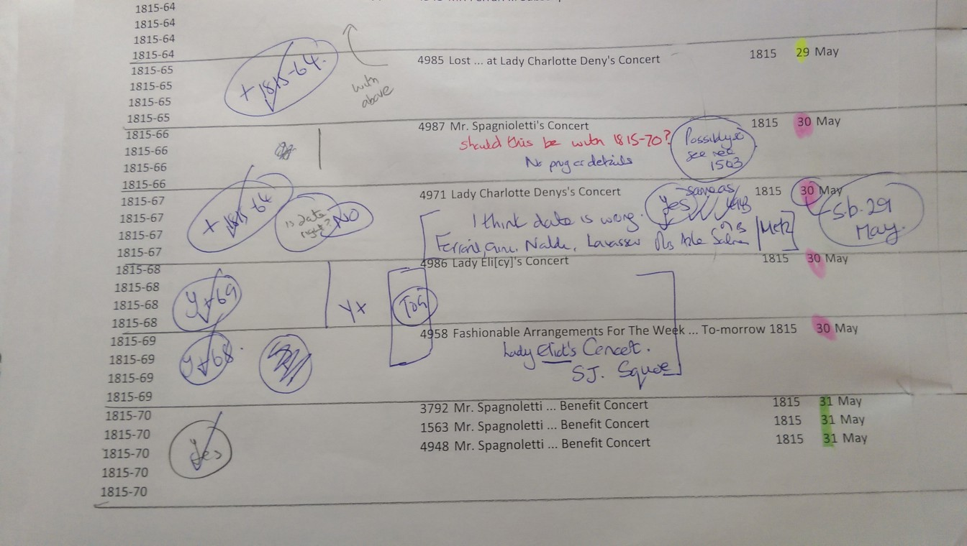

Slide 16
adapting interaction for AI
‘best’ UI – short term gain
epistemic interaction – long term gains
Notes:
Lawrence Alma-Tadema's water-colour of an ambivalent Pandora, 1881
https://en.wikipedia.org/wiki/Pandora%27s_box#/media/File:Lawrence_Alma-Tadema_10.jpeg
https://www.publicdomainpictures.net/en/view-image.php?image=82495&picture=cat-peeking-around-corner

Slide 17
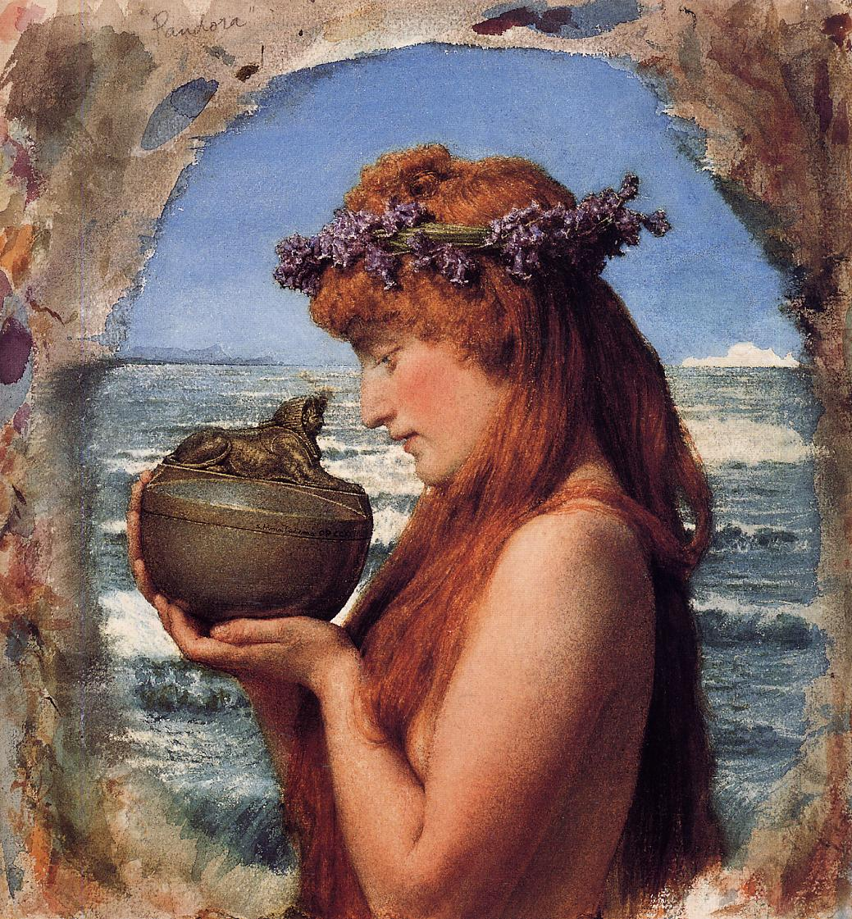
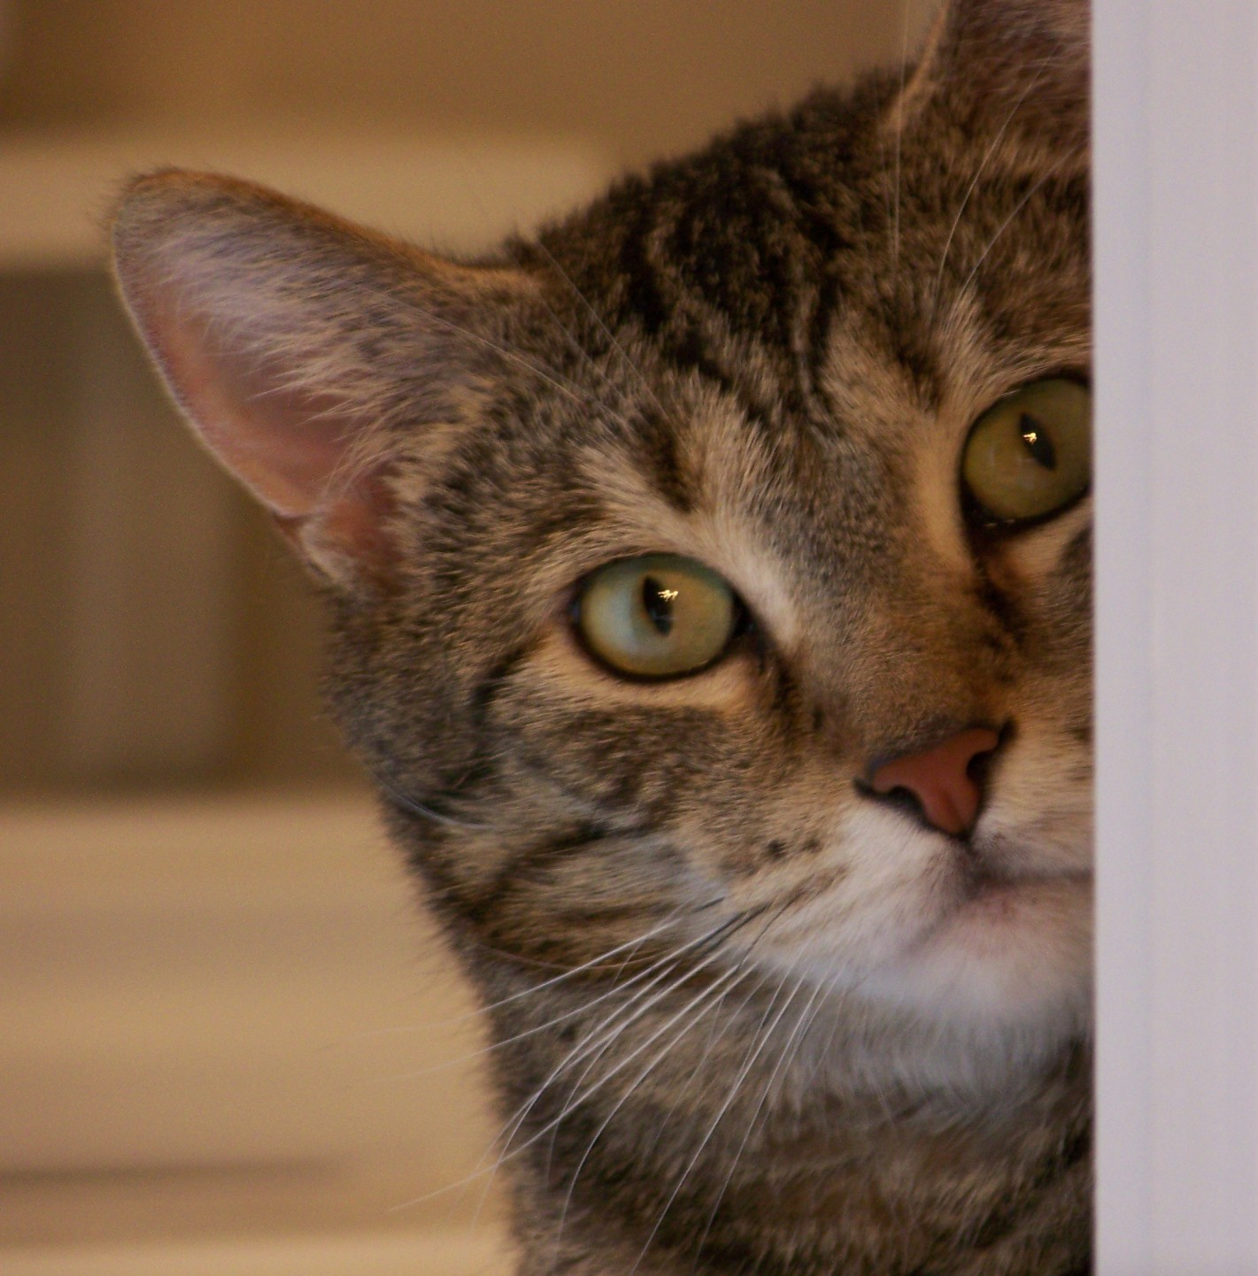
epistemic action
wondering
what’s inside?
just
peek
Notes:
Lawrence Alma-Tadema's water-colour of an ambivalent Pandora, 1881
https://en.wikipedia.org/wiki/Pandora%27s_box#/media/File:Lawrence_Alma-Tadema_10.jpeg
https://www.publicdomainpictures.net/en/view-image.php?image=82495&picture=cat-peeking-around-corner

Slide 18
epistemic interaction
redesign user interactions
to make more information available
for machine adaptation

Slide 19

“currently
heating” icon
target
temperature
20°
17°
current
temperature
temperature
setting buttons

Slide 20

“I want it
warmer”
button
“I want it
cooler”
button

Slide 21
more information
for adaptation
20°
17°

Slide 22
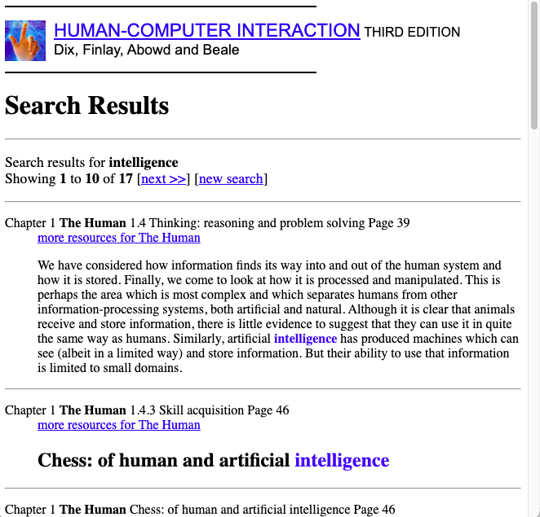
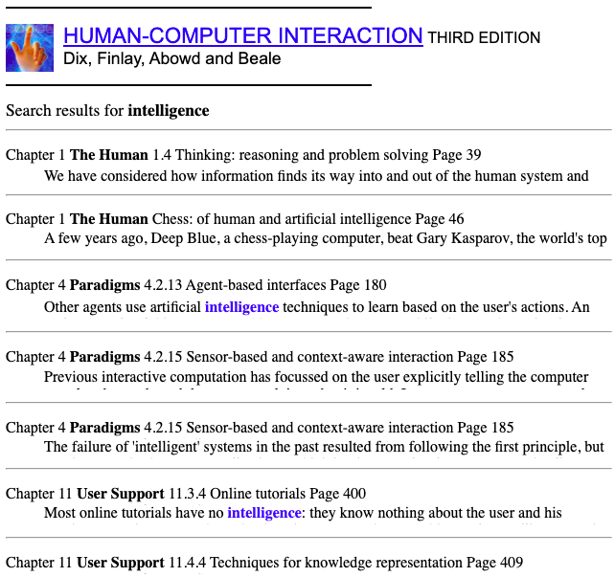
case study: epistemic action for search results

Slide 23
document results – option 1 – scroll
scroll down
to see
more results

Slide 24
document results – option 2 – accordion
press ‘+’
to expand
interesting
items

Slide 25
which option? – epistemic interaction …
A-B user testing
scroll a little better
scroll
accordion
accordion gives more data
for AI adaptation

Slide 26
4.4 Trust and over-reliance

Slide 27
mutual ‘trust’ required for synergistic interactions
trust is multifaceted:
trust in the good intentions of the person
(sometimes called moral trust)
trust in the predictable intentions of the person
(not necessarily good)
trust in their ability to carry them out
(skills, knowledge, opportunity)
trust as manifest in one relying on another agent.
should be appropriate (warranted trust)
  user’s trust in AI:
  automation bias and communicating reliability
  AI’s trust in user:
  capabilities and frailties … learning to defer

Slide 28
Key Points

Slide 29
key points
who is the master? human, AI or synergistic
human control high – automation high – or both
who (human or AI) does what?
  consider abilities, handover, situational awareness
AI may need to adapt for UI
  not best solution, but suggest and inform.
UI may also need to adapt for AI
  epistemic interaction provides better info for AI.
appropriate (warranted) trust critical
  avoid automation bias
  communicate uncertainty and ‘learn to defer’

