Slide 1
AI for HCI – Chapter 8 Human-life Computing
8.1 Chatbots and conversational user interfaces
8.2 Navigating the uncanny valley
8.3 Explainable AI
8.3.1 Global and local explanations
8.3.2 White-box, black-box and grey box methods
8.3.3 Training and execution
Notes:
8 Human-life Computing
8.1 Chatbots and conversational user interfaces
8.2 Navigating the uncanny valley
8.3 Explainable AI
8.3.1 Global and local explanations
8.3.2 White-box, black-box and grey box methods
8.3.3 Training and execution

Slide 2
human-like computing
AI inspired by human intelligence
NN very low-level & needs large datasets
small datasets and single-shot learning
AI that works better with humans
human-like behaviour
not necessarily internally
more acceptable for humans
e.g. care situations
focus here

Slide 3
8.1 Chatbots and conversational user interfaces

Slide 4
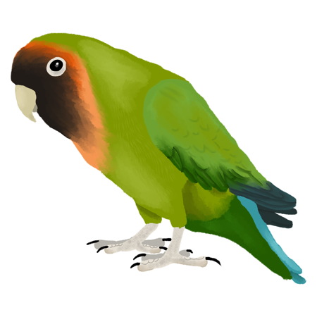
talking with computers
long history: Eliza and HAL and Turing test
text chatbots
early chatbots: scripts and pattern matching
now LLMs … stochastic parrots
speech
early envisionments – Phone Slave (1984/5)
home automation –
limited vocabulary but speech recognition adds uncertainty
https://commons.wikimedia.org/w/index.php?curid=157529682
Notes:
By Di (they-them) - Own work, CC BY-SA 4.0, https://commons.wikimedia.org/w/index.php?curid=157529682
https://www.youtube.com/watch?v=xNM_5JKvjok

Slide 5
conversational interfaces
emulate human techniques such as echoing
“let’s go out to the [unclear] to see a film” … “great idea, the new Bond film is on at the Plaza”
match domain and technology
e.g. Eliza and Rogerian therapy
home automation – limited core vocabulary
adaptations
AI – speaker independent vs speaker dependent
humans – speak more clearly to help AI (often unconscious)

Slide 6
blurring the boundaries
simple AI with a human face
Ask Jeeves (early web search) question format => more search terms => better results
complex AI with human backup
single chatbot sometimes automated sometimes human can shift from utterance to utterance
user may not realise … ethics?

Slide 7
8.2 Navigating the uncanny valley

Slide 8
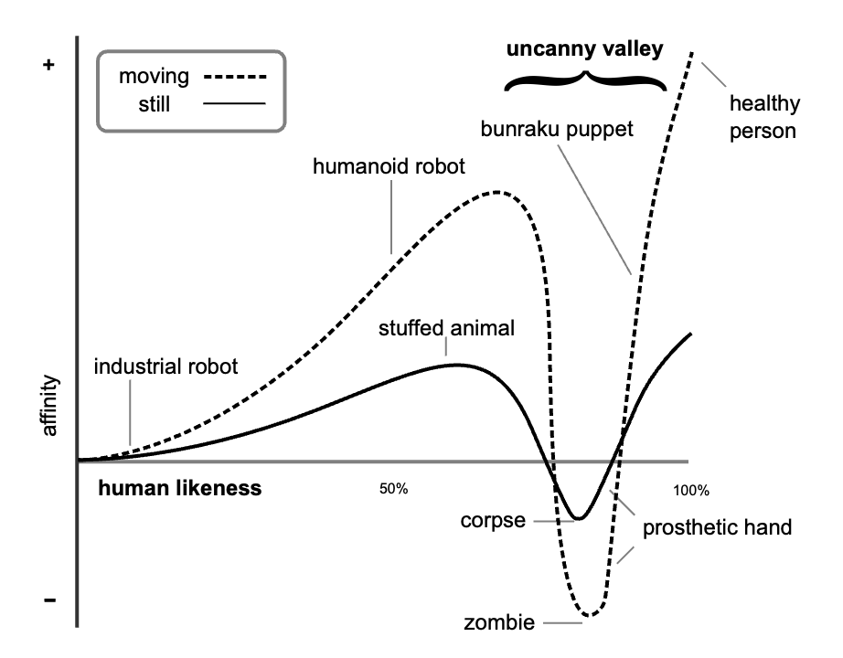
uncanny valley (from Japanese, ‘Bukimi no tani’)
coined by roboticist Masahiro Mori
robots (and puppets):
more and more human-life => better and better
until …
the point when they became scary or just weird
Notes:
By Smurrayinchester - self-made, based on image by Masahiro Mori and Karl MacDorman at http://www.androidscience.com/theuncannyvalley/proceedings2005/uncannyvalley.html (archive), CC BY-SA 3.0, https://commons.wikimedia.org/w/index.php?curid=2041097
https://commons.wikimedia.org/wiki/File:Mori_Uncanny_Valley.svg

Slide 9
not just robots
is that a human helpdesk or a chatbot?
will AI familiarity change picture?
before the chasm – more human is better
e.g. Peiris in 1990s, clinical consultations for difficult topics
form before consultation → easier to be frank
paper forms → automated forms → chatbot
the more human the more honest
chatbot = simple script plus topic model
so much easier now with LLMs!

Slide 10
8.3 Explainable AI
8.3.1 Global and local explanations
8.3.2 White-box, black-box and grey box methods
8.3.3 Training and execution
Notes:
8.3.1 Global and local explanations
8.3.2 White-box, black-box and grey box methods
8.3.3 Training and execution

Slide 11
why do we need XAI?
bias
racist chatbots and biased algorithms
de-bias training data – hard to do and not sufficient
more transparency – explain rules or ML
dealing with failure
e.g autonomous vehicle accidents => need to ask why?
legislation
e.g. EU ‘right to an explanation’

Slide 12
what is an explanation?
sufficient reason
e.g. justifying lunch choice: “I’ll just have a salad as I had a big breakfast”.
multi-billion parameter NN don’t want a weight-by-weight analysis
XAI visualisations or models 3 dimensions:
global model vs. local point explanation
level of knowledge from white box to black box
training process vs rules for execution

Slide 13
global and local explanations
global explanation
behaviour of the system as a whole
e.g. drop feature to assess importance
– for image see which pixels most critical
local explanation
why this specific decision
e.g. local perturbations => local models

Slide 14

white-box
black-box
analysing and understanding from the outside
creating scructable internal representations
grey-box
peeking within understanding internal representations

Slide 15
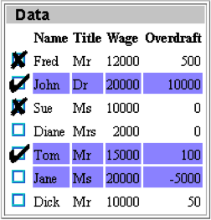

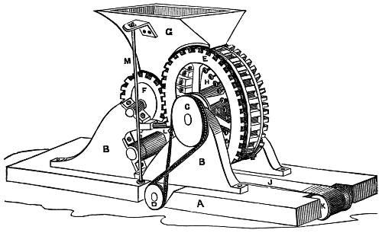
training and execution – e.g. QbB
training examples
SQL query
scrutable execution?
decision tree
machine learning
cond

cond
inscrutable training?



Slide 16
Key Points

Slide 17
key points
human-like computing has two aspects:
AI inspired by human intelligence
AI that works better with humans (our focus)
chatbots – long history theory (Turing test), fiction (HAL) and research (Eliza)
conversational user interfaces
can emulate human conversational techniques
both systems and speakers adapt.
match technology & application domain
may blur the boundaries between AI, non-AI code and human responses.
uncanny valley
almost human interactions are bad
until that point the more human-like, the better
explainable AI needed – bias, failure and legislation.
explanations need sufficient reason not weight-by-weight analysis of ML
XAI: local/global, white/black/grey box, training/execution

