Slide 1
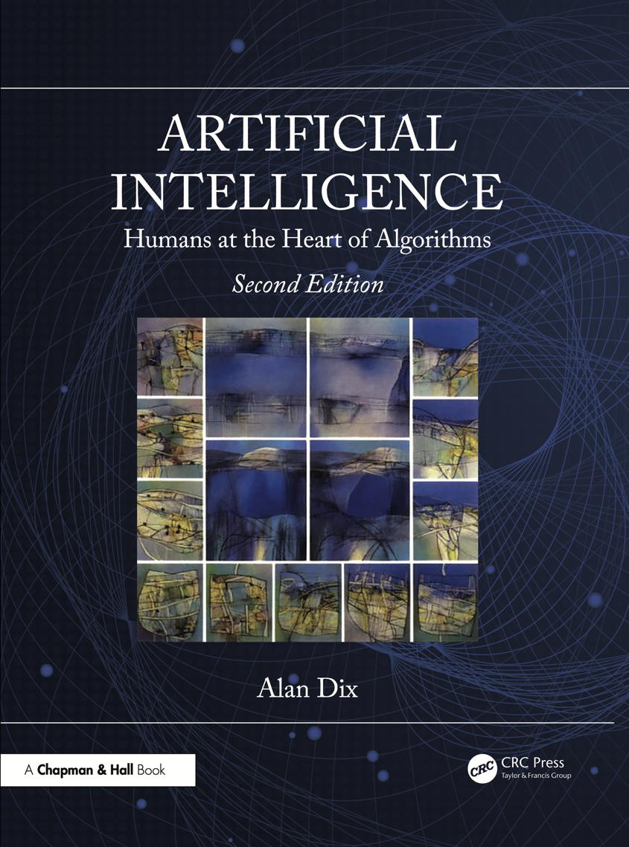
Chapter 2
Knowledge in AI
Notes:
List of Figures
2.1 Four knights: how many moves? 12
2.2 A different representation makes the solution clearer. 13
2.3 Full list of variants of the relationship ``cousin''. 14
2.4 Truth values for simple logic operators. 15
2.5 Production system rules for assessing a loan application. 17
2.6 A fragment of a semantic network. 20
2.7 Frame representation of supermarket. 21

Slide 2
Four knights: how many moves?
Fig. 2.1
Notes:
2.1 Four knights: how many moves? 12
know/knights.eps

Slide 3

A different representation makes the solution clearer
1
6
8
1
2
3
7
5
3
4
5
6
7
8
9
2
4
valid
move
Fig. 2.2
9
Notes:
2.2 A different representation makes the solution clearer. 13
know/represent.png

Slide 4
Full definition of the relationship “cousin”.
a dog's cousin is a daughter of a sister of its mother
a dog's cousin is a daughter of a sister of its father
a dog's cousin is a daughter of a brother of its mother
a dog's cousin is a daughter of a brother of its father
a dog's cousin is a son of a sister of its mother
a dog's cousin is a son of a sister of its father
a dog's cousin is a son of a brother of its mother
a dog's cousin is a son of a brother of its father
Fig. 2.3
Notes:
2.3 Full definition of the relationship “cousin”. 14
learning/phases.eps

Slide 5
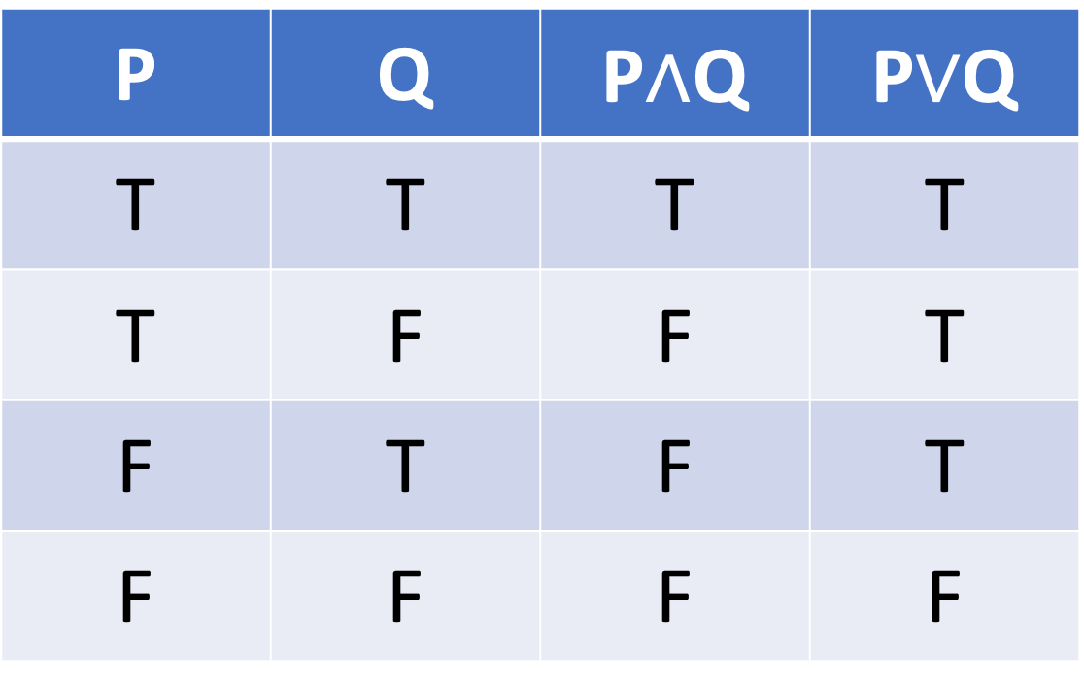
Truth values for simple logic operators
P | Q | P$∧$Q | P$∨$Q
T | T | T | T
T | F | F | T
F | T | F | T
F | F | F | F
Fig. 2.4
Notes:
2.4 Truth values for simple logic operators. 15

Slide 6
Production system rules for assessing a loan application
1. IF <client working? is unknown>
THEN ask "Are you working?"
read WORKING
remove <client working? is unknown>
add <client working? is WORKING>
2. IF <client working? is YES> and <salary is unknown>
THEN ask "What is your salary?"
read SALARY
remove <salary is unknown>
add <salary is SALARY>
3. IF <client working? is YES> and <salary is SALARY> and SALARY > (5 * AMOUNT REQUESTED)
THEN grant loan of AMOUNT REQUESTED
clear database
finish
…
Fig. 2.5a
Notes:
2.5a Production system rules for assessing a loan application. 17

Slide 7
Production system rules for assessing a loan application (ctd)
4. IF <client working? is YES> and <salary is SALARY> and SALARY <= (5 * AMOUNT REQUESTED)
THEN grant loan of (SALARY/5)
clear database
finish
5. IF <client working? is NO> and <client student? is unknown>
THEN ask "Are you a student?"
read STUDENT
remove <client student? is unknown>
add <client student? is STUDENT>
6. IF <client working? is NO> and <client student? is YES>
THEN discuss student loan
clear database
finish
7. IF <client working? is NO> and <client student? is NO>
THEN refuse loan
clear database
finish
Fig. 2.5b
Notes:
2.5b Production system rules for assessing a loan application. 17

Slide 8
A fragment of a semantic network
Fig. 2.6
Notes:
2.6 A fragment of a semantic network. 20
know/semnet.eps

Slide 9
Frame representation of supermarket
Fig. 2.7
Notes:
2.7 Frame representation of supermarket. 21
know/frame.eps

