Slide 1
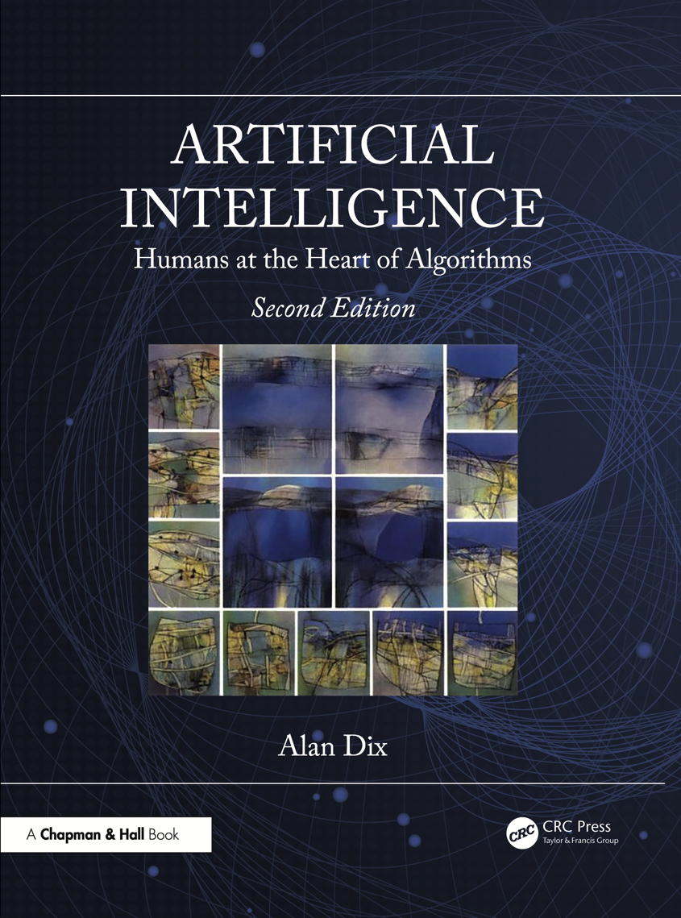
Chapter 3
Reasoning
Notes:
List of Figures
3.1 Case-based reasoning. 31
3.2 Modifying cases. 32
3.3 Graph pattern. 33
3.4 Spreading activation 34
3.5 Bayesian network. 34

Slide 2
Case-based reasoning
Fig. 3.1
Notes:
3.1 Case-based reasoning. 31
reason/case.eps

Slide 3
Modifying cases
Fig. 3.2
Notes:
3.2 Modifying cases. 32
reason/modify-case.eps

Slide 4
Graph pattern
Person [A]
married
Person [B]
parent
NOT parent
parent
Person [C]
Person [D]
Fig. 3.3
Notes:
3.3 Graph pattern. 33
reason/graph-pattern.png

Slide 5
Spreading activation
spread activation to related nodes
Vivi
initial activation
UoA
Athens
Costas
Greece
UoP
Tripolis
George
weaker spread back through 1-m links than through m-1
lower threshold on spread
Fig. 3.4
Notes:
3.4 Spreading activation. 34
(from Dix et a., 2010)
reason/spreading-activation.png

Slide 6
Bayesian Network
wear coat
feel hot
sunny day | Y | Y | N | N
wear coat | Y | N | Y | N
feel hot | 0.9 | 0.7 | 0.5 | 0.1
sunny day
eat ice cream
Fig. 3.5
Notes:
3.5 Bayesian Network 34
reason/bayesian-net.png

