Slide 1

Chapter 6
Neural Networks
Notes:
List of Figures
6.1 A single perceptron. 76
6.2 Sheep dogs or rescue dogs? 76
6.3 A linearly separable problem. 77
6.4 The actual pattern space. 77
6.5 XOR problem (diagram after Beale \& Jackson (1990)). 77
6.6 A multi-layer perceptron architecture. 78
6.7 A simple multi-layer perceptron to solve the XOR problem. 78
6.8 Different threshold functions. 79
6.9 Associative memory. 81
6.10 Boltzmann machine. 82
6.11 Restricted Boltzmann machine. 82
6.12 Kohonen self-organising network. 83
6.13 Example of a hybrid architecture. 85
6.14 Does this network solve the XOR problem? 85
6.15 Does this network work? 86

Slide 2
A single perceptron.
Fig. 6.1
Notes:
6.1 A single perceptron. 76
cog/single.eps

Slide 3
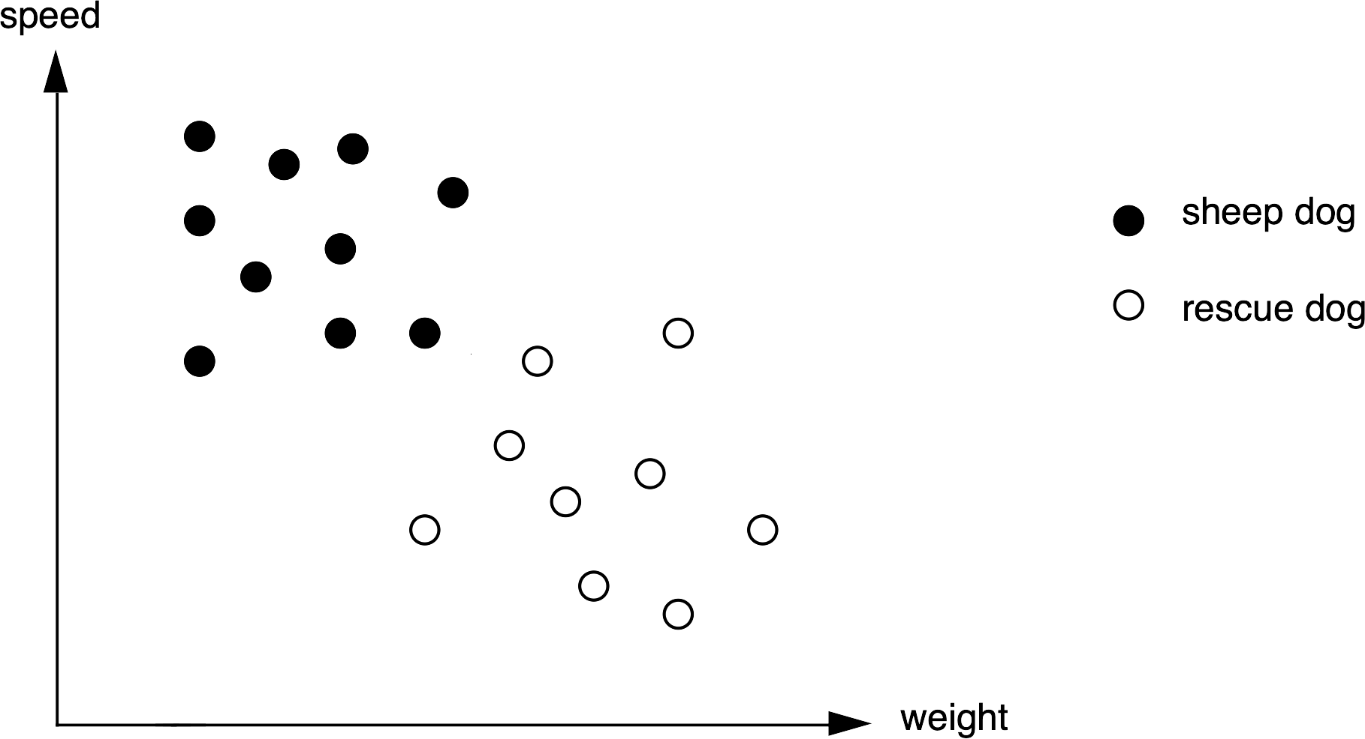
Sheep dogs or rescue dogs?
Fig. 6.2
Notes:
6.2 Sheep dogs or rescue dogs? 76
cog/dogs1.eps

Slide 4
A linearly separable problem
Fig. 6.3
Notes:
6.3 A linearly separable problem. 77
cog/dogs2.eps

Slide 5
The actual pattern space
Fig. 6.4
Notes:
6.4 The actual pattern space. 77
cog/dogs3.eps

Slide 6
XOR problem
Fig. 6.5
Notes:
6.5 XOR problem (diagram after Beale & Jackson (1990)). 77
cog/xor.eps

Slide 7
A multi-layer perceptron architecture
Fig. 6.6
Notes:
6.6 A multi-layer perceptron architecture. 78
cog/mlp.eps

Slide 8
A simple multi-layer perceptron to solve the XOR problem
Fig. 6.7
Notes:
6.7 A simple multi-layer perceptron to solve the XOR problem. 78
cog/mlpxor.eps

Slide 9
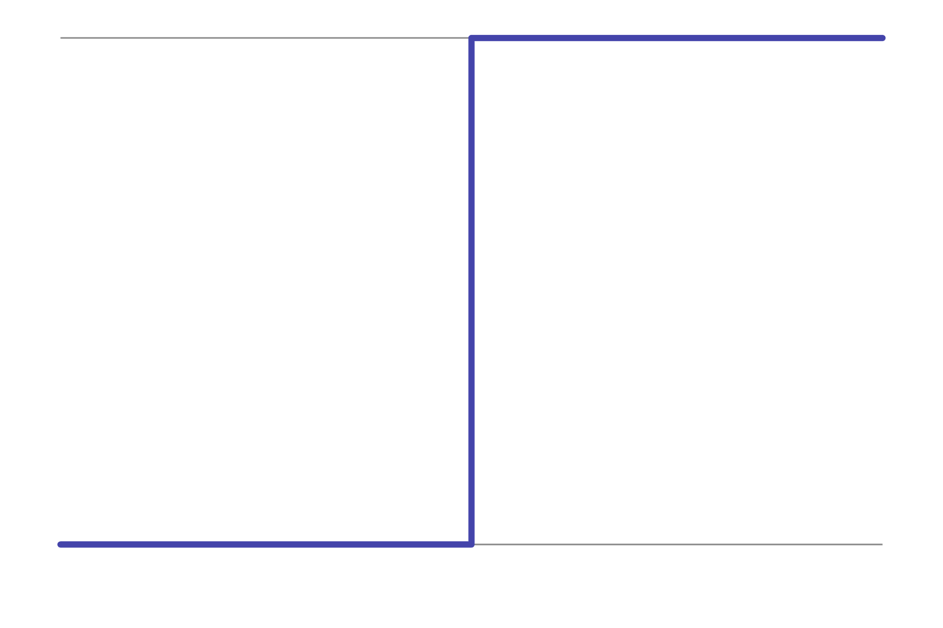
Different threshold functions – step
Fig. 6.8a
Notes:
6.8 Different threshold functions. 79

Slide 10
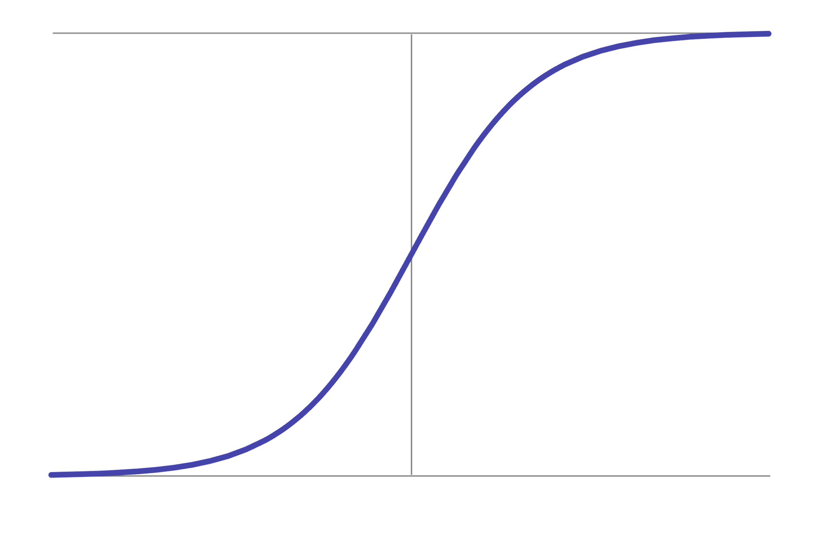
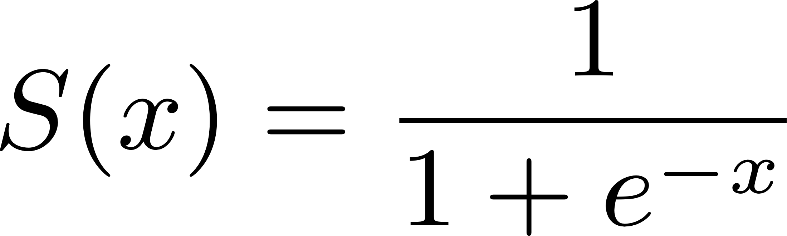
Different threshold functions - sigmoid
Fig. 6.8b
Notes:
6.8 Different threshold functions. 79

Slide 11
Associative memory
Fig. 6.9
Notes:
6.9 Associative memory. 81
cog/assoc.eps

Slide 12
Boltzmann Machine
visible nodes
hidden nodes
fully
connected
Fig. 6.10
Notes:
6.10 Boltzmann machine. 82

Slide 13
Boltzmann Machine
visible nodes
hidden nodes
fully
connected
Fig. 6.10
Notes:
6.10 Boltzmann machine. 82

Slide 14
Restricted Boltzmann Machine
visible nodes
fully connected
between layers
hidden nodes
Fig. 6.11
Notes:
6.11 Restricted Boltzmann machine. 82

Slide 15
Restricted Boltzmann Machine
visible nodes
fully connected
between layers
hidden nodes
Fig. 6.11
Notes:
6.11 Restricted Boltzmann machine. 82

Slide 16
Kohonen Self-Organising Network
1. network weights
initialised
ŵ₀₀
ŵ₁₀
ŵ₂₀
ŵ₃₀
ŵ₄₀
ŵ₅₀
ŵ₀₁
ŵ₁₁
ŵ₂₁
ŵ₃₁
ŵ₄₁
ŵ₅₁
ŵ₀₂
ŵ₁₂
ŵ₂₂
ŵ₃₂
ŵ₄₂
ŵ₅₂
ê₁
ê₂
ŵ₀₃
ŵ₁₃
ŵ₂₃
ŵ₃₃
ŵ₄₃
ŵ₅₃
2. examples
fed in turn
ŵ₀₄
ŵ₁₄
ŵ₂₄
ŵ₃₄
ŵ₄₄
ŵ₅₄
ê₃
ê₄
ŵ₀₅
ŵ₁₅
ŵ₂₅
ŵ₃₅
ŵ₄₅
ŵ₅₅
ê₅
3. closest
match found
4. chosen cell and
neighbours modified
Fig. 6.12
Notes:
6.12 Kohonen self-organising network. 83

Slide 17
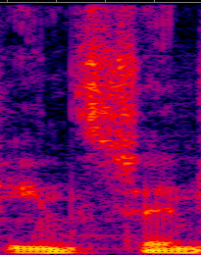

Example of a hybrid architecture
frequency spec
transformation
machine learning
(Kohonen network)
language specific
recognition
ŵ₀₀
ŵ₁₀
ŵ₂₀
ŵ₃₀
ŵ₄₀
ŵ₅₀
ŵ₀₁
ŵ₁₁
ŵ₂₁
ŵ₃₁
ŵ₄₁
ŵ₅₁
ŵ₀₂
ŵ₁₂
ŵ₂₂
ŵ₃₂
ŵ₄₂
ŵ₅₂
/f//o//n//i//m/
“phoneme”
ŵ₀₃
ŵ₁₃
ŵ₂₃
ŵ₃₃
ŵ₄₃
ŵ₅₃
ŵ₀₄
ŵ₁₄
ŵ₂₄
ŵ₃₄
ŵ₄₄
ŵ₅₄
ŵ₀₅
ŵ₁₅
ŵ₂₅
ŵ₃₅
ŵ₄₅
ŵ₅₅
raw audio
signal
sequence of
phonemes
spoken
words
spectrogram
Fig. 6.13
Notes:
6.13 Example of a hybrid architecture. 85
Spectogram, cropped version of https://commons.wikimedia.org/wiki/File:Spectrogram-19thC.png
Aquegg, Public domain, via Wikimedia Commons

Slide 18
Does this network solve the XOR problem?
Fig. 6.14
Notes:
6.14 Does this network solve the XOR problem? 85
cog/ex1.eps

Slide 19
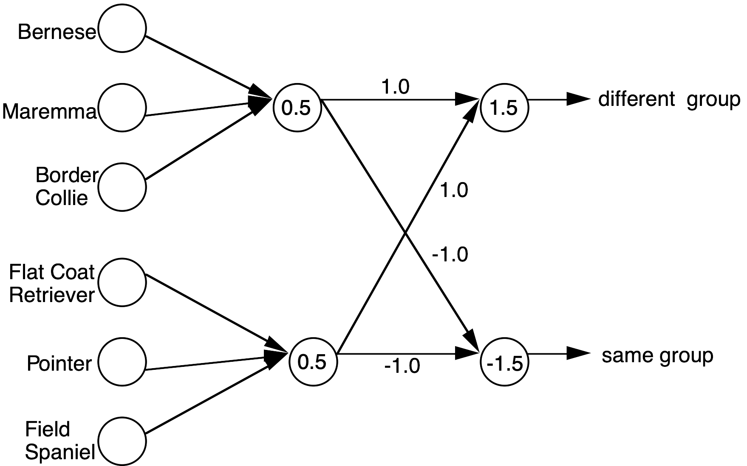
Does this network work?
Fig. 6.15
Notes:
6.15 Does this network work? 86
cog/ex2.eps

