Slide 1
Chapter 7
Statistical and Numerical Techniques
Notes:
List of Figures
7.1 Linear regression for short walks: solid line ignoring the outlier, dotted line including all data. 89
7.2 Piecewise-linear regression -- longer walks. 90
7.3 Matrix representing number of times a specific movie has been seen by each person. 91
7.4 Principal components showing directions of maximum variation in the dataset. Adapted from Nicoguaro, CC BY 4.0, via Wikimedia Commons. 93
7.5 Linearly separable clusters. 93
7.6 More complex clusters. 94
7.7 UK income distribution 2011/12. Source: Office of National Statistics\nobreakspace {}\cite {ONS14}. 95
7.8 Normal distribution. Source: By Ainali--Own work, CC BY-SA 3.0, https://commons.wikimedia.org/w/index.php?curid=3141713. 96
7.9 Long tail of large incomes. Source: Statistics for HCI\nobreakspace {}\cite {dix2020stats}, adapted from Office of National Statistics\nobreakspace {}\cite {ONS14}. 97
7.10 Linear regression as least squares -- different ways to do it. 98
7.11 Piecewise linear fit, where non-linear function would be better. 98
7.12 Reservoir computing -- main stages. 100

Slide 2
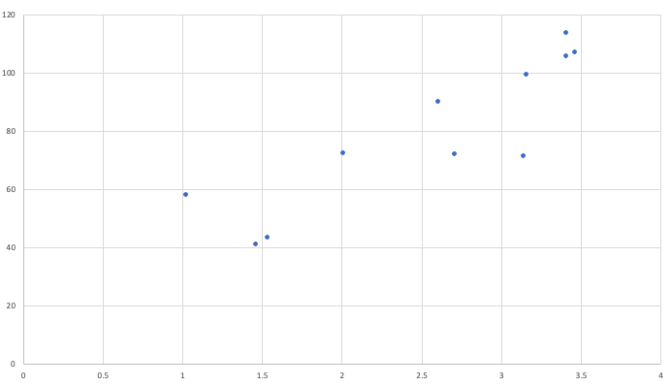
Linear regression for short walks
120
outlier
100
dotted line including all data
time taken for walk (y axis)
80
A
60
40
solid line ignoring outlier
20
slope
intercept
1
2
3
4
distance (x axis)
Fig. 7.1
Notes:
7.1 Linear regression for short walks: solid line ignoring the outlier, dotted line including all data. 89

Slide 3
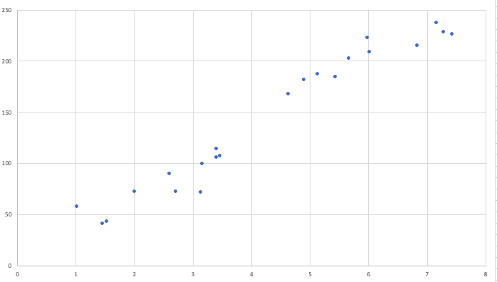
Piecewise-Linear regression -- longer walks
250
200
time taken for walk
150
100
50
1
2
3
4
5
6
7
8
Fig. 7.2
distance
Notes:
7.2 Piecewise-linear regression -- longer walks. 90

Slide 4
Matrix representing number of times a specific movie has been seen by each person
movie id (13575 movies in total)
1 2 3 ... 13574 13575
1 0 2 0 ... 1 0
2 1 0 0 ... 0 0
3 0 1 0 ... 0 0
... ... ... ... ... ... ...
26952 1 0 0 ... 0 1
26953 0 0 3 ... 0 0
person id (26952 in total)
Fig. 7.3
Notes:
7.3 Matrix representing number of times a specific movie has been seen by each person. 91

Slide 5
Principal components showing directions of maximum variation in the data set
first principal component in direction of greatest variation
second principal component orthogonal to first
Fig. 7.4
Notes:
7.4 Principal components showing directions of maximum variation in the data set. Adapted from Nicoguaro, CC BY 4.0, via Wikimedia Commons 93
By Nicoguaro - Own work, CC BY 4.0, https://commons.wikimedia.org/w/index.php?curid=46871195 https://en.wikipedia.org/wiki/Principal_component_analysis#/media/File:GaussianScatterPCA.svg

Slide 6
Linearly separable clusters
Fig. 7.5
Notes:
7.5 Linearly separable clusters. 93

Slide 7
More complex clusters
Fig. 7.6
Notes:
7.6 More complex clusters. 94

Slide 8
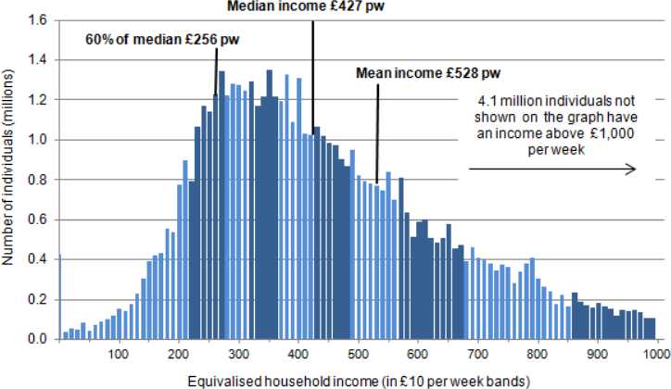
UK income distribution 2011/12
Fig. 7.7
Notes:
7.7 UK income distribution 2011/12 95
From: Sustainable Development Indicators, Office of National Statistics, July 2014 http://webarchive.nationalarchives.gov.uk/20160105183323/http://www.ons.gov.uk/ons/rel/wellbeing/sustainable-development-indicators/july-2014/sustainable-development-indicators.html

Slide 9
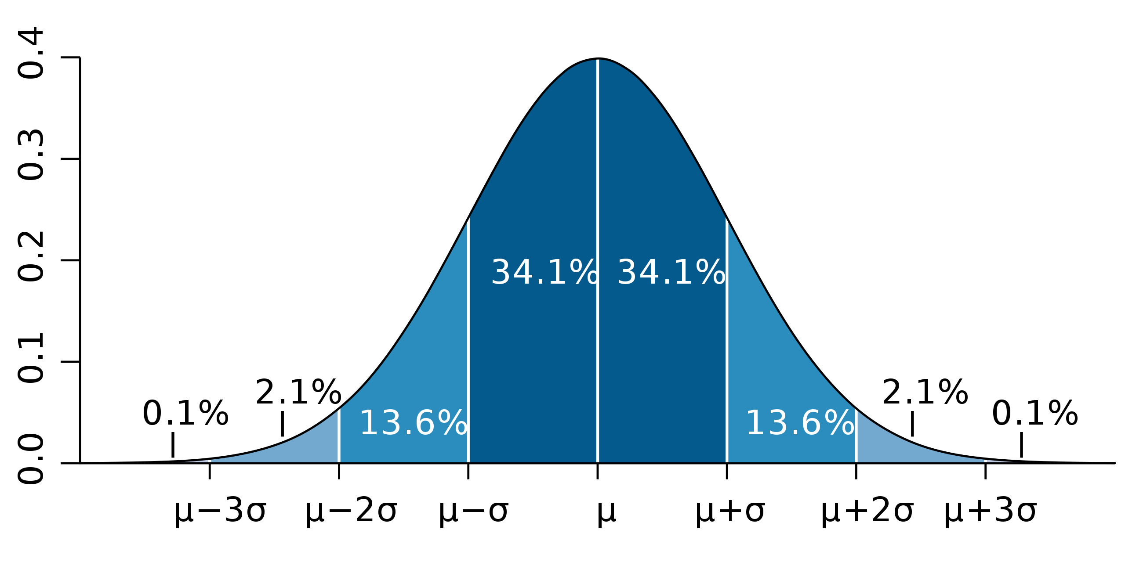
Normal distribution
Fig. 7.8
Notes:
7.8. Normal distribution. 96
stats/Standard_deviation_diagram_micro.png
Image: By Ainali - Own work, CC BY-SA 3.0, https://commons.wikimedia.org/w/index.php?curid=3141713

Slide 10
long tail
what happens here?
From: Sustainable Development Indicators, Office of National Statistics, July 2014 http://webarchive.nationalarchives.gov.uk/20160105183323/http://www.ons.gov.uk/ons/rel/wellbeing/sustainable-development-indicators/july-2014/sustainable-development-indicators.html
Fig. 7.9 (detail)
Notes:
7.9 (detail) Long tail of large incomes 97

Slide 11
Long tail of large incomes
average company director
Prime Minister
£2000/week
£3000/week
University of Bath vice-chancellor
£10,000/week
£20,000/week
Wayne Rooney
Fig. 7.9
£100,000/week
£200,000/week
£300,000/week
Notes:
7.9 Long tail of large incomes 97
Source: Statistics for HCI~\cite{dix2020stats}, adapted from Office of National Statistics~\cite{ONS14}
From: Sustainable Development Indicators, Office of National Statistics, July 2014 http://webarchive.nationalarchives.gov.uk/20160105183323/http://www.ons.gov.uk/ons/rel/wellbeing/sustainable-development-indicators/july-2014/sustainable-development-indicators.html

Slide 12
Linear regression as least squares -- different ways to do it
120
100
regression of y on x minimises square of y distance
time taken for walk (y axis)
80
60
40
regression of y on x minimises square of y distance
20
1
2
3
4
distance (x axis)
Fig. 7.10
Notes:
7.10 Linear regression as least squares -- different ways to do it. 98
regression y on x: slope=25.2662912 intercept=15.2541964
regression x on y: slope=0.03032562 intercept=0.13106439
y = 100 x = 3.164

Slide 13
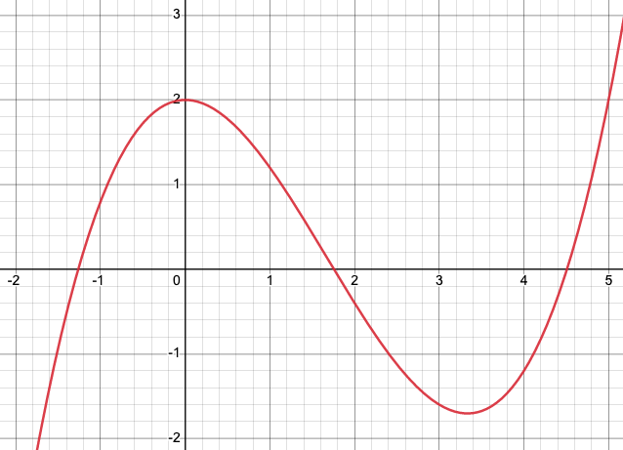
Piecewise linear fit, where non-linear function would be better
Fig. 7.11
Notes:
7.11 Piecewise linear fit, where non-linear function would be better 98
https://www.desmos.com/calculator
0.2\left(x^{3}-5x^{2}+10\right)

Slide 14
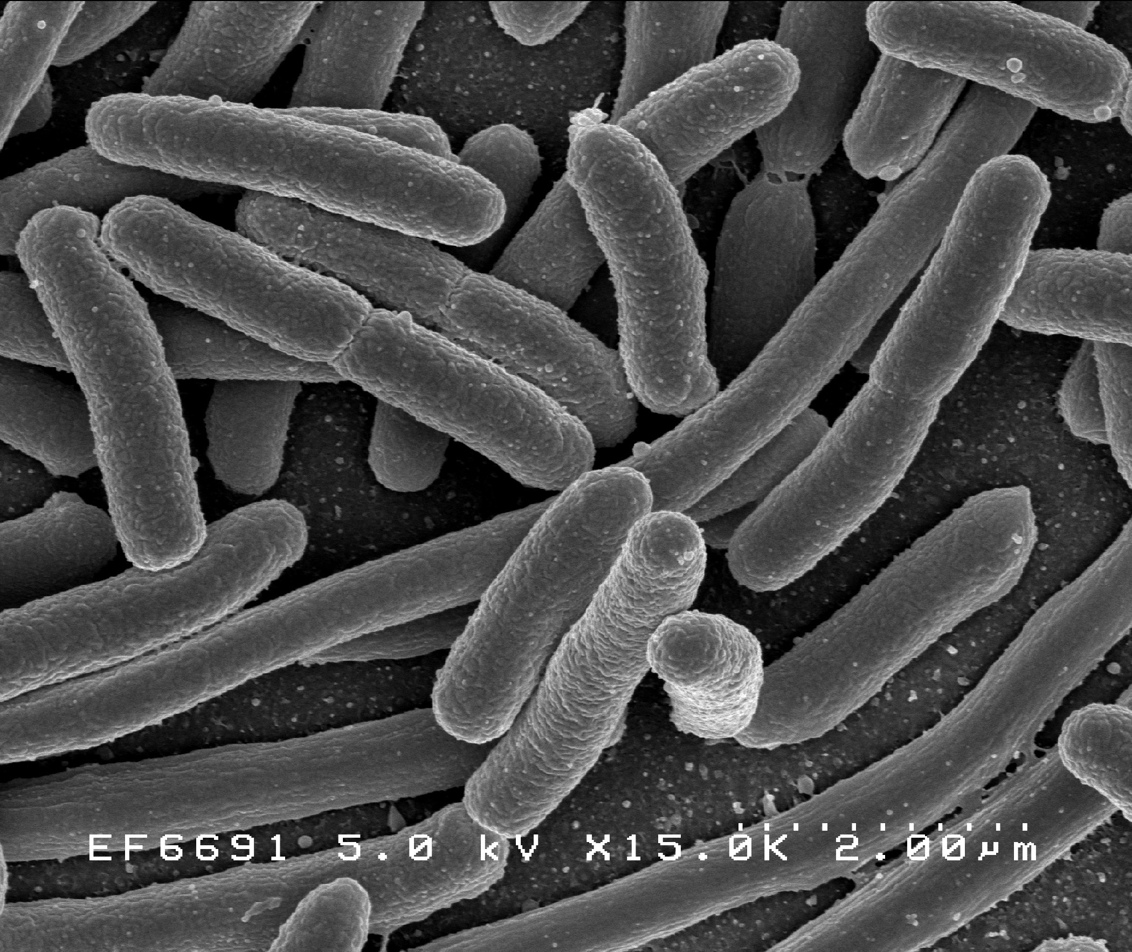
Reservoir computing – main stages
raw input transformed into suitable form
machine learning layer to map to desired output
non-linear
processes
input data
output
reservoir
readout
10011 11000 11011 10111 10011 01110 01011 11111 01001 01001 11110 00001
11000 11011 10111 10011 01110 01011 11111 01001 01001 11110 00001 10011
biological, quantum, etc.
processing may have complex temporal dynamics
Fig. 7.12
Notes:
7.12 Reservoir computing – main stages. 100
NIAID, Public domain, via Wikimedia Commons
https://commons.wikimedia.org/wiki/File:E._coli_Bacteria_(7316101966).jpg

