Slide 1
Chapter 9
Making Sense of Machine Learning
Notes:
List of Figures
9.1 Training phase of machine learning. 117
9.2 Application phase of machine learning. 118
9.3 Three ways of using the output of unsupervised learning. 119
9.4 ROC curve -- trade-off between false positive and false negative rates. 120
9.5 ROC curve -- choosing between classifiers. 121
9.6 Hill climbing may get stuck at local maximum. 122
9.7 Potential solutions in multi-objective optimisation. 128
9.8 Pinch-point node clamped to intermediate label in semi-supervised learning. 130
9.9 ROC curve for Exercise\nobreakspace {}\ref {ex:ml-theory.roc}. 130

Slide 2
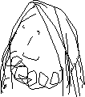
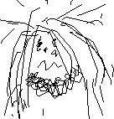
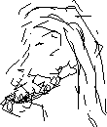
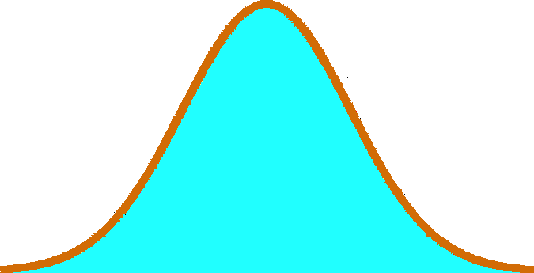
Training phase of machine learning
training set
learning algorithm
rule set
IF X>17 THEN ..
IF A=3 & B<6 THEN …
IF C<D & C < A THEN
IF X <12 THEN
10011 11000 11011 10111 10011 01110 01011 11111 01001 01001 11110 00001
other parameters
fitness function
Fig. 9.1
Notes:
9.1 Training phase of machine learning. 117
cogs by Gregor Cresnar from the Noun Project

Slide 3
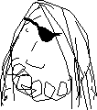
Application phase of machine learning
rule set
IF X>17 THEN ..
IF A=3 & B<6 THEN …
IF C<D & C < A THEN
IF X <12 THEN
category / decision
recognition algorithm
10011 11000 11011 10111 10011 01110 01011 11111 01001 01001 11110 00001
Fig. 9.2
unseen data
Notes:
9.2 Application phase of machine learning. 118
cogs by Gregor Cresnar from the Noun Project. CC-BY-3.0. https://thenounproject.com/icon/cogs-170064/
lightbulb idea by Milinda Courey from the Noun Project. CC-BY-3.0. https://thenounproject.com/icon/lightbulb-idea-354070/

Slide 4
Using unsupervised learning – human understanding
unsupervised learning
visualisation and interpretation
IF X>17 THEN ..
IF A=3 & B<6 THEN …
IF C<D & C < A THEN
IF X <12 THEN
10011 11000 11011 10111 10011 01110 01011 11111 01001 01001 11110 00001
Fig. 9.3(i)
Notes:
9.3 Three ways of using the output of unsupervised learning. 119
cogs by Gregor Cresnar from the Noun Project

Slide 5
Using unsupervised learning – expert labelling
unsupervised learning
expert adds labels
IF X>17 THEN ..
IF A=3 & B<6 THEN …
IF C<D & C < A THEN
IF X <12 THEN
10011 11000 11011 10111 10011 01110 01011 11111 01001 01001 11110 00001
♠♥♣♦
labelled rules fed into recognition algorithm
♥
Fig. 9.3(ii)
unseen data allocated label
Notes:
9.3 Three ways of using the output of unsupervised learning. 119
cogs by Gregor Cresnar from the Noun Project

Slide 6
Using unsupervised learning – pre-processing
unsupervised learning
IF X>17 THEN ..
IF A=3 & B<6 THEN …
IF C<D & C < A THEN
IF X <12 THEN
10011 11000 11011 10111 10011 01110 01011 11111 01001 01001 11110 00001
remove labels
supervised learning
♦
♣
♦
♣
♥
♥
♠
♠
pre-process to simplify data
labelled training set
labelled simplified training set
Fig. 9.3(iii)
Notes:
9.3 Three ways of using the output of unsupervised learning. 119
cogs by Gregor Cresnar from the Noun Project

Slide 7
ROC curve – trade-off between false positive and false negative rates
1.0
high recall, but low precision
true positive rate
(recall)
0.5
often somewhere between
is best tradeoff
high precision, but low recall
0
0.5
1.0
Fig. 9.4
false positive rate
(1–precision)
Notes:
9.4 ROC curve -- trade-off between false positive and false negative rates. 120

Slide 8
ROC curve – choosing between classifiers
1.0
perfect classifier
classifier A
true positive rate
(recall)
classifier B
0.5
classifier C
random classifier
0
0.5
1.0
Fig. 9.5
false positive rate
(1–precision)
Notes:
9.5 ROC curve -- choosing between classifiers. 121

Slide 9
Hill climbing may get stuck at local maximum
… so never reach the global maximum
… but may get stuck at a local maximum
hill climbing moves upwards in direction of steepest gradient
Fig. 9.6
Notes:
9.6 Hill climbing may get stuck at local maximum. 122

Slide 10
Potential solutions in multi-objective optimisation
2:1 trade-off line
objective A
S1
S4
Pareto-optimal solutions
S2
S3
other solutions
S5
S6
Fig. 9.7
objective B
Notes:
9.7 Potential solutions in multi-objective optimisation. 128

Slide 11
Pinch-point node clamped to intermediate label in semi-supervised learning
upstream layers
downstream layers
pinch point
input layer
output layer
V
𝛅
backpropagation as normal
discrepancy drives upstream backpropagation
node clamped
to intermediate
label
value used for
downstream forward propagation
Fig. 9.8
Notes:
9.8 Pinch-point node clamped to intermediate label in semi-supervised learning. 130

Slide 12
ROC curves for ex. 9.3
1.0
perfect classifier
classifier A
true positive rate
(recall)
classifier B
0.5
classifier C
random classifier
0
0.5
1.0
false positive rate
(1–precision)
Fig. 9.9
Notes:
9.9 ROC curve for Exercise 9.3 130

