Slide 1
Chapter 10
Data Preparation
Notes:
List of Figures
10.1 Typical data preparation stages. 133
10.2 Bimodal distribution with natural break point (adapted from Qwfp at English Wikipedia, CC BY-SA 3.0, \url {https://commons.wikimedia.org/wiki/File:BimodalAnts.png}). 136
10.3 Normally distributed data split into four equally probable categories at upper and lower quartiles and median. 136
10.4 Taxonomy of animals in pet shop with cut-off nodes chosen to have (very) roughly similar sizes. 137
10.5 Normalising data to a fixed range. 138
10.6 Normalising data to a fixed variance. 138
10.7 Sigmoid function smoothly limits extreme values. 139
10.8 Jupyter Notebook showing replayable Python code (Image: Andrey Yakimchik -- CC BY 4.0, https://commons.wikimedia.org/w/index.php?curid=97158987). 142

Slide 2
Typical data preparation stages
extraction
manipulation
Dix A Finlay J Abowd G Beale R
CSV / SQL
0010010
1010011
0100101
1110011
0110101000111010001110101010110101100101010101111010101011010101101011010110101010100111011
reconciliation and linking
transform values
final data for algorithm
web scrape
0010010
1010011
0100110
1110010
API / RSS
authority files / standard ontologies
validation rules and sanity checks
sensors
Fig. 10.1
Notes:
10.1 Typical data preparation stages. 133

Slide 3
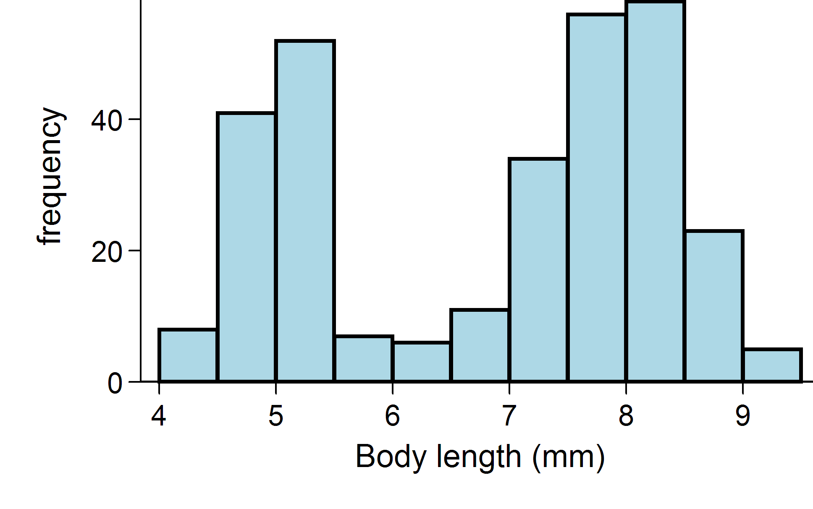
Bimodal distribution with natural break point
natural break around here
Fig. 10.2
Notes:
10.2 Bimodal distribution with natural break point 136
Qwfp at English Wikipedia, CC BY-SA 3.0, https://commons.wikimedia.org/wiki/File:BimodalAnts.png

Slide 4
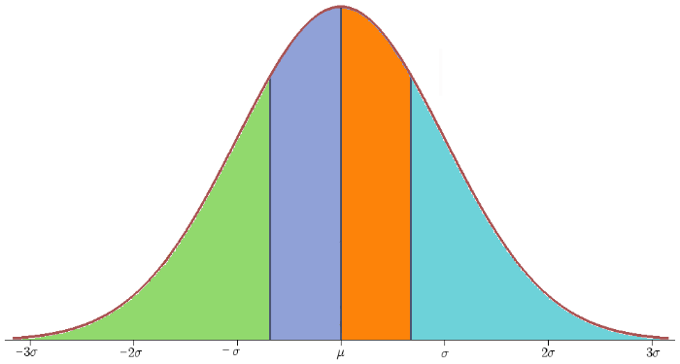
Normally distributed data split into four equally probably categories at upper and lower quartiles and median
25% in each range
Fig. 10.3
Notes:
10.3 Normally distributed data split into four equally probably categories at upper and lower quartiles and median 136
Iqr.png: Ark0nderivative work: Gato ocioso, CC BY-SA 3.0 , https://commons.wikimedia.org/wiki/File:Iqr_with_quantile.png

Slide 5
Taxonomy of animals
pets (2392 items)
mammals (1721 items)
birds (432 items)
reptiles (239 items)
cats (633 items)
dogs (789 items)
mice & rats (299 items)
cut-off nodes chosen to have (very) roughly similar sizes
Fig. 10.4
Notes:
10.4 Taxonomy of animals in pet shop with cut-off nodes chosen to have (very) roughly similar sizes 137

Slide 6
Normalising data to a fixed range
i data item/row
j facet/column
Input unnormalised data X[i,j]
Output normalised data Y[i,j]
Foreach j
Lo[j] = min over i X[i,j]
Hi[j] = max over i X[i,j]
Foreach i,j
Y[i,j] = (X[i,j] -- Lo[j]) / (Hi[j] -- Lo[j])
in range 0 <= Y[i,j] <= 1
Fig. 10.5
Notes:
10.5 Normalising data to a fixed range 138

Slide 7
Normalising data to a fixed variance
i data item/row
j facet/column
with mean=0 and sd=1
Input unnormalised data X[i,j]
Output normalised data Y[i,j]
Foreach j
M[j] = average X[i,j]
V[j] = variance X[i,j]
SD[j] = sqrt(V[j])
Foreach i,j
Y[i,j] = (X[i,j] -- M[j]) / SD[j]
average over rows varying i
also ranging over rows
standard deviation
Fig. 10.6
Notes:
10.6 Normalising data to a fixed variance 138

Slide 8
Sigmoid function smoothly limits extreme values
central region near-linear
extreme values bounded
Fig. 10.7
Notes:
10.7 Sigmoid function smoothly limits extreme values 139
MartinThoma, CC0, via Wikimedia Commons https://commons.wikimedia.org/wiki/File:Sigmoid-function-2.svg

Slide 9
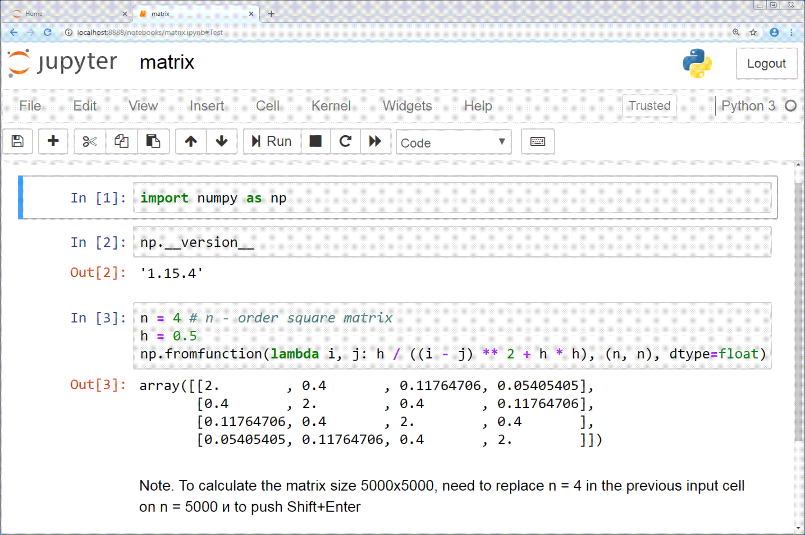
Jupyter Notebook showing replayable Python code
Fig. 10.8
Notes:
10.8 Jupyter Notebook showing replayable Python code 142
data-prep/Jupyter_Notebook.png
Image: Andrey Yakimchik - CC BY 4.0, https://commons.wikimedia.org/w/index.php?curid=97158987

Slide 10
Table 10.1 Data Used in Exercise 10.2
mountain height source
Everest 8,850 meters https://education.nationalgeographic.org/resource/mount-everest/
Yr Wyddfa 3,560 feet https://www.britannica.com/place/Snowdon
Agiocochook 6,288.3 ft https://en.wikipedia.org/wiki/Mount_Washington
Kilimanjaro 5895 m https://www.statista.com/statistics/1237791/highest-mountains-in-africa/
Notes:
Table 10.1 Data Used in Exercise 10.2 143

Slide 11
inline table Exercise 10.2
x y x y x y
82.092 2.480 65.875 2.691 35.956 4.989
24.601 4.521 64.667 2.010 34.963 4.971
8.120 5.065 76.328 2.493 73.086 2.508
72.420 7.975 80.725 8.000 56.624 2.219
15.439 4.589 58.251 2.268 28.790 4.418
21.561 4.488 30.578 5.115 86.419 7.521
72.306 2.715 67.602 1.347 23.260 3.865
65.517 7.597 36.831 5.433 82.545 7.707
Notes:
inline table Exercise 10.2 143

