Slide 1
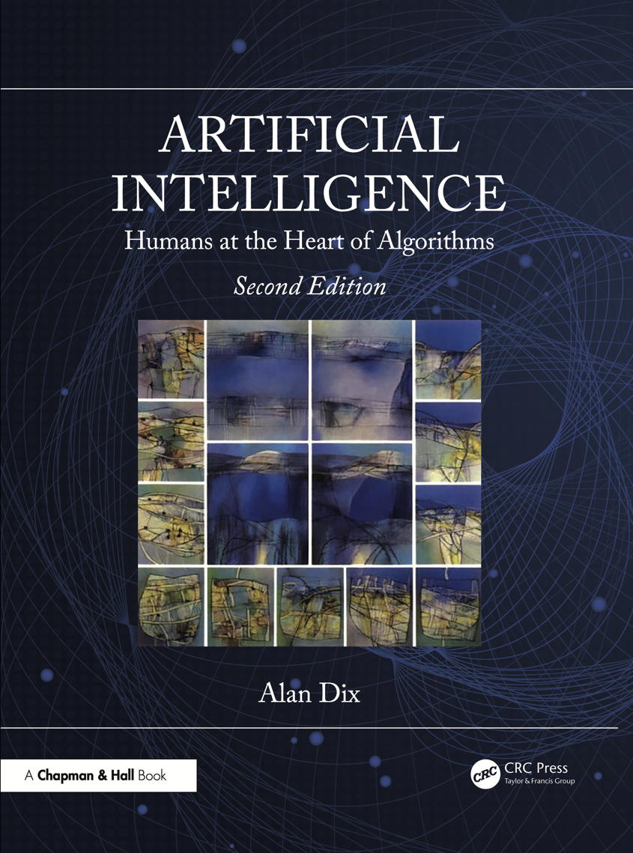
Chapter 12
Computer vision
Notes:
List of Figures
12.1 Phases of computer vision. 162
12.2 Digitised image. 163
12.3 Thresholding. 163
12.4 A difficult image to threshold. 164
12.5 Applying a digital filter. 165
12.6 Applying a 2x2 smoothing filter. 166
12.7 Gaussian filter with s.d. = 0.8 166
12.8 Different gradient filters. 167
12.9 Applying gradient filters. 168
12.10 Gradient filter on a diagonal edge. 168
12.11 Robert's operator. 168
12.12 Sobel's operator. 169
12.13 Approximations to the Laplacian. 169
12.14 Using the Laplacian. 170
12.15 Following edges. 171
12.16 Region merging. 172
12.17 Quadtree representation of image. 174
12.18 Scene with edges labelled. 174
12.19 Possible trihedral vertices -- T junctions (T1--T4), arrows (A1--A3), forks (F1--F5) and L junctions (L1--L6). 174
12.20 Applying Waltz's algorithm. 175
12.21 Scene with ambiguous labelling. 176
12.22 Improper scene. 176
12.23 Two objects or three? 176
12.24 Shadows and highlights. 177
12.25 Simple template matching. 177
12.26 Choosing an object-centred co-ordinate system. 178
12.27 Different orientations of an object. 179
12.28 Matching an object. 179
12.29 Handwriting recognition -- warping the sample. 180
12.30 Convolutional neural network. 182
12.31 Autoencoder. 182
12.32 Training a diffusion model. 183
12.33 Using a diffusion model to generate images from prompts. 184
12.34 Stereo vision. 185
12.35 Triangulation. 185
12.36 For exercise 4. 187

Slide 2
Phases of computer vision
Fig. 12.1
Notes:
12.1 Phases of computer vision. 162
vision/process.eps

Slide 3
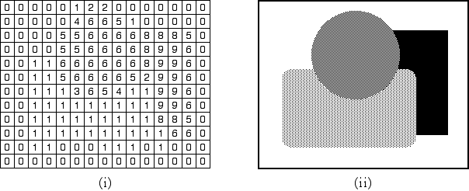
Digitized image
Fig. 12.2
Notes:
12.2 Digitised image. 163
vision/digitize.png

Slide 4
Thresholding
Fig. 12.3
Notes:
12.3 Thresholding. 163
vision/thresh-1.eps

Slide 5
A difficult image to threshold
Fig. 12.4
Notes:
12.4 A difficult image to threshold. 164
vision/thresh-2.eps

Slide 6
Applying a digital filter
Fig. 12.5
Notes:
12.5 Applying a digital filter. 165
vision/filtered-1.eps

Slide 7
Applying a 2x2 smoothing filter
Fig. 12.6
Notes:
12.6 Applying a 2x2 smoothing filter. 166
vision/filtered-2.eps

Slide 8

Gaussian filter with $σ$ = 0.8
Fig. 12.7
Notes:
12.7 Gaussian filter with s.d. = 0.8 166
vision/filtered-3.eps

Slide 9
Different gradient filters
horizontal
gradients
vertical
gradient
Fig. 12.8
Notes:
12.8 Different gradient filters. 167
vision/gradient-1.eps

Slide 10
Applying gradient filters
Fig. 12.9
Notes:
12.9 Applying gradient filters. 168
vision/gradient-2.eps

Slide 11
Gradient filter on a diagonal edge
Fig. 12.10
Notes:
12.10 Gradient filter on a diagonal edge. 168
vision/gradient-3.eps

Slide 12
Robert's operator
Fig. 12.11
Notes:
12.11 Robert's operator. 168
vision/robert.eps

Slide 13
Sobel's operator
Fig. 12.12
Notes:
12.12 Sobel's operator. 169
vision/sobel-1.eps

Slide 14
Approximations to the Laplacian
Fig. 12.13
Notes:
12.13 Approximations to the Laplacian. 169
vision/sobel-2.eps

Slide 15
Using the Laplacian
Fig. 12.14
Notes:
12.14 Using the Laplacian. 170
vision/sobel-3.eps

Slide 16
Following edges
Fig. 12.15
Notes:
12.15 Following edges. 171
vision/edge.eps

Slide 17
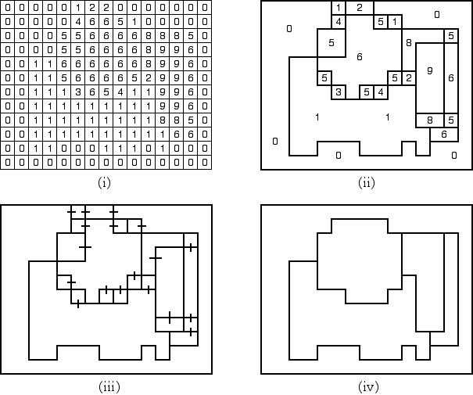
Region merging
Fig. 12.16
Notes:
12.16 Region merging. 172
vision/region-2.png

Slide 18
Quad-tree representation of image
Fig. 12.17
Notes:
12.17 Quadtree representation of image. 174
vision/quadtree.eps

Slide 19
Scene with edges labelled
Fig. 12.18
Notes:
12.18 Scene with edges labelled. 174
vision/waltz-1.eps

Slide 20
Possible trihedral vertices – T junctions
Fig. 12.19a
Notes:
12.19a Possible trihedral vertices – T junctions (T1–T4), arrows (A1–A3), forks (F1–F5) and L junctions (L–-L6). 174
vision/trihed-1.eps

Slide 21
Possible trihedral vertices – arrows
Fig. 12.19b
Notes:
12.19b Possible trihedral vertices – T junctions (T1–T4), arrows (A1–A3), forks (F1–F5) and L junctions (L–-L6). 174
vision/trihed-2.eps

Slide 22
Possible trihedral vertices – forks
Fig. 12.19c
Notes:
12.19c Possible trihedral vertices – T junctions (T1–T4), arrows (A1–A3), forks (F1–F5) and L junctions (L–-L6). 174
vision/trihed-3.eps

Slide 23
Possible trihedral vertices – L junctions
Fig. 12.19d
Notes:
12.19d Possible trihedral vertices – T junctions (T1–T4), arrows (A1–A3), forks (F1–F5) and L junctions (L–-L6). 174
vision/trihed-4.eps

Slide 24
Applying Waltz's algorithm
Fig. 12.20
Notes:
12.20 Applying Waltz's algorithm. 175
vision/waltz-2.eps

Slide 25
Scene with ambiguous labelling
Fig. 12.21
Notes:
12.21 Scene with ambiguous labelling. 176
vision/waltz-3.eps

Slide 26
Improper scene
Fig. 12.22
Notes:
12.22 Improper scene. 176
vision/waltz-4.eps
vision/waltz-5.eps

Slide 27
Two objects or three?
Fig. 12.23
Notes:
12.23 Two objects or three? 176
vision/shadows-1.eps

Slide 28
Shadows and highlights
Fig. 12.24
Notes:
12.24 Shadows and highlights. 177
vision/shadows-2.png

Slide 29
Simple template matching
Fig. 12.25
Notes:
12.25 Simple template matching. 177
vision/match-1.eps

Slide 30
Choosing an object-centred co-ordinate system
Fig. 12.26
Notes:
12.26 Choosing an object-centred co-ordinate system. 178
vision/match-2.eps

Slide 31
Different orientations of an object
Fig. 12.37
Notes:
12.27 Different orientations of an object. 179
vision/object-1.eps

Slide 32
Matching an object
Fig. 12.28
Notes:
12.28 Matching an object. 179
vision/object-2.eps

Slide 33
Handwriting recognition – warping the sample
Fig. 12.29
Notes:
12.29 Handwriting recognition -- warping the sample. 180
vision/handwriting.eps

Slide 34

Convolutional neural network
all or many
patches extracted
each patch passed to
copy of same network
outputs of each patch
form input to later layers
Fig. 12.30
Notes:
12.30 Convolutional neural network. 182

Slide 35
Autoencoder
same image in
input and output layers
encoding
network
pinch point
acts as encoded
version of image
decoding
network
Fig. 12.31
Notes:
12.31 Autoencoder. 182

Slide 36
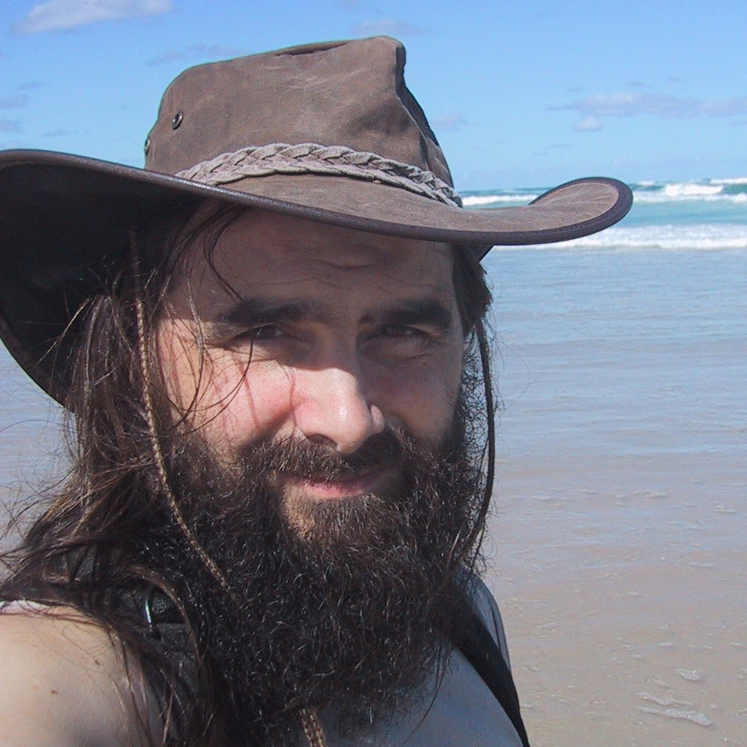
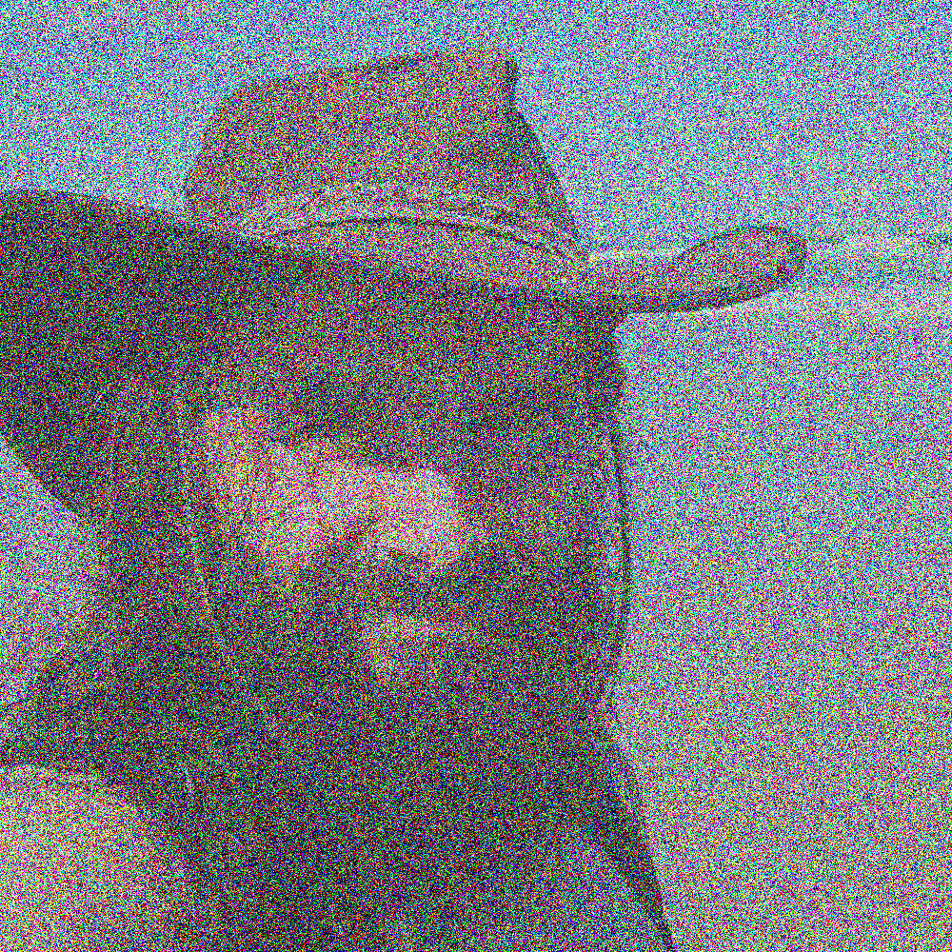
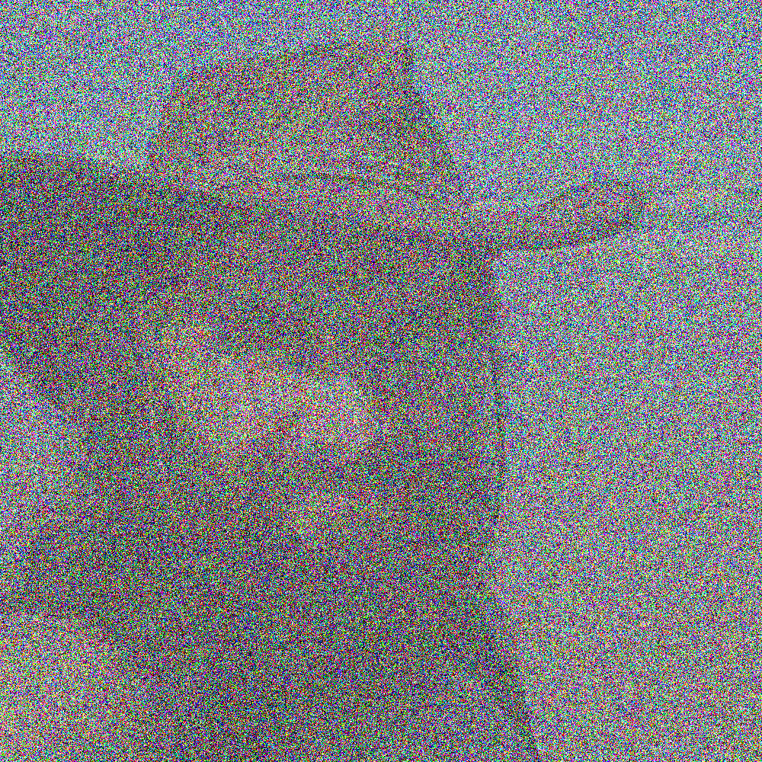
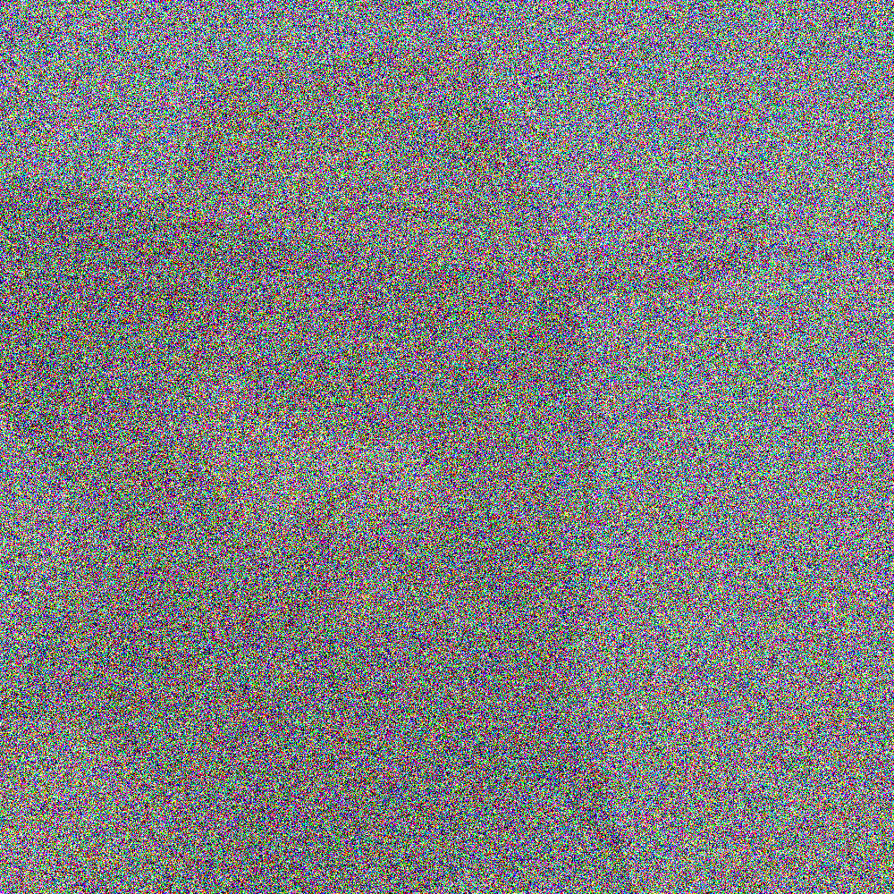

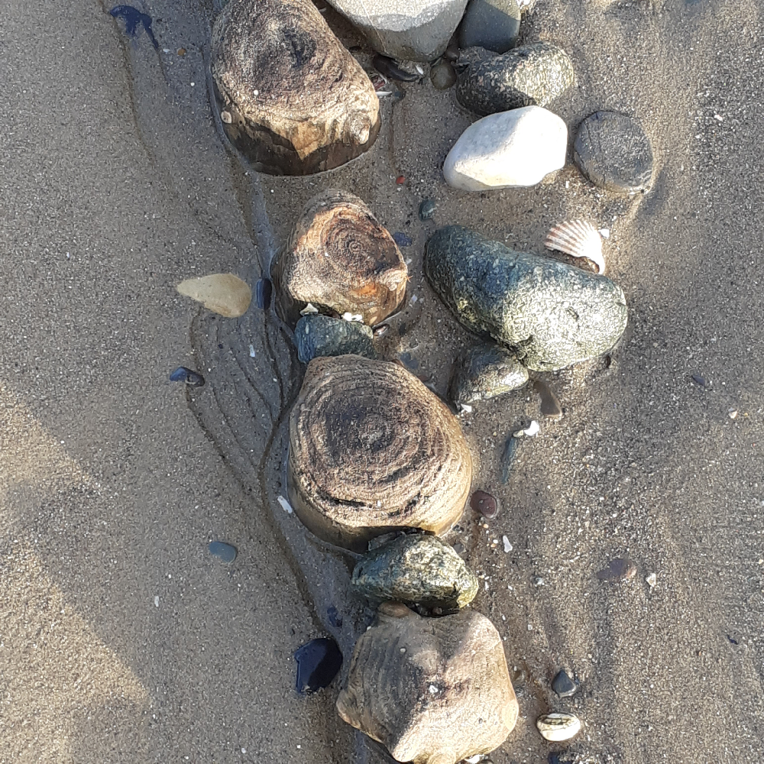
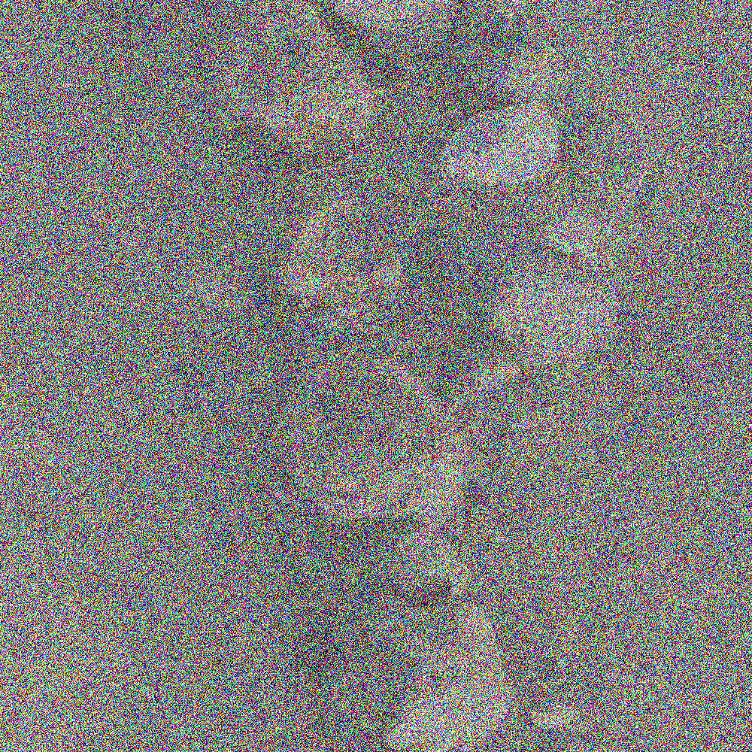


Training a diffusion model
(i) add Gaussian noise
(ii) train network to reverse the process
Fig. 12.32
(iii) include many kinds of images in the training process
Notes:
12.32 Training a diffusion model. 183
own photos adding noise with https://pinetools.com/add-noise-image

Slide 37


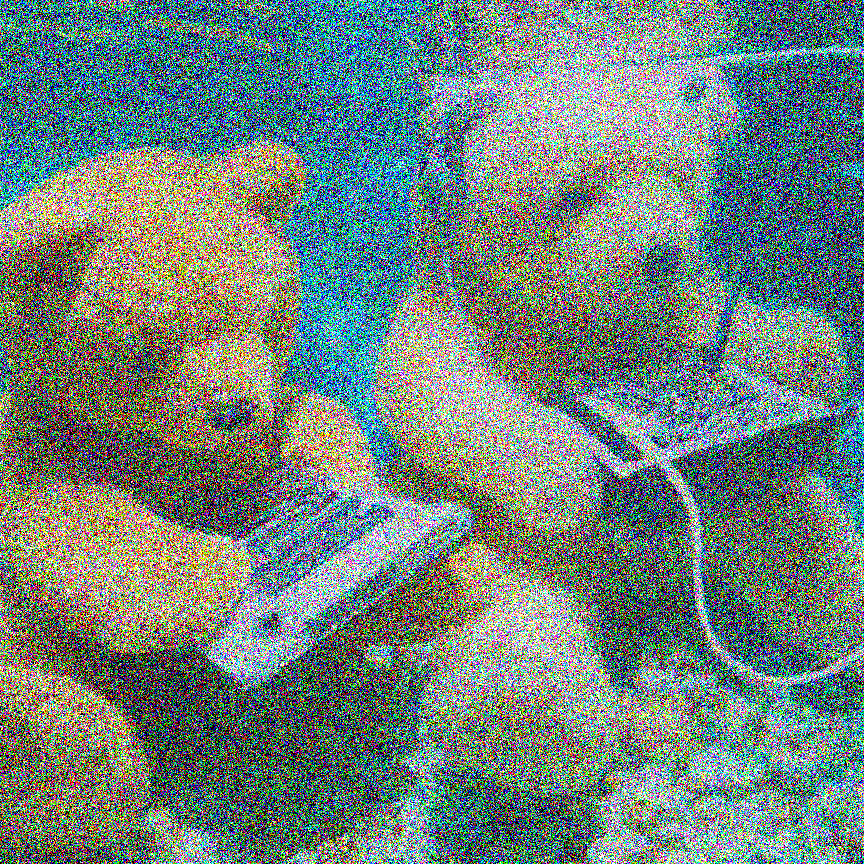

Using a diffusion model to generate images from prompts
(i) noise reduction steps
teddies &
technology
teddies &
technology
teddies &
technology
(ii) class guidance
Fig. 12.33
Notes:
12.33 Using a diffusion model to generate images from prompts. 184

Slide 38
Stereo vision
Fig. 12.34
Notes:
12.34 Stereo vision. 185
vision/stereo-1.eps

Slide 39
Triangulation
Fig. 12.35
Notes:
12.35 Triangulation. 185
vision/stereo-2.eps

Slide 40
For exercise 4
Fig. 12.34
Notes:
12.36 For exercise 4. 187
vision/vis-ex-i.eps
vision/vis-ex-ii.eps

