Slide 1
Chapter 13
Natural language understanding
Notes:
List of Figures
13.1 Initial grammar fragment. 193
13.2 Parse tree for the first sentence. 193
13.3 Further grammar rules. 194
13.4 Parse tree for the second sentence. 194
13.5 Transition network. 194
13.6 Navigation through transition network. 195
13.7 Grammar fragment for context-sensitive grammar. 196
13.8 Sample entries for the word ``base'' in WordNet. 197
13.9 Example output of CLAWS WWW tagger with three meanings for `base'. Note that the tagger copes with the typing error `by'. 197
13.10 Semantic grammar fragment. 199
13.11 Parse tree for the first sentence. 199
13.12 Parse tree for the second sentence. 199

Slide 2
Initial grammar fragment.
Fig. 13.1
Notes:
13.1 Initial grammar fragment. 193
nlp/gram1.eps

Slide 3
Parse tree for the first sentence.
Fig. 13.2
Notes:
13.2 Parse tree for the first sentence. 193
nlp/parse1.eps

Slide 4
Parse tree for the first sentence.
S
RelP
VP
V
PP
P
NP
Det
N
Fig. 13.2
who
belongs
to
a
union
Notes:
13.2 Parse tree for the first sentence. 193
nlp/parse1.eps

Slide 5
Further grammar rules
Fig. 13.3
Notes:
13.3 Further grammar rules. 194
nlp/gram2.eps

Slide 6
Parse tree for the second sentence.
Fig. 13.4
Notes:
13.4 Parse tree for the second sentence. 194
nlp/parse2.eps

Slide 7
Parse tree for the second sentence.
S
AuxV
NP
VP
PN
V
PP
P
NP
Det
PN
Fig. 13.4
Does
Sam Smith
work
in
the
IT Department
Notes:
13.5 Transition network. 194
nlp/parse2.eps

Slide 8
Transition network
Fig. 13.5
Notes:
13.5 Transition network. 315
nlp/trans1.eps

Slide 9
Navigation through transition network
Fig. 13.6
Notes:
13.6 Navigation through transition network. 195
nlp/trans2.eps

Slide 10
Grammar fragment for context-sensitive grammar.
Fig. 13.7
Notes:
13.7 Grammar fragment for context-sensitive grammar. 196
nlp/contsen.eps

Slide 11
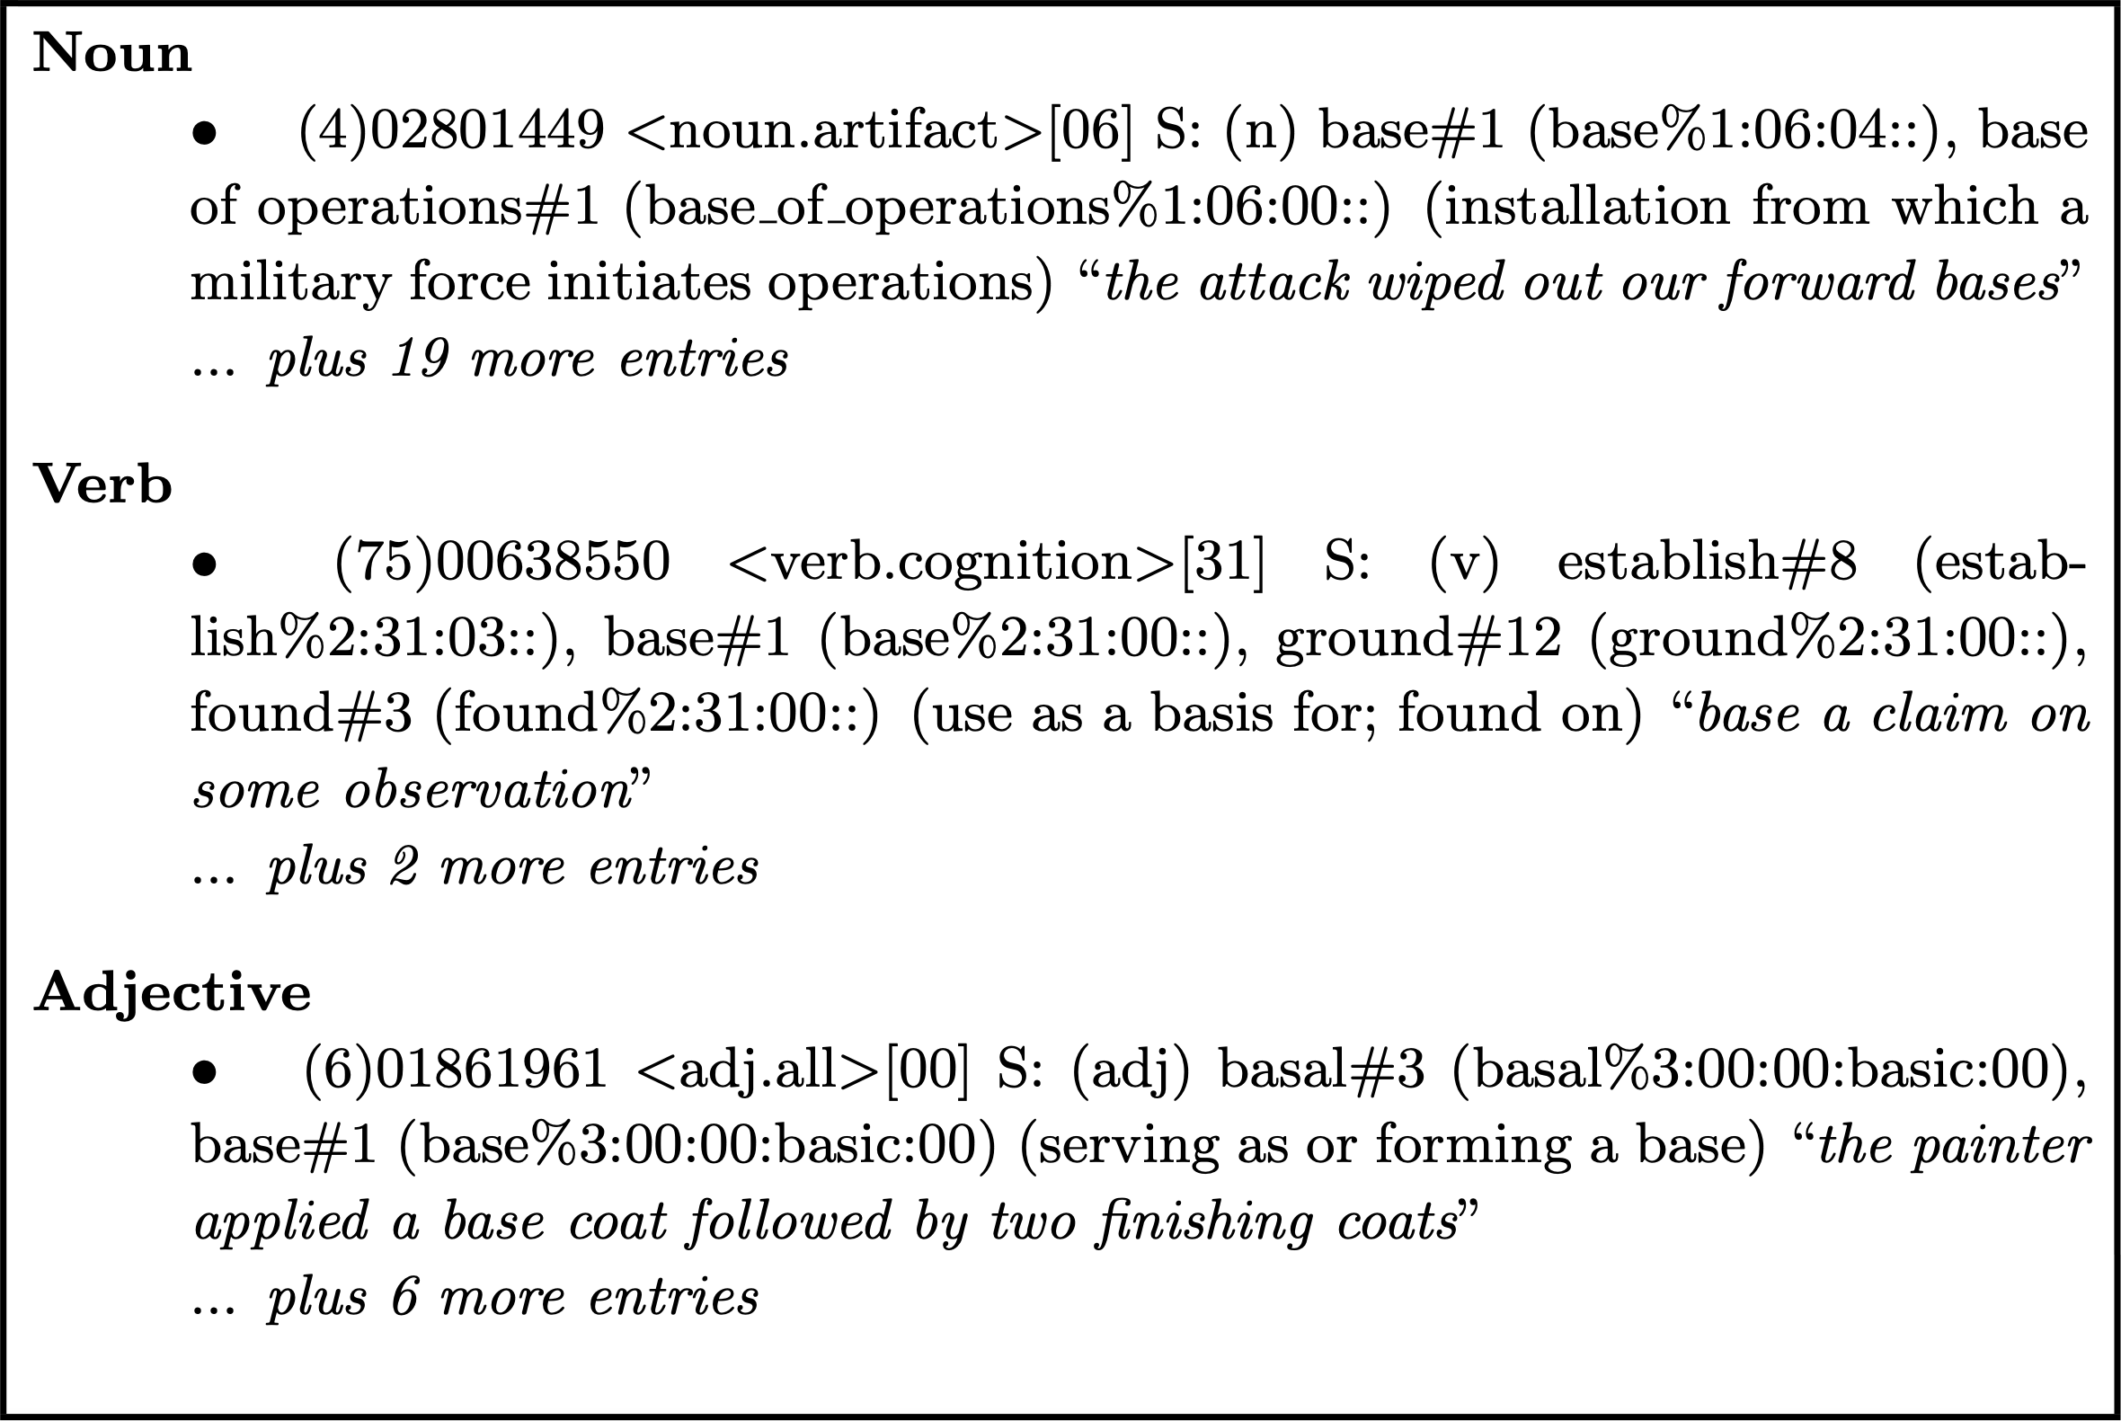
Sample entries for the word “base” in WordNet
Fig. 13.8
Notes:
13.8 Sample entries for the word “base” in WordNet 197
https://wordnet.princeton.edu/license-and-commercial-use

Slide 12
Example output of CLAWS WWW tagger
copes with typing error in input
I’ll base by travel plans on the weather, either take a helicopter from the air base or climb from base camp
I_PNP 'll_VM0 base_VVI by_PRP travel_NN1 plans_VVZ on_PRP the_AT0 weather_NN1 , _PUN either_AV0 take_VVB a_AT0 helicopter_NN1 from_PRP the_AT0 air_NN1 base_NN1 or_CJC climb_VVB from_PRP base_SENT camp_NN1
different meanings of the word ‘base’
Fig. 13.9
Notes:
13.9 Example output of CLAWS WWW tagger with three meanings for ‘base’. Note that the tagger copes with the typing error ‘by’ 197

Slide 13
Semantic grammar fragment
Fig. 13.10
Notes:
13.10 Semantic grammar fragment. 199
nlp/semgram.eps

Slide 14
Parse tree for the first sentence
Fig. 13.11
Notes:
13.11 Parse tree for the first sentence. 199
nlp/semparse1.eps

Slide 15
Parse tree for the second sentence
Fig. 13.12
Notes:
13.12 Parse tree for the second sentence. 199
nlp/semparse2.eps

