Slide 1
Chapter 14
Time Series and Sequential Data
Notes:
List of Figures
14.1 Stock market leading up to and after Black Monday, 19th October 1987 (adapted from \url {https://commons.wikimedia.org/wiki/File:Black_Monday_Dow_Jones.svg}). 206
14.2 Digitally produced spectrogram of a male voice saying `nineteenth century' (\url {https://commons.wikimedia.org/wiki/File:Spectrogram-19thC.png}). 208
14.3 A simple family of wavelets -- the Haar Wavelet. 209
inline in Table 4.1 208
14.4 Locating sub-sequences in longer sequence. 213
14.5 Diffuse classification of regions. 213
14.6 Recurrent neural network (RNN). 215
14.7 Running a recurrent neural network on data stream $d_1, d_2, d_3, \ldots $ 215
14.8 Covid-19 deaths for UK in 2020 -- daily data is very noisy, but a 7-day moving average is far more stable (adapted from: \url {https://coronavirus.data.gov.uk/details/deaths}). 216
14.9 Using statistical processing as pre-processor for other AI techniques. 217
14.10 Using ML to choose parameters for statistical processing. 217
14.11 Extract of ECG trace (adapted from Ptrump16 -- Own work, CC BY-SA 4.0, \url {https://commons.wikimedia.org/w/index.php?curid=77817932}). 219

Slide 2
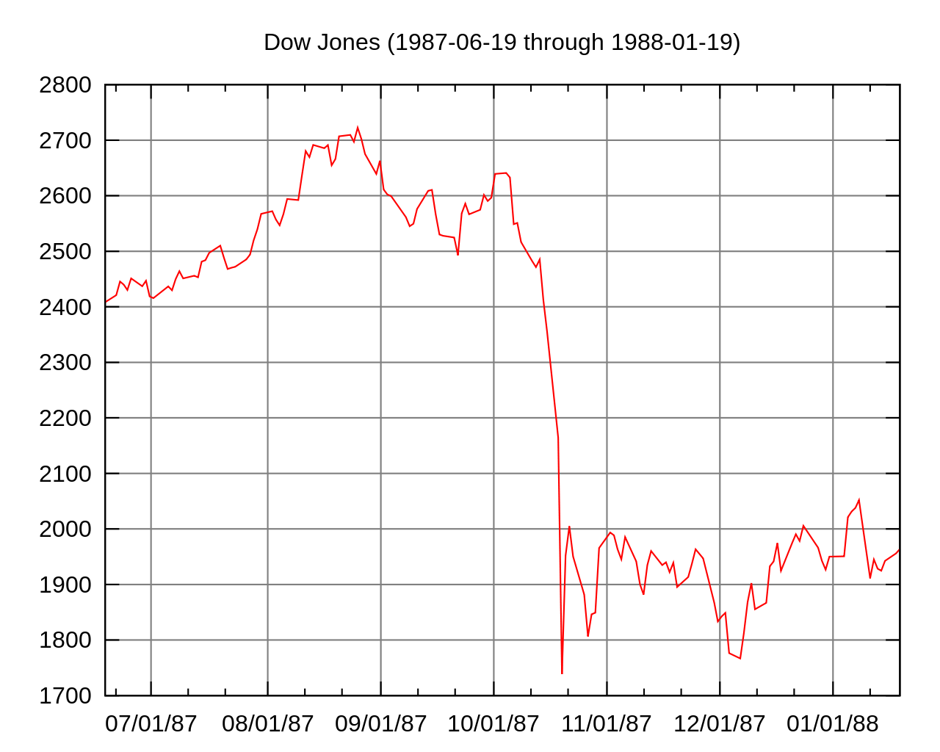
Stock market leading up to and after Black Monday
Black Monday discontinuous change
(19th October 1987)
Bull market
Bear market
Fig. 14.1
Notes:
14.1 Stock market leading up to and after Black Monday, 19th October 1987 206
Autopilot, CC BY-SA 3.0 <https://creativecommons.org/licenses/by-sa/3.0>, via Wikimedia Commons https://commons.wikimedia.org/wiki/File:Black_Monday_Dow_Jones.svg

Slide 3
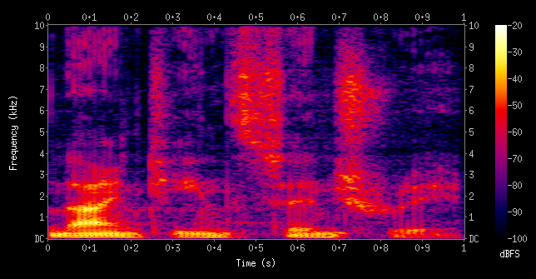
Digitally produced spectrogram of a male voice saying `nineteenth century'
Fig. 14.2
Notes:
14.2 Digitally produced spectrogram of a male voice saying ‘nineteenth century’ 208
time/Spectrogram-19thC.png
https://commons.wikimedia.org/wiki/File:Spectrogram-19thC.png
Aquegg, Public domain, via Wikimedia Commons

Slide 4
Haar Wavelet
w_0_0
w_1_0
w_1_1
w_2_0
w_2_1
w_2_2
Fig. 14.3
w_2_3
Notes:
14.3 A simple family of wavelets -- the Haar Wavelet. 209

Slide 5
0.5
B
0.5
0.25
A
0.25
0.5
C
0.5
0.5
Table 14.1b
Notes:
inline in Table 4.1 208

Slide 6
Locating sub-sequences in longer sequence
target sequence
ends with target
ends with target
ends with target
contains target
contains target
contains target
Fig. 14.4
Notes:
14.4 Locating sub-sequences in longer sequence. 213

Slide 7
Locating sub-sequences in longer sequence
target sequence
ends with target
ends with target
ends with target
contains target
contains target
contains target
Fig. 14.4
Notes:
14.4 Locating sub-sequences in longer sequence. 213

Slide 8
Diffuse classification of regions
type A
type B
type A
indeterminate
transition
Fig. 14.5
Notes:
14.5 Diffuse classification of regions. 213

Slide 9
Recurrent neural network (RNN)
state
‘state’ inputs
‘state’ outputs
inputs
outputs
inputs
outputs
(i) standard neural network
(ii) recurrent neural network
Fig. 14.6
Notes:
14.6 Recurrent neural network (RNN). 215

Slide 10
Running a recurrent neural network on data stream
time step 1
time step 2
time step 3
s₀
s₁
s₂
s₃
d₁
o₁
d₂
o₂
d₃
o₃
Fig. 14.7
Notes:
14.7 Running a recurrent neural network on data stream d_1, d_2, d_3, … 215

Slide 11
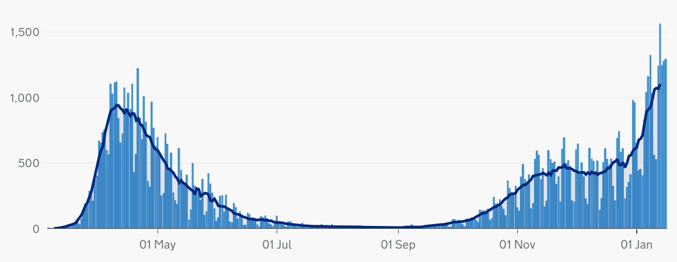
Covid-19 deaths for UK in 2020
daily data is very erratic
7-day average is more stable
Fig. 14.8
Notes:
14.8 Covid-19 deaths for UK in 2020 -- daily data is very noisy, but a 7-day moving averages is far more stable. 216
https://coronavirus.data.gov.uk/details/deaths

Slide 12
Using statistical processing as pre-processor for other AI techniques
statistical model
other AI/ML techniques
Σ
σ
μ
raw data
transformed data
Fig. 14.9
Notes:
14.9 Using statistical processing as pre-processor for other AI techniques. 217
cogs by Gregor Cresnar from the Noun Project

Slide 13
Using ML to choose parameters for statistical processing
statistical model
Σ
σ
μ
choose parameters
AI/ML
Fig. 14.10
Notes:
14.10 Using ML to choose parameters for statistical processing. 217
cogs by Gregor Cresnar from the Noun Project

Slide 14
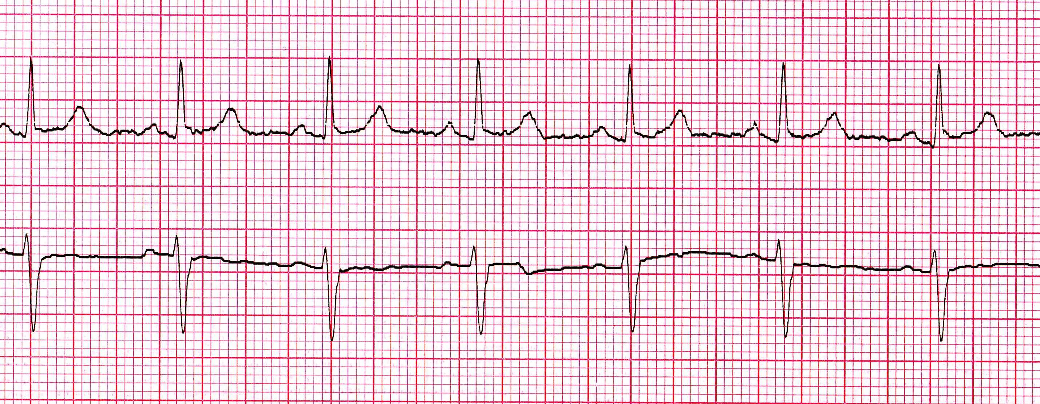
Extract of ECG trace
Fig. 14.11
Notes:
14.11 Extract of ECG trace 219
time/Normal_12_lead_EKG-extract.jpg
adapted from Ptrump16 -- Own work, CC BY-SA 4.0,
https://commons.wikimedia.org/w/index.php?curid=77817932

Slide 15
Table 14.1 Markov Model (upper) Transition Probability Table; (lower) Drawn as a Network.
Next letter
Current letter A B C
A 0.5 0.25 0.25
B 0.5 0.5 0
C 0.5 0 0.5
0.5
B
0.25
0.5
A
0.25
0.5
C
0.5
0.5
Notes:
Table 14.1 Markov Model (upper) Transition Probability Table; (lower) Drawn as a Network 208

Slide 16
inline table Section 14.3.1 p.208
Raw frequencies Totals
AA: 7 AB: 3 AC: 9 start with A: 19
BA: 2 BB: 2 BC: 0 start with B: 4
CA: 9 CB: 0 CC: 5 start with C: 14
Notes:
inline table Section 14.3.1 208

Slide 17
Table 14.2 Estimated Transition Probabilities Based on Observed Transition Frequencies.
Next letter
Current letter A B C
A 0.368 0.158 0.474
B 0.500 0.500 0.000
C 0.643 0.000 0.357
Notes:
Table 14.2 Estimated Transition Probabilities Based on Observed Transition Frequencies 208

Slide 18
Table 14.3 Markov Model Transition Probability Based on Previous Two Letters.
Next letter
Last 2 letters A B
AA 0.75 0.25
AB 0.5 0.5
BA 0.25 0.75
BB 1 0
Notes:
Table 14.3 Markov Model Transition Probability Based on Previous Two Letters. 209

Slide 19
inline table Section 14.3.2 p.209
Raw frequencies Totals
AAA: 11 AAB: 6 starting with AA: 17
ABA: 7 ABB: 8 starting with AB: 15
BAA: 6 BAB: 8 starting with BA: 14
BBA: 8 BBB: 0 starting with BB: 8
Notes:
inline table Section 14.3.2 209

Slide 20
Table 14.4 Observed Transition Probabilities for Order 2 Markov Model.
Next letter
Last 2 letters A B
AA 0.75 0.25
AB 0.5 0.5
BA 0.25 0.75
BB 1 0
Notes:
Table 14.4 Observed Transition Probabilities for Order 2 Markov Model. 209

Slide 21
Table 14.5 Hidden Markov Model for British Summer Weather – Hidden State in Brackets (Changeable/Wet).
Tomorrows weather
Current weather Sun Rain Sun Rain
(Changeable) (Changeable) (Wet) (Wet)
Sun (Changeable) 0.3 0.4 0.1 0.2
Rain (Changeable) 0.3 0.3 0 0.4
Sun (Wet) 0.2 0.1 0.1 0.6
Rain (Wet) 0 0.1 0 0.9
Notes:
Table 14.5 Hidden Markov Model for British Summer Weather – Hidden State in Brackets (Changeable/Wet). 210

Slide 22
Table 14.6 High-level Classification of Periods of Data as a Coarse-grained Time Series
D-723 high-rate, normal pattern – 15 mins (strenuous activity)
D-724 low-heart rate – 30 mins (rest)
D-725 tachycardia – 2 mins (problem)
... … …
Notes:
Table 14.6 High-level Classification of Periods of Data as a Coarse-grained Time Series 218

Slide 23
Table 14.7 Weather Transition Probabilities for Use in Exercise 14.1
Tomorrows weather
Current weather Sun Rain Sun Rain
(Changeable) (Changeable) (Wet) (Wet)
Sun (Changeable) 1/3 1/3 1/6 1/6
Rain (Changeable) 1/3 1/3 0 1/3
Sun (Wet) 1/6 1/6 1/6 1/2
Rain (Wet) 0 1/6 0 5/6
Notes:
Table 14.7 Weather Transition Probabilities for Use in Exercise 14.1. 219

