Slide 1

Chapter 15
Planning and robotics
Notes:
List of Figures
15.1 Blocks world. 222
15.2 Navigation challenge for a robot 224
15.3 Using a configuration space to plan a route 224
15.4 Circle-based configuration space. 225
15.5 Corridors and rooms between obstacles. 225
15.6 Local planning to avoid obstacles. 226
15.7 Avoiding moving objects. 227
15.8 The real world and the model world. 227
15.9 Calculating limb positions. 229
15.10 Robot with two limbs. 230
15.11 Compliant motion. 230
15.12 Resolving ambiguity. 232
15.13 Designing for easy assembly. 233
15.14 For exercise 3. 235

Slide 2
Blocks world
Fig. 15.1
Notes:
15.1 Blocks world. 222
robotics/blocks.eps

Slide 3
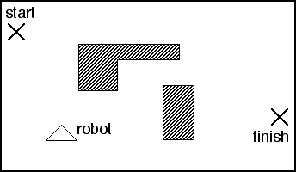
Navigation challenge for a robot
Fig. 15.2
Notes:
15.2 Navigation challenge for a robot 224
robotics/config-1.png

Slide 4
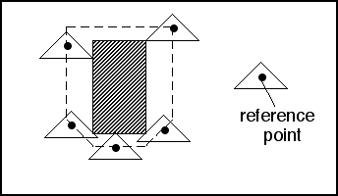
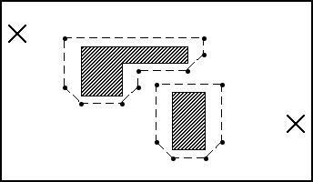
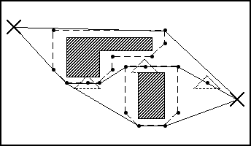
Using a configuration space to plan a route
(i)
(ii)
(iii)
Fig. 15.3
Notes:
15.3 Using a configuration space to plan a route 224
robotics/config-1.png

Slide 5
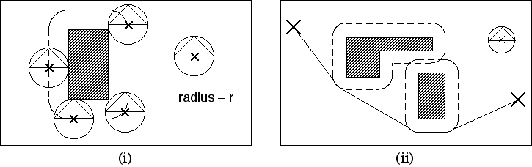
Circle-based configuration space.
Fig. 15.4
Notes:
15.4 Circle-based configuration space. 225
robotics/config-2.png

Slide 6
Corridors and rooms between obstacles
Fig. 15.5
Notes:
15.5 Corridors and rooms between obstacles. 225
robotics/rooms.eps

Slide 7
Local planning to avoid obstacles
Fig. 15.6
Notes:
15.6 Local planning to avoid obstacles. 226
robotics/avoid-1.eps

Slide 8
Avoiding moving objects
Fig. 15.7
Notes:
15.7 Avoiding moving objects. 227
robotics/avoid-2.eps

Slide 9
The real world and the model world
Fig. 15.8
Notes:
15.8 The real world and the model world. 227
robotics/sensing.eps

Slide 10
Calculating limb positions
Fig. 15.9
Notes:
15.9 Calculating limb positions. 229
robotics/dalek-1.eps

Slide 11
Robot with two limbs
Fig. 15.10
Notes:
15.10 Robot with two limbs. 230
robotics/dalek-2.eps

Slide 12
Compliant motion
Fig. 15.11
Notes:
15.11 Compliant motion. 230
robotics/feedback.eps

Slide 13
Resolving ambiguity
Fig. 15.12
Notes:
15.12 Resolving ambiguity. 232
robotics/active.eps

Slide 14
Designing for easy assembly
Fig. 15.13
Notes:
15.13 Designing for easy assembly. 233
robotics/screws.eps

Slide 15
For exercise 3
Fig. 15.14
Notes:
15.14 For exercise 3. 235
robotics/rob-ex.eps

Slide 16
Table 15.1 Blocks World Operations
operation precondition postcondition
pick_up(A) on_table(A) in_hand(A)
∧¬ on_top(C,A) ∧¬ on_table(A)
∧¬ in_hand(X)
put_down(A) in_hand(A) on_table(A)
∧¬ in_hand(A)
pick_off(A,B) on_top(A,B) in_hand(A)
∧¬ on_top(C,A) ∧¬ on_top(A,B)
∧¬in_hand(X)
put_on(A,B) in_hand(A) on_top(A,B)
∧¬ on_top(C,B) ∧¬ in_hand(A)
Notes:
Table 15.1 Blocks World Operations. 223

Slide 17
Table 15.2 Object Location and Velocity Data. (Note error values also recorded for each.)
time object id type position velocity
(x,y) error (x,y) error
1 #317 ball (3.3,3.2) 0.1 (−0.5,1.0) 0.2
1 #318 ball (2.8,2.0) 0.1 (0,−0.5) 0.2
1 #319 box (3.7,1.7) 0.1 — 0.0
2 #320 cone (1.5,0.5) 0.1 (0,0) 0.2
3 #321 ball (2.7,0.7) 0.1 (0.1,−0.8) 0.2
Notes:
Table 15.2 Object Location and Velocity Data. (Note error values also recorded for each.). 228

