Slide 1
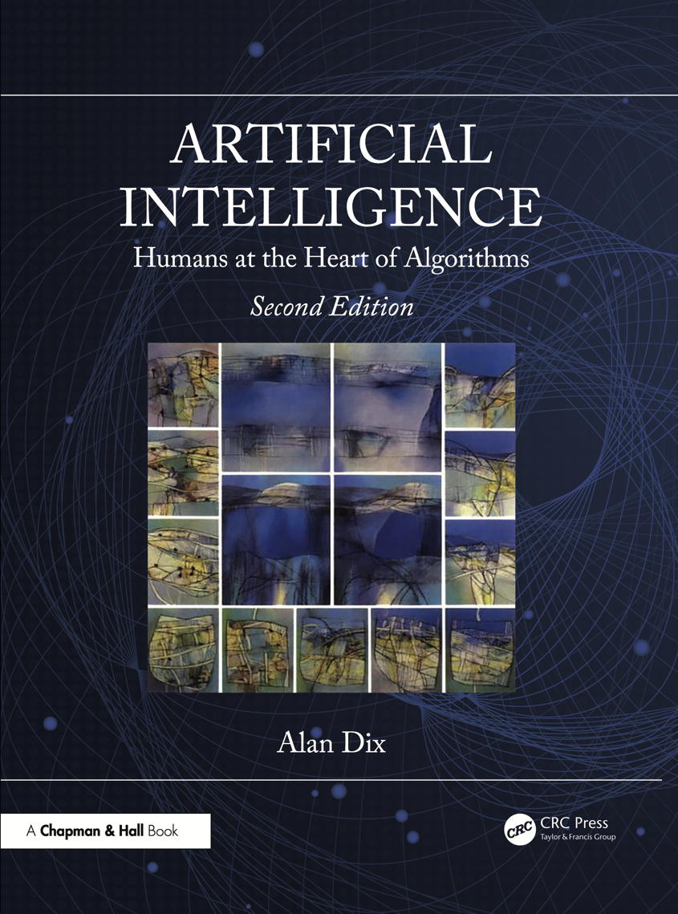
Chapter 18
Expert and
decision support systems
Notes:
List of Figures
18.1 Different forms of expert involvement. 271
18.2 Expert system capturing and applying knowledge. 273
18.3 Typical expert system architecture. 273
18.4 WebProtégé -- a web-based version of the Protégé} ontology editor \cite {musen2015protege}. 281
18.5 Hybrid expert system incorporating machine learning guided by human expertise. 282
18.6 Query-by-Browsing -- shows inferred rule both as SQL query and highlighted listing. 284
18.7 Dancing histograms: (left) plain stacked histogram -- easy to discern overall trends and trends in the baseline category (apples), but other categories less clear; (right) add interaction -- click on a category (bananas) to alter the baseline and make trends in that category easier to see. 286
18.8 Connected visualisations. 287
18.9 Visual analysis – the big picture: data coming from the world is used to generate insights, which influence decisions, which then change the world. 289

Slide 2
Different forms of expert involvement.
explicit
rules
traditional
expert systems
decision
support systems
knowledge
acquisition
source
expert
guided
machine learning
based expert systems
past expert
data
visual
analytics
raw data
Fig. 18.1
automated
non-/less-expert
expert
application
Notes:
18.1 Different forms of expert involvement. 271

Slide 3


Expert system capturing and applying knowledge
knowledge acquisition
application
expert
system
expert
rules
automated
action
advising
non-expert
Fig. 18.2
Notes:
18.2 Expert system capturing and applying knowledge. 273

Slide 4
Typical expert system architecture
user
dialogue and UI component
explanation
component
inference: reasoning
and heuristics
Fig. 18.3
knowledge base
Notes:
18.3 Typical expert system architecture. 273

Slide 5
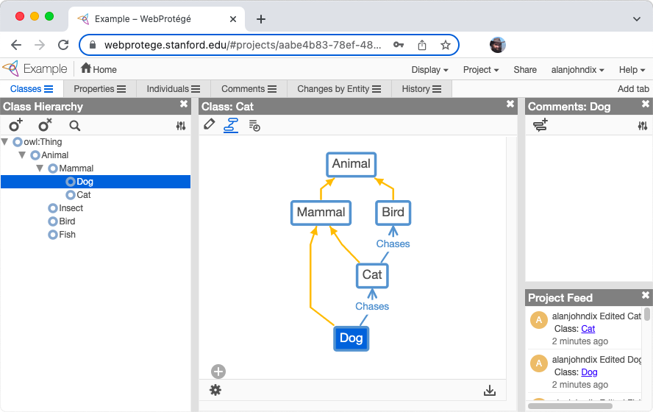
WebProtégé – a web-based version of the Protégé ontology editor
Fig. 18.4
Notes:
18.4 WebProtégé -- a web-based version of the Protégé} ontology editor \cite {musen2015protege}. 281
expert/webprotege.png

Slide 6
Hybrid expert system incorporating machine learning guided by human expertise
expert
knowledge
elicitation
features and
labels
machine
learning
raw data
rules
0010010
1010011
0100101
1110011
01101010001110100011101010100101101
ground
truth labels
Fig. 18.5
Notes:
18.5 Hybrid expert system incorporating machine learning guided by human expertise. 282

Slide 7
Query-by-Browsing
inferred rule
as SQL query
(intensional)
also highlighted in listing
(extensional)
Fig. 18.6
Notes:
18.6 Query-by-Browsing -- shows inferred rule both as SQL query and highlighted listing. 284
learning/screen.eps

Slide 8
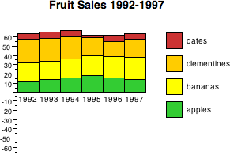
Dancing histograms: plain stacked histogram
easy to discern overall trends and trends in the baseline category (apples), but other categories less clear
Fig. 18.7a
Notes:
18.7 Dancing histograms: (left) plain stacked histogram -- easy to discern overall trends and trends in the baseline category (apples), but other categories less clear; (right) add interaction -- click on a category (bananas) to alter the baseline and make trends in that category easier to see. 286

Slide 9
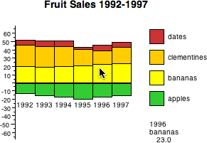
Dancing histograms: add interaction
click on a category (bananas) to alter the baseline and make trends in that category easier to see
Fig. 18.7b
Notes:
18.7 Dancing histograms: (left) plain stacked histogram -- easy to discern overall trends and trends in the baseline category (apples), but other categories less clear; (right) add interaction -- click on a category (bananas) to alter the baseline and make trends in that category easier to see. 286

Slide 10
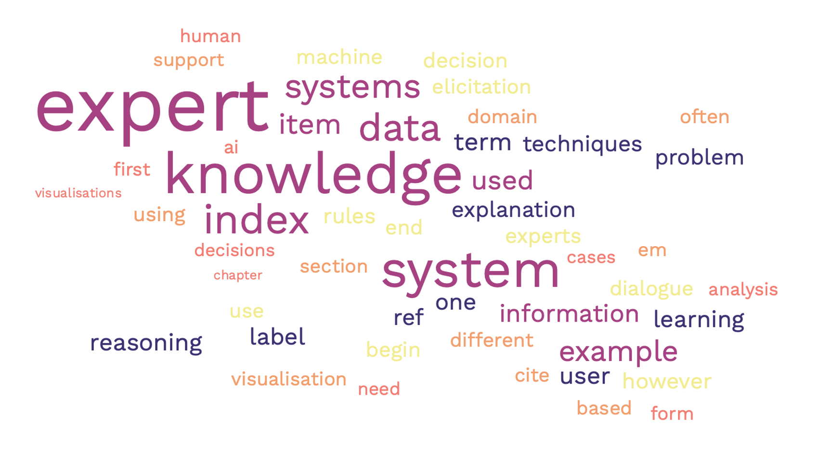

Connected visualisations
select documents
from network view
word cloud is recomputed
for selected documents
highlighting words
in the word cloud
will filter the
document
collection
select
cluster
save
copy
Fig. 18.8
Notes:
18.8 Connected visualisations. 287
https://www.freewordcloudgenerator.com/
3. Artwork license
All images can be used for your personal or commercial purposes. You can copy, modify, distribute and use high quality images, even for commercial purposes, all without asking permission

Slide 11

Visual analytics – big picture
organisational
social & political
context
action
?
decision
world
visualisation
data
processing
direct
interaction
Fig. 18.9
Notes:
18.9 Visual analytics – the big picture: data coming from the world is used to generate insights, which influence decisions, which then change the world. 289

Slide 12
Table 18.1 Strengths of Humans and Computers in Decision Making
(From Mary L. Cummings. Automation bias in intelligent time critical decision support systems. In AIAA 1st intelligent systems technical conference 2004.)
Humans are better at: Computers are better at:
Perceiving patterns Responding quickly to
control tasks
Improvising and using Repetitive and routine tasks
flexible procedures
Recalling relevant facts at Reasoning deductively
the appropriate time
Reasoning inductively Handling many complex tasks
simultaneously
Exercising judgment
Notes:
Table 18.1 Strengths of Humans and Computers in Decision Making, from [62]. 284
From Mary L. Cummings. Automation bias in intelligent time critical decision support systems. In AIAA 1st intelligent systems technical conference 2004. Chicago, IL, 20–22 September 2004.

