Slide 1
Chapter 19
AI working with and for humans
Notes:
List of Figures
19.1 Shneiderman's two-dimensional human--centred AI framework. 297
19.2 Talking to Siri. 298
19.3 Firefly -- individual lights flash a unique code and are then positioned using triangulation from multiple camera angles. 303
19.4 Sensor fusion: from multiple raw sensors to rich context model. 304
19.5 Courtesy lights -- when do you want them on? 305
19.6 Heating controller (left) first design option more information; (right)\nobreakspace {}second\nobreakspace {}design option less information, more intelligence. 306
19.7 Appropriate intelligence -- Sum button in Excel. 307
19.8 Multiple levels of processing in a speech-based system. 309
19.9 Levels of confidence and action -- simplified view. 309
19.10 onCue -- designing appropriate interactions. 310
19.11 Two search engine interaction styles. 312

Slide 2
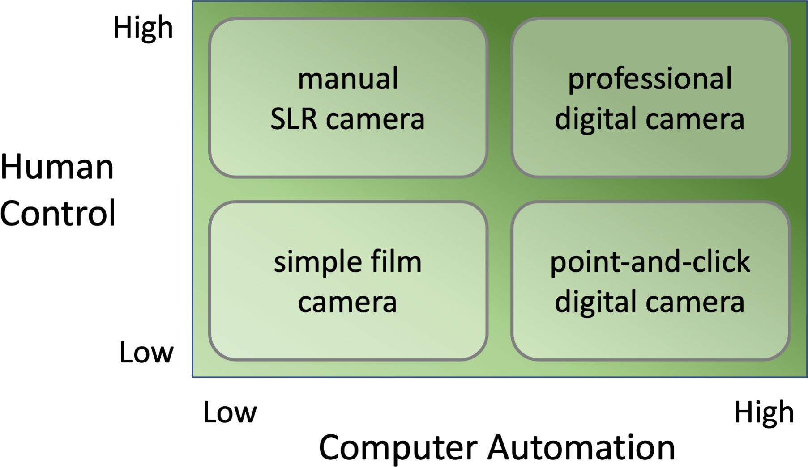
Shneiderman's human–centred AI framework
Fig. 19.1
Notes:
19.1 Shneiderman's two-dimensional human--centred AI framework. 297
human/shneiderman-levels.png

Slide 3
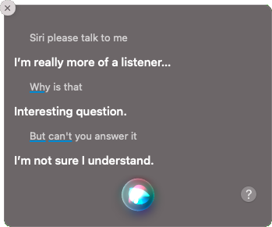
Talking to Siri
Fig. 19.2
Notes:
19.2 Talking to Siri. 298
human/talking-to-siri.png

Slide 4
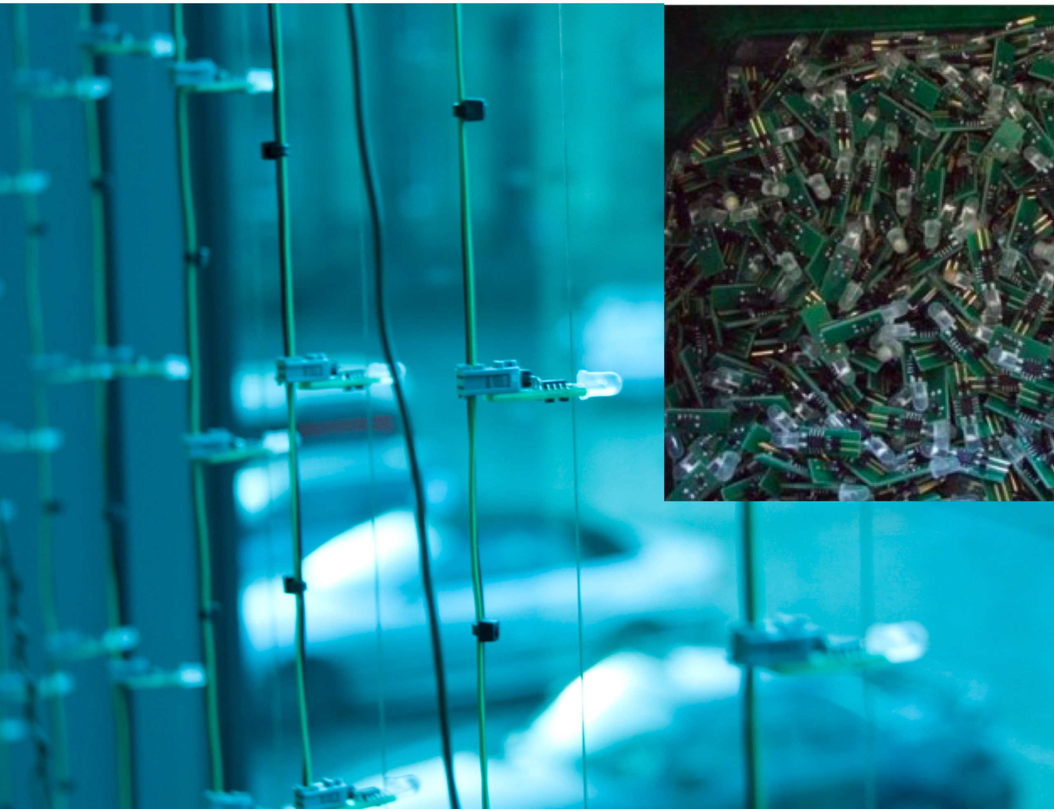
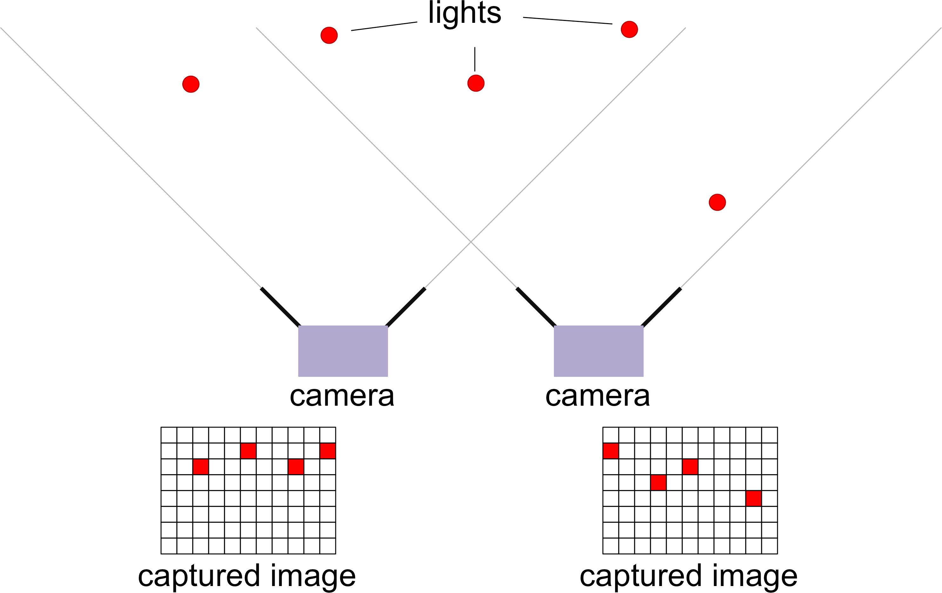
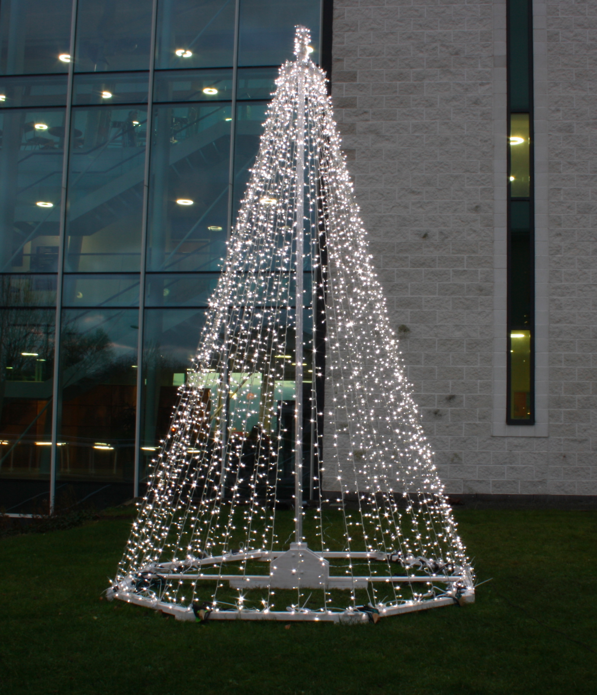
Firefly – individual lights flash a unique code and are then positioned using triangulation from multiple camera
Fig. 19.3
Notes:
19.3 Firefly -- individual lights flash a unique code and are then positioned using triangulation from multiple camera angles. 303
human/firefly-2.jpg
human/firefly-1.jpg
human/firefly-3.png

Slide 5
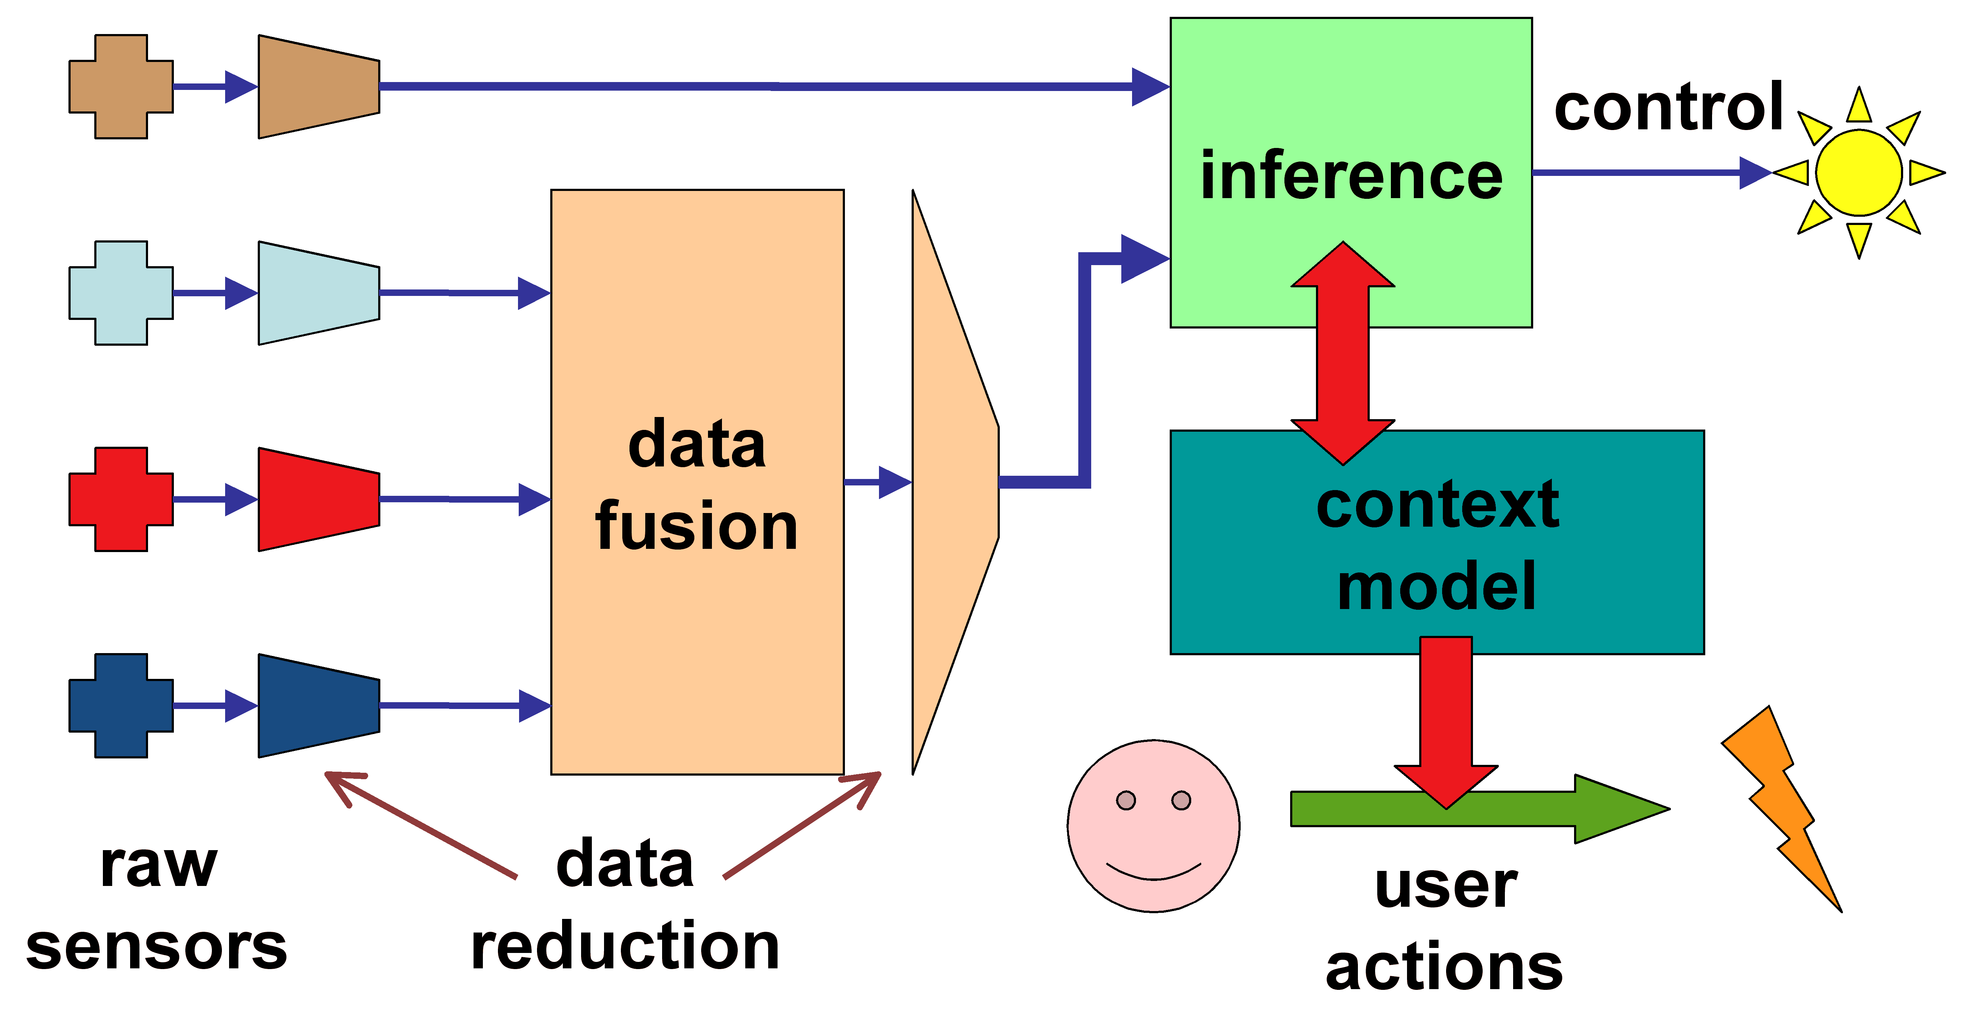
Sensor fusion: from multiple raw sensors to rich context model
Fig. 19.4
Notes:
19.4 Sensor fusion: from multiple raw sensors to rich context model. 304
human/sensor-fusion.png

Slide 6
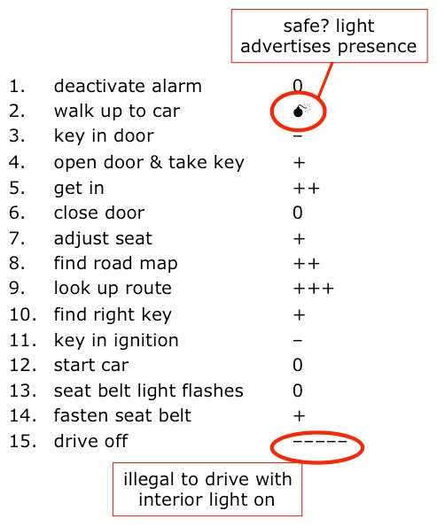
Courtesy lights when do you want them on?
Fig. 19.5
Notes:
19.5 Courtesy lights -- when do you want them on? 305
human/courtesy-scenario.jpg

Slide 7
Heating controller (left) first design option more information; (right) second design option less information, more intelligence
“currently heating” icon
target temperature
“I want it
warmer” button
20°
17°
“I want it
cooler” button
current temperature
temperature setting buttons
Fig. 19.6
Notes:
19.6 Heating controller (left) first design option more information; (right) second design option less information, more intelligence. 306
Twitter, CC BY 4.0 <https://creativecommons.org/licenses/by/4.0>, via Wikimedia Commons
https://commons.wikimedia.org/wiki/File:Twemoji12_2744.svg

Slide 8
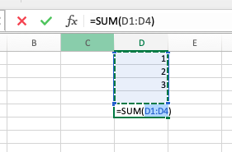
Appropriate intelligence – Sum button in Excel
SUM button scans for numbers above the chosen cell
easy to change selection if needed
Fig. 19.7
Notes:
19.7 Appropriate intelligence -- Sum button in Excel. 307

Slide 9
Multiple levels of processing in speech-based system
potential uncertainty and feedback at each level
?
?
?
?
lexical
syntactic
semantic
pragmatic
no/oh London/Lisbon
20302 Lisbon the city
20302 bottles of milk flight to Lisbon
a lot of milk? assume from JFK
Fig. 19.8
Notes:
19.8 Multiple levels of processing in a speech-based system. 309
https://commons.wikimedia.org/wiki/File:Antu_mic-on.svg
Fabián Alexis, CC BY-SA 3.0 <https://creativecommons.org/licenses/by-sa/3.0>, via Wikimedia Commons

Slide 10
Levels of confidence and action
just do it!
act with feedback and easy repair
higher
single suggestion with confirmation
confidence
ranked suggestions
lower
Fig. 19.9
tentative suggestions
Notes:
19.9 Levels of confidence and action -- simplified view. 309

Slide 11
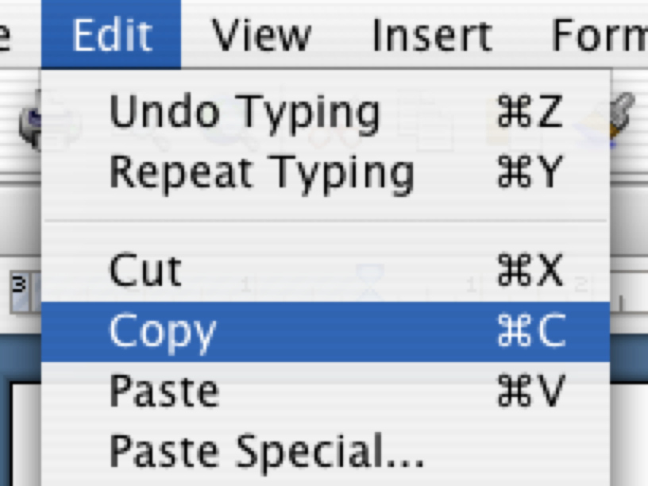
onCue – designing appropriate interactions
j
user selects text
k
20 21 22 23
25 24 20 17
7 7 3 7
the dancing histograms very useful a
ing out some of the textile sites yo
x's page at http://www.hiraeth.com/
and copies it to clipboard
l
slowly icons fade in
histograms
Fig. 19.10
Notes:
19.10 onCue -- designing appropriate interactions. 310

Slide 12
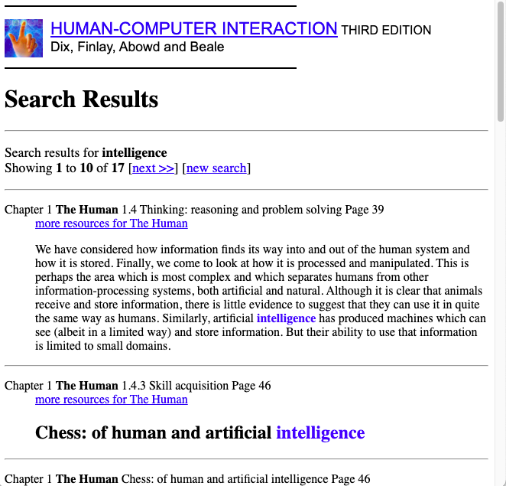
Two search engine interactions styles
Fig. 19.11a
Notes:
19.11 Two search engine interaction styles. 312

Slide 13
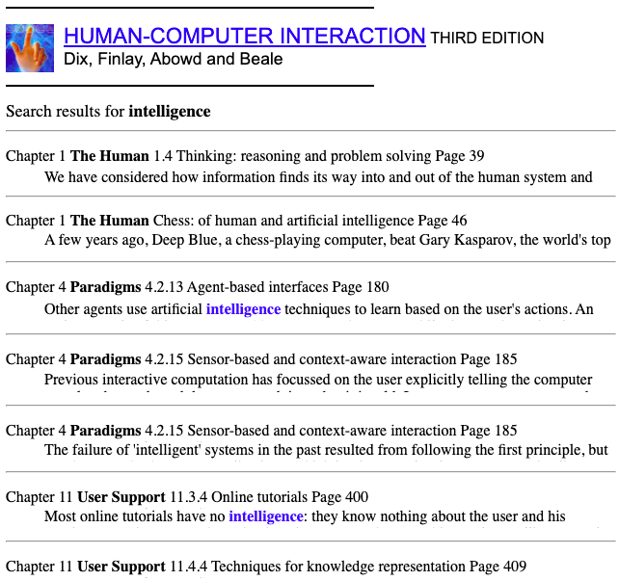
Two search engine interactions styles
Fig. 19.11b
Notes:
19.11 Two search engine interaction styles. 312

Slide 14
Table 19.1 Who Has Control and Who Does the Work, Some Examples
initiative decision action example
machine machine human delivery service
human machine machine autonomous car
human joint human decision support
machine joint joint recommender system
human joint machine engine management system
Notes:
Table 19.1 Who Has Control and Who Does the Work, Some Examples. 296
.

Slide 15
Table 19.2 Confusion Matrix for Activity Recognition
actual activity
running walking hopping
running 67% 12% 21%
walking 82% 15% 3%
hopping 57% 7% 36%
classified activity
Notes:
Table 19.2 Confusion Matrix for Activity Recognition. 304
.

