Slide 1
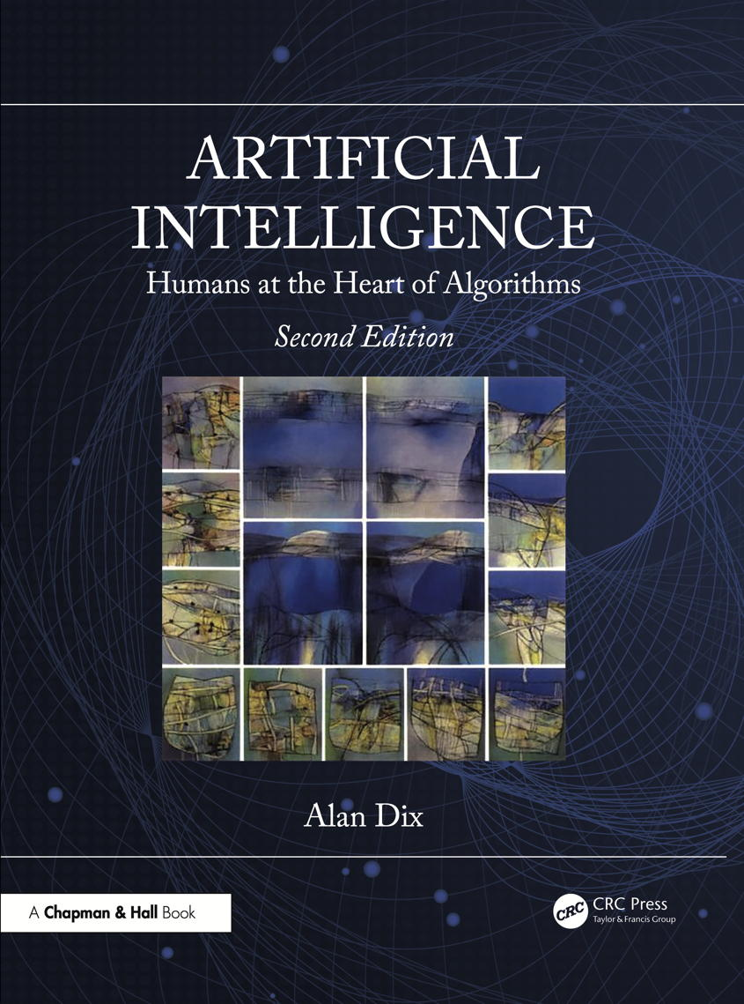
Chapter 20
When things go wrong
Notes:
List of Figures
20.1 Increasing opacity in more complex algorithms. 316
20.2 Bias entering at different stages in machine learning. 317
20.3 Google image search ``Professor'' 13th Feb 2019 -- 15 images, 10 white males. 319
20.4 Google image search ``CEO'' 13th Feb 2019 -- 14 individual images, 9 white males. 319

Slide 2
Increasing opacity in more complex algorithms
rules and regulations
ordinary code
classic AI
machine learning and neural nets
increasing opacity
Fig. 20.1
Notes:
20.1 Increasing opacity in more complex algorithms. 316

Slide 3
Bias entering at different stages in machine learning
training data
societal bias in goals
objective function
learning
past bias in training data
learnt rules
choice of features
‘best’ may be biased
Fig. 20.2
Notes:
20.2 Bias entering at different stages in machine learning. 317
bias/sources-of-bias.png

Slide 4
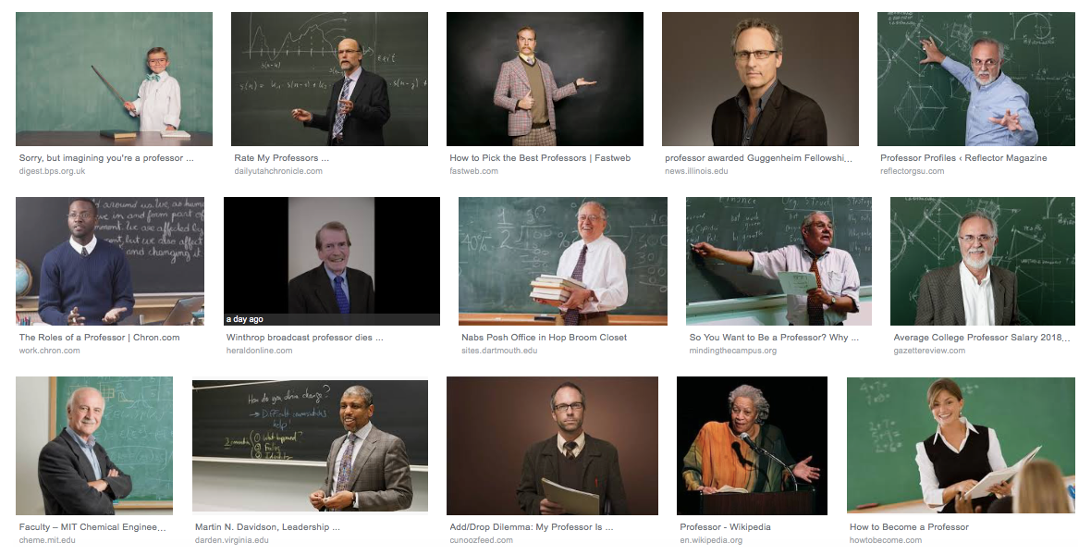
Google image search “Professor” (13th Feb 2019) 15 images, 10 white male
Fig. 20.3
Notes:
20.3 Google image search ``Professor'' 13th Feb 2019 -- 15 images, 10 white males. 319
bias/Google-professor-13-Feb-2019.png

Slide 5
Google image search “CEO” (13th Feb 2019) 14 individual images, 9 white male
Fig. 20.4
Notes:
20.4 Google image search ``CEO'' 13th Feb 2019 -- 14 individual images, 9 white males. 319
bias/Google-CEO-13-Feb-2019.png

Slide 6
Table 20.1 Data Used in Exercises 20.1 and 20.2. Key: M–Mathematics, S–Science, L–Language, H–History.
XY height M S L H apt A apt B
X 1.53 N N Y Y 0 3
X 1.56 N Y Y Y 2 3
Y 1.68 N Y N N 2 0
Y 1.6 Y Y Y N 3 2
Y 1.65 Y Y N Y 3 1
Y 1.65 Y Y Y N 3 3
X 1.56 N Y Y Y 2 3
X 1.52 Y N N Y 1 1
X 1.56 Y N Y N 0 3
Y 1.71 N Y N N 2 0
Notes:
Table 20.1 Data Used in Exercises 20.1 and 20.2. Key: M–Mathematics, S–Science, L–Language, H–History.. 327
.

Slide 7
Table 20.1 (ctd) Data Used in Exercises 20.1 and 20.2. Key: M–Mathematics, S–Science, L–Language, H–History.
XY height M S L H apt A apt B
X 1.54 N N Y Y 0 3
Y 1.75 N Y N N 2 0
X 1.53 N N N Y 0 0
Y 1.63 N Y N N 2 0
X 1.58 N Y Y Y 3 3
Y 1.63 Y Y N N 3 0
Y 1.69 N Y N Y 3 0
X 1.56 Y N Y Y 1 3
Y 1.6 Y Y Y N 3 2
X 1.63 N N Y N 0 2
Notes:
Table 20.1 Data Used in Exercises 20.1 and 20.2. Key: M–Mathematics, S–Science, L–Language, H–History.. 327
.

Slide 8
Table 20.2 First Dataset Used in Exercise 20.3
x y x y x y
1.804 4.344 1.219 3.050 1.275 3.966
1.671 4.609 1.324 3.463 3.665 3.298
4.845 3.538 3.542 2.357 4.876 3.535
1.821 4.301 1.832 2.642 4.664 3.651
1.777 4.645 4.338 2.706 2.464 3.357
4.362 2.600 4.189 4.021 1.264 4.161
1.735 3.849 4.383 2.113 1.283 3.969
4.014 1.477 4.577 2.373 1.509 4.118
4.846 4.151 1.330 3.669 1.458 3.351
4.167 3.277 3.990 2.056 3.807 3.298
4.856 3.372 1.114 3.909 1.862 5.366
1.233 3.442 0.978 4.113 4.144 2.072
4.607 2.574 4.786 1.899 3.780 3.388
1.746 3.680
Notes:
Table 20.2 First Dataset Used in Exercise 20.3 327

Slide 9
Table 20.3 Second Dataset Used in Exercise 20.3
x y x y x y
1.809 2.160 2.214 2.341 4.743 1.852
3.971 1.430 4.268 3.946 3.410 3.594
2.943 1.849 4.564 2.526 2.225 2.172
4.534 2.325 1.810 3.400 3.771 3.573
3.499 2.309 2.204 3.609 2.558 4.856
4.340 2.065 2.472 4.136 3.269 3.593
4.479 3.830 1.803 1.955 1.937 1.842
3.384 3.684 2.517 3.792 4.295 2.658
4.319 2.553 1.698 1.542 1.979 3.460
2.367 4.100 1.971 3.457 4.449 3.834
4.460 3.668 4.101 2.024 2.499 3.835
2.311 1.134 4.450 4.447 3.947 2.009
1.673 3.604 1.712 1.934 1.743 2.653
3.793 4.317
Notes:
Table 20.3 Second Dataset Used in Exercise 20.3 328

