Slide 1
Chapter 21
Explainable AI
Notes:
List of Figures
21.1 Query-by-Browsing (\url {https://www.meandeviation.com/qbb/}). 333
21.2 QbB -- under the bonnet. 334
21.3 Decision tree for whether police stop a car (selected path in red). 334
21.4 Alternative decision tree taking into account emergency vehicles. 335
21.5 Sensitivity analysis using small perturbations of the original data. 336
21.6 Three broad classes of explainability technique. 336
21.7 Simplification of rule set. 338
21.8 Adversarial learning to generate training sets for white-box learning. 338
21.9 Exploratory analysis for human visualisation. 338
21.10 Key feature detection through perturbations. 338
21.11 Identifying central and boundary examples. 338
21.12 Grey-box techniques prising open the black-box at an internal layer. 339
21.13 Clustering and comprehension of low-level features. 340
21.14 High-level model generation. 340

Slide 2
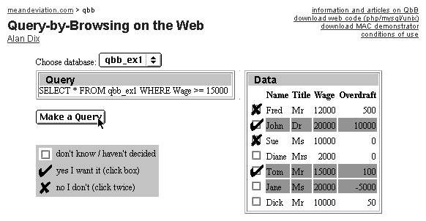
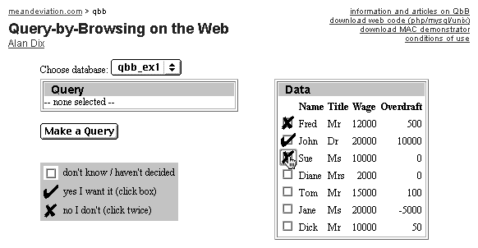
Query-by-Browsing
(3) system infers SQL query
(4) query results highlighted
(2) user asks system to make a query
(1) user marks chosen records
Fig. 21.1
Notes:
21.1 Query-by-Browsing 333
https://www.meandeviation.com/qbb/

Slide 3
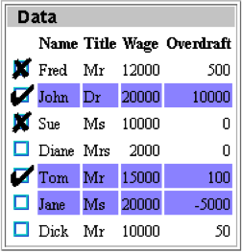
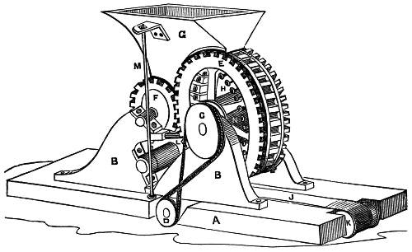
QbB – under the bonnet
examples
SQL query
decision tree
machine learning
cond

cond


Fig. 21.2
Notes:
21.2 QbB -- under the bonnet. 334

Slide 4
Decision tree for whether police stop a car (selected path in red)
on police database of wanted vehicles
Y
N
driving dangerously
more choices
…
…
…
…
…
…
…
…
Y
N
driving too fast
more choices
…
…
…
…
…
…
…
…
Y
N
STOP
more choices
…
…
…
…
…
…
…
…
Fig. 21.3
Notes:
21.3 Decision tree for whether police stop a car (selected path in red). 334

Slide 5
Alternative decision tree taking into account emergency vehicles
more choices before this
…
…
…
…
…
…
driving too fast
Y
N
p=0.02
p=0.98
emergency vehicle
more choices
…
…
…
…
…
…
…
…
Y
N
p=0.01
p=0.99
more choices
STOP
…
…
…
…
…
…
…
…
Fig. 21.4
Notes:
21.4 Alternative decision tree taking into account emergency vehicles. 335

Slide 6
Sensitivity analysis
black-box algorithm
why?
create local decision model
input
x
B(x)
✘
✘
✘
✘
✔
✔
✘
✔
✘
x₁
B(x₁)
✘
lots of variations
x₁
B(x₂)
✔
...
✘
✔
smoker
✘
✔
weight
✘
✔
exercise
x_{n}
B(x_{n})
✘
visualise sensitivity
Fig. 21.5
Notes:
21.5 Sensitivity analysis using small perturbations of the original data. 336

Slide 7
Three broad classes of explainability technique
white-box
black-box
analysing and understanding from the outside
creating scrutable internal representations
grey-box
peeking within understanding internal representations
Fig. 21.6
Notes:
21.6 Three broad classes of explainability technique. 336

Slide 8
Simplification of rule set
training set
black-box learning
inscrutable rules
scrutable rules
tweak
Fig. 21.7
Notes:
21.7 Simplification of rule set. 338

Slide 9
Adversarial learning to generate training sets for white-box learning
black-box adversarial learning
case-base of behaviour
white-box learning
scrutable rules
Fig. 21.8
Notes:
21.8 Adversarial learning to generate training sets for white-box learning. 338

Slide 10
Exploratory analysis for human visualisation
training set
black-box learning
inscrutable rules
Fig. 21.9
lots of examples
black-box classifier
visualise input-output
Notes:
21.9 Exploratory analysis for human visualisation. 338

Slide 11
Key feature detection through perturbations
black-box learning
inscrutable rules
randomly vary feature values
black-box classifier
hotspot visualisation
Fig. 21.10
Notes:
21.10 Key feature detection through perturbations. 338

Slide 12
Identifying central and boundary examples
boundary cases small perturbations change class
central cases perturbations do not change class
penumbra larger perturbations change class
Fig. 21.11
Notes:
21.11 Identifying central and boundary examples. 338

Slide 13
Identifying central and boundary examples
boundary cases small perturbations change class
central cases perturbations do not change class
penumbra larger perturbations change class
Fig. 21.11
Notes:
21.11 Identifying central and boundary examples. 338

Slide 14
Grey-box techniques prising open the black-box at an internal layer
black-box system
input
output
slice black box at internal layer
input
first-stage
black box
internal representation
second-stage
black box
output
Fig. 21.12
Notes:
21.12 Grey-box techniques prising open the black-box at an internal layer. 339

Slide 15
Clustering and comprehension of low-level features
input examples
clusters
black-box classifier
SOM
extract intermediate activation
various algorithms
MDS
activations as input
Fig. 21.13
Notes:
21.13 Clustering and comprehension of low-level features. 340

Slide 16
High level model generation
input examples
black-box classifier
output classes
extract intermediate activation
white-box learning
scrutable rules
activations with output class as training set
Fig. 21.14
Notes:
21.14 High-level model generation. 340

