Slide 1
Chapter 22
Models of the mind – Human-Like Computing
Notes:
22.1 Basic SOAR diagram. After Newell \citeyear {Newell:92}. 347
22.2 Rubin's vase (Source: NevitNevit Dilmen, CC BY-SA 3.0 via Wikimedia Commons). 348
22.3 Semantic network for disambiguation. 349
22.4 Regret in machine learning. 353
22.5 ChatGPT advice about an emotional situation (\url {https://askaichat.app/}, 6th May 2024). 353

Slide 2
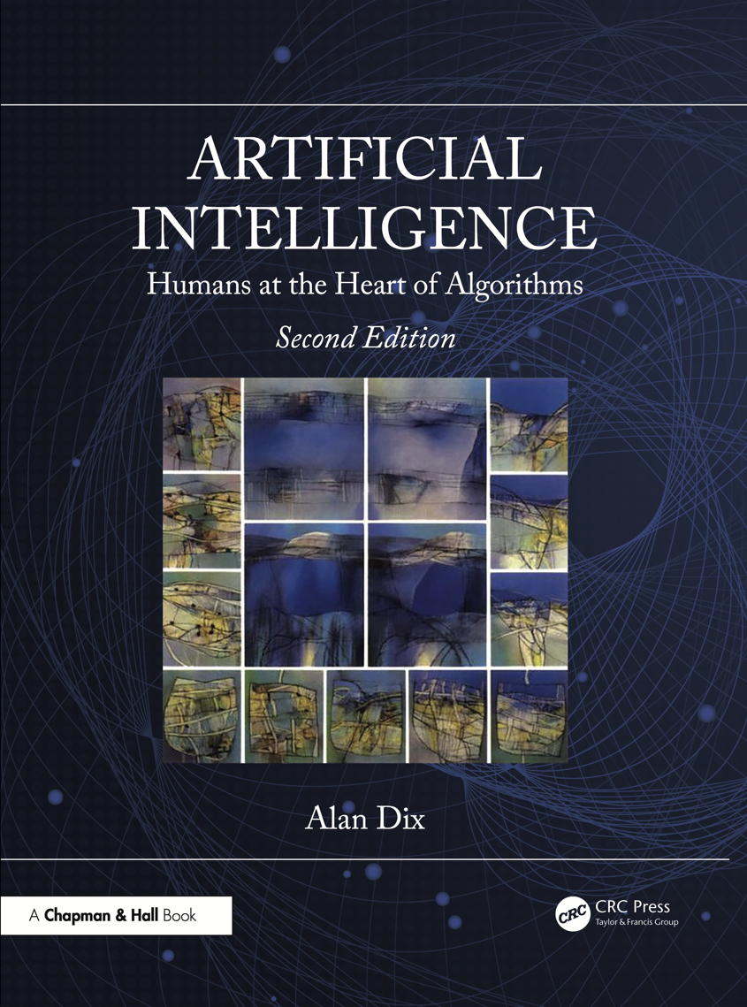
Chapter 1
Introduction
Notes:
List of Figures

Slide 3
Basic SOAR diagram
Chunking
Long-Term Recognition Memory
Working Memory
Multiple Productions
Contains current problem spaces
production1: condition1 and condition2
?
action1 and action2
production2: condition3 and condition4
impasse
action1 and action4
. . .
Goal stack
?
impasse
Fig. 22.1
Notes:
22.1 Basic SOAR diagram. After Newell (1992) 347

Slide 4
Rubin's vase
Fig. 22.2
Notes:
22.2 Rubin's vase 348
cog/rubins-vase.png
Ataturk.svg: NevitNevit Dilmen, CC BY-SA 3.0 via Wikimedia Commons. https://commons.wikimedia.org/wiki/File:Face_or_vase_ata_01.svg

Slide 5
Semantic network for disambiguation
bow
reinforce
weapon
front of boat
bend at waist
inhibit
back of boat
monarch
facial expression
rock band
stern
Queen
Fig. 22.3
Notes:
22.3 Semantic network for disambiguation. 349

Slide 6
Regret in machine learning
basic ML module
game mechanics
stimulus
cards dealt
SRE assoc
lookup and choose
response
stick/twist
update
plug-in regret module
emotion
effect
win/lose
modify
post-hoc info.
further cards dealt
Fig. 22.4
Notes:
22.4 Regret in machine learning. 353

Slide 7
ChatGPT advice about an emotional situation
Fig. 22.5
Notes:
22.5 ChatGPT advice about an emotional situation 353
https://askaichat.app/ (6th May 2024)

Slide 8
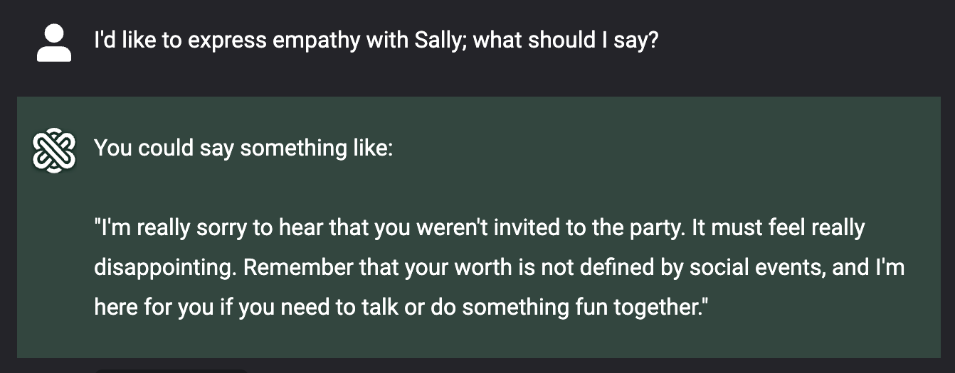
ChatGPT advice … ctd … empathy?
Notes:
22.5 ChatGPT advice about an emotional situation 353
…. ctd ….
https://askaichat.app/ (6th May 2024)

