Slide 1
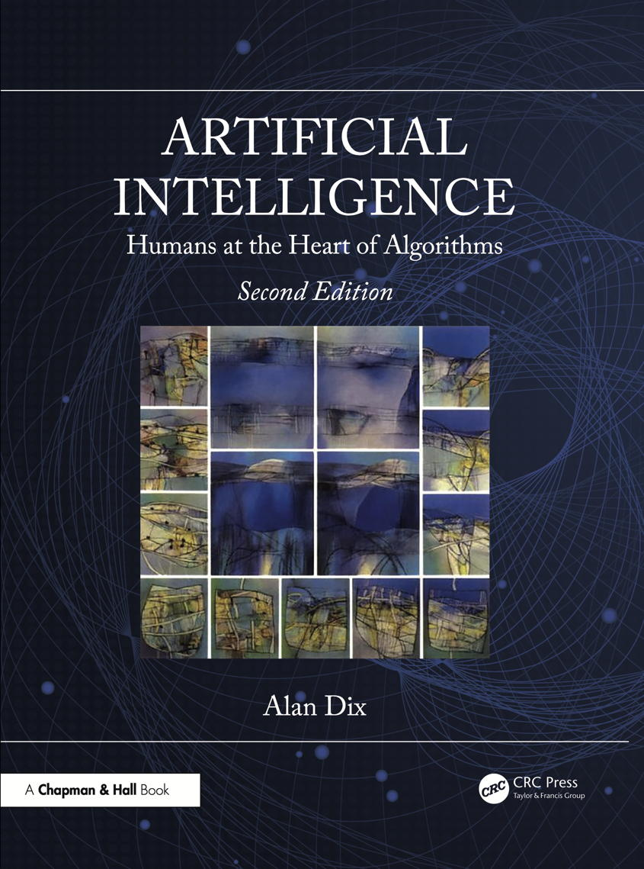
Chapter 23
Philosophical, ethical and social issues
Notes:
List of Figures
23.1 Generate and filter: initial ideas are iteratively evaluated, filtered, recombined and modified until the final problem solution or work of art is selected. 359
23.2 Anticipate, Reflect, Engage, Act -- The UKRI \term {AREA Framework} for Responsible Innovation \cite {ukri2023responsible}. 363
23.3 Trolley problem: do you sacrifice one life to save five? (Image: McGeddon Vector: Zapyon -- This SVG diagram includes elements from this icon: CC-BY-SA 4.0, https://commons.wikimedia.org/w/index.php?curid=67107784). 363
23.4 Reducing the dimensionality of inner layers to reduce re-training and runtime costs. 370

Slide 2
Generate and filter
idea 1
idea 1’
✔
?
✗
idea 2
✗
solution
problem / need
idea 3
idea 4’
idea 4
✗
idea 5
Fig. 23.1
Notes:
23.1 Generate and filter: initial ideas are iteratively evaluated, filtered, recombined and modified until the final problem solution or work of art is selected. 359

Slide 3
The UKRI AREA Framework for Responsible Innovation
Anticipate – Describe and analyse the impacts, intended or otherwise, that might arise. Do not seek to predict but rather support the exploration of possible impacts (such as economic, social and environmental) and implications that may otherwise remain uncovered and little discussed.
Reflect – Reflect on the purposes of, motivations for and potential implications of the research, together with the associated uncertainties, areas of ignorance, assumptions, framings, questions, dilemmas and social transformations these may bring.
Engage – Open up such visions, impacts and questioning to broader deliberation, dialogue, engagement and debate in an inclusive way.
Act – Use these processes to influence the direction and trajectory of the research and innovation process itself.
Fig. 23.2
Notes:
23.2 Anticipate, Reflect, Engage, Act -- The UKRI AREA Framework for Responsible Innovation 363
\cite {ukri2023responsible}.

Slide 4
Trolley problem – do you sacrifice one life to save five?
Fig. 23.3
Notes:
23.3 Trolley problem: do you sacrifice one life to save five? 363
social/Trolley_Problem.png
Original: McGeddon Vector: Zapyon, CC BY-SA 4.0
https://commons.wikimedia.org/w/index.php?curid=67107784
This SVG diagram includes elements from:
public – https://commons.wikimedia.org/wiki/File:BSicon_TRAM1.svg
CC BY-SA 4.0 – https://commons.wikimedia.org/wiki/File:Rozjazd_pojedynczy.svg
CC BY-SA 4.0 – https://commons.wikimedia.org/wiki/File:Person_icon_BLACK-01.svg

Slide 5
Trolley problem – do you sacrifice one life to save five?
do nothing
Fig. 23.3
Notes:
23.3 Trolley problem do you sacrifice one life to save five? 363
social/Trolley_Problem.png
Original: McGeddon Vector: Zapyon, CC BY-SA 4.0
https://commons.wikimedia.org/w/index.php?curid=67107784
This SVG diagram includes elements from:
https://commons.wikimedia.org/wiki/File:BSicon_TRAM1.svg
https://commons.wikimedia.org/wiki/File:Rozjazd_pojedynczy.svg
https://commons.wikimedia.org/wiki/File:Person_icon_BLACK-01.svg

Slide 6
Trolley problem – do you sacrifice one life to save five?
do nothing
five people die
Fig. 23.3
Notes:
23.3 Trolley problem do you sacrifice one life to save five? 363
social/Trolley_Problem.png
Original: McGeddon Vector: Zapyon, CC BY-SA 4.0
https://commons.wikimedia.org/w/index.php?curid=67107784
This SVG diagram includes elements from:
https://commons.wikimedia.org/wiki/File:BSicon_TRAM1.svg
https://commons.wikimedia.org/wiki/File:Rozjazd_pojedynczy.svg
https://commons.wikimedia.org/wiki/File:Person_icon_BLACK-01.svg

Slide 7
Trolley problem – do you sacrifice one life to save five?
pull lever
Fig. 23.3
Notes:
23.3 Trolley problem do you sacrifice one life to save five? 363
social/Trolley_Problem.png
Original: McGeddon Vector: Zapyon, CC BY-SA 4.0
https://commons.wikimedia.org/w/index.php?curid=67107784
This SVG diagram includes elements from:
https://commons.wikimedia.org/wiki/File:BSicon_TRAM1.svg
https://commons.wikimedia.org/wiki/File:Rozjazd_pojedynczy.svg
https://commons.wikimedia.org/wiki/File:Person_icon_BLACK-01.svg

Slide 8
Trolley problem – do you sacrifice one life to save five?
pull lever
five saved
one dies
Fig. 23.3
Notes:
23.3 Trolley problem do you sacrifice one life to save five? 363
social/Trolley_Problem.png
Original: McGeddon Vector: Zapyon, CC BY-SA 4.0
https://commons.wikimedia.org/w/index.php?curid=67107784
This SVG diagram includes elements from:
https://commons.wikimedia.org/wiki/File:BSicon_TRAM1.svg
https://commons.wikimedia.org/wiki/File:Rozjazd_pojedynczy.svg
https://commons.wikimedia.org/wiki/File:Person_icon_BLACK-01.svg

Slide 9
Reducing the dimensionality of inner layers
low dimension representation of inner layers
Fig. 23.4
Notes:
23.4 Reducing the dimensionality of inner layers to reduce re-training and runtime costs. 370
https://www.unite.ai/can-you-build-large-language-models-like-chatgpt-at-half-cost/
https://theconversation.com/it-takes-a-lot-of-energy-for-machines-to-learn-heres-why-ai-is-so-power-hungry-151825

